Slide 1
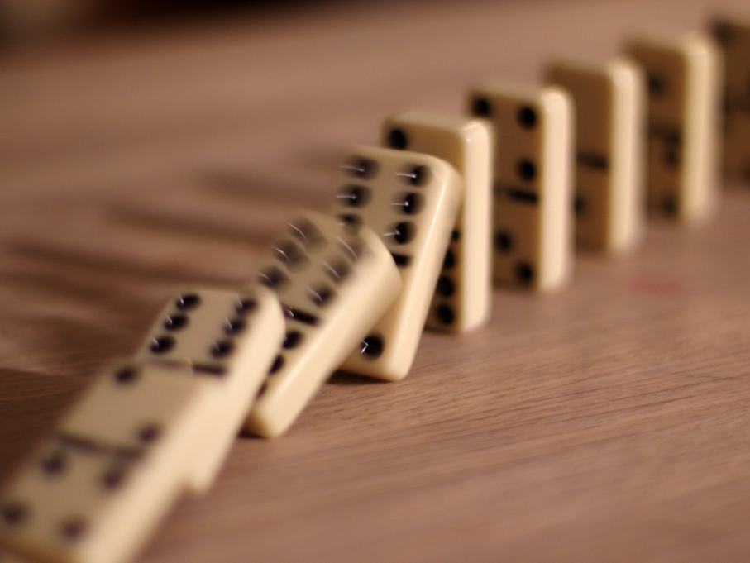

M25 Conference May 2017
Chain reaction:
How inspiration for us became inspiration for others
https://c1.staticflickr.com/6/5705/21496317363_a2a99d7fcf_b.jpg
Notes:
VH
I’m Vanessa Hill, one of the Service Development Liaison Librarians in Library and Student Support (LSS) at Middlesex University and I support staff and students in the School of S&T specifically computing, product design and engineering, maths and stats.
This is Adam Edwards my line manager who is the Liaison Manager for the Schools of S&T and Law.

Slide 2
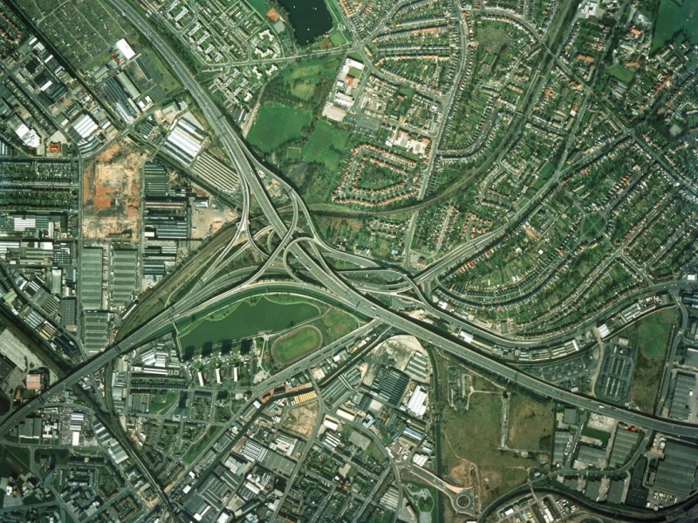
https://commons.wikimedia.org/wiki/File:Spaghetti-Junction-Crop.jpg
http://quest.eb.com.ezproxy.mdx.ac.uk/search/spaghetti-junction/1/132_1303499/Motorway-junction
Notes:
VH
We would like to share our story with you of being inspired by others and how as a result we have in turn inspired others.
Ours is a story of several things coming together at the right time….just like the wonderful Spaghetti Junction in my home city…….and how this lead us down a road that we could not have imagined……a bit like actually driving on the Spaghetti junction!
So we started to work together in 2011.
This was a pivotal moment in both our careers when its true to say that everything changed.
To cut a long story short back in 2008 I found myself teaching in a new subject area (computing) which I knew nothing about, consequently preparing demonstrations for library workshops took too long and I was unhappy teaching students in a traditional didactic way.
I had already started to make a few changes finding myself between managers.
Adam having joined Middlesex around the same time found himself suddenly having to teach again after many years with only the L&T skills he had used 20 years previously. His more recent experience at his previous place of work made him realise that library workshops were not fun for anyone or effective.
At our first 121 we discussed a number of issues and problems…….Adam says he can’t remember this conversation, but I ranted for a solid hour.
Despite his memory loss, things started to change.

Slide 3

Inspiration
Teaching and learning
Back to basics
Games
Solutions
http://maxpixel.freegreatpicture.com/Sunrise-Blue-Horizon-Sky-Sunlight-Clouds-Dawn-165094
Notes:
VH
What inspired the changes that we made to our pedagogy were 2 workshops that we attended.
Just prior to working with Adam I attended a day long workshop run by the great Sharon Markless at CILIP on ‘Teaching information literacy in HE workshop’.
I had been Marklessed before, but part of being inspired is having a need.…….I had a need and the time was right for change.
I brought back a number of key L&T principles which resonated with my own ideas e.g.
Don’t try and cover to much: make the best use of the time
Discussion is powerful: let students discover for themselves, we don’t need to demonstrate or dictate
Don’t try and clone expertise etc: students unlikely to search for information like librarians
So we went back to basics and considered what things we really needed to teach and identified 4 key information literacy fundamentals.
The vehicle to enable these changes came after Adam attended the Librarians Information Literacy Annual Conference (LILAC) in early 2011. Adam attended a workshop by Susan Boyle from University College Dublin on the use of games in library workshops.
He came back full of ideas and so we set to work.
We started to develop games and activities for each of the 4 elements in our workshops.
Initially we concentrated on first year Under Graduate workshops, but have since developed a whole programme of training for all levels from Foundation up to Post Grad.
***************Examples on next slide********************

Slide 4
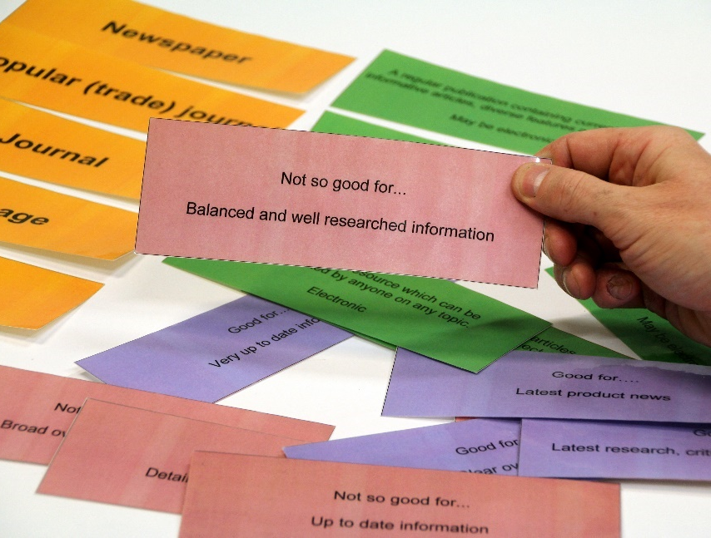
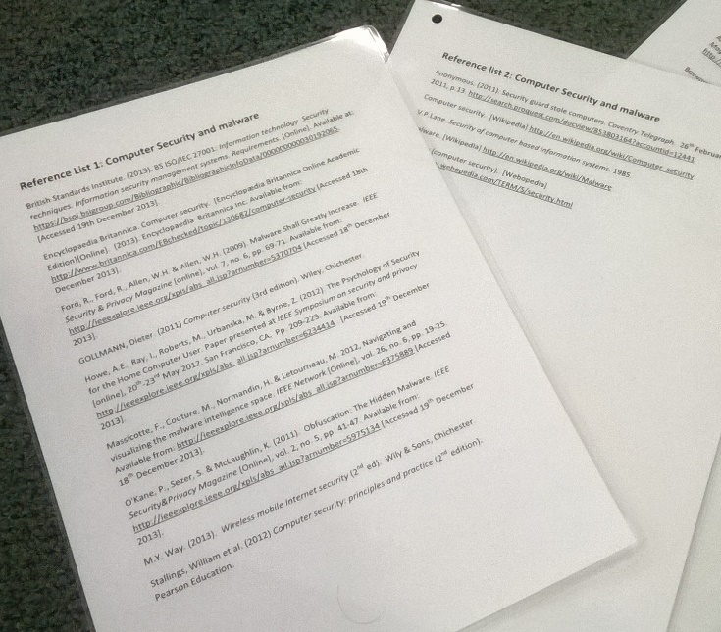
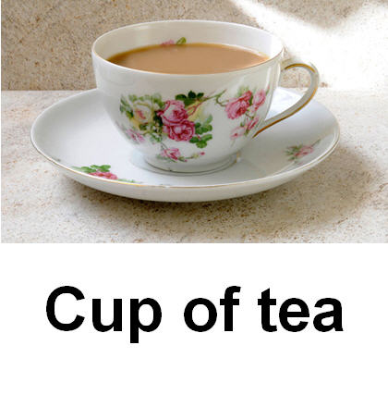
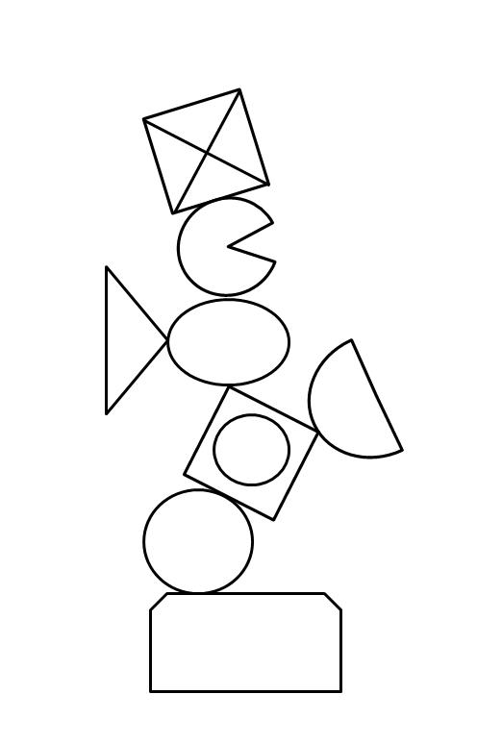
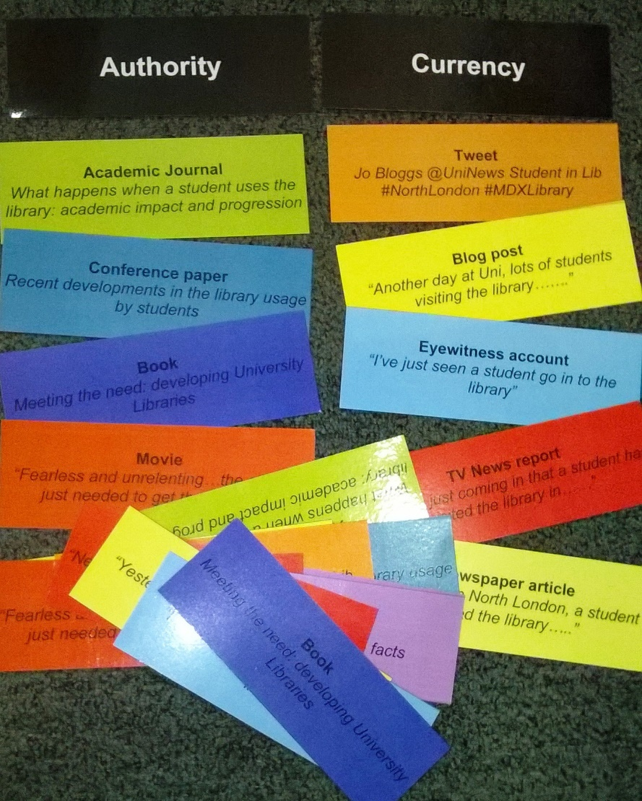
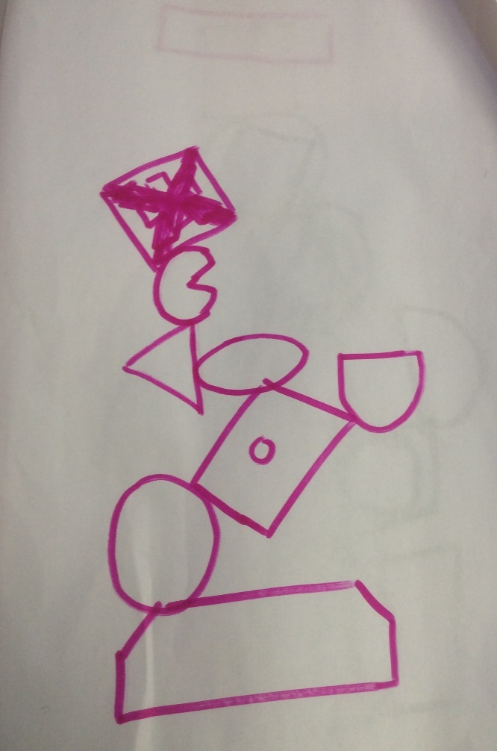
https://contentbuilder.merlot.org/toolkit/users/Adam17/edwardshill
Notes:
VH
Here are a few examples of what we developed.
There isn’t time to explain them now, but more information is available online for anyone interested. Details at the link on the screen.
Many of them are card games, but not all.
But they are all cheap and easy to produce and simple to play.
The important thing about them is that they enable discussion, collaboration, peer learning, reflection and feedback.

Slide 5
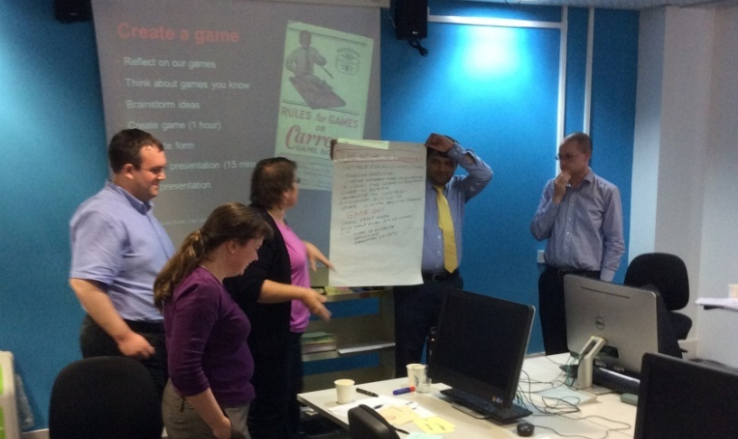
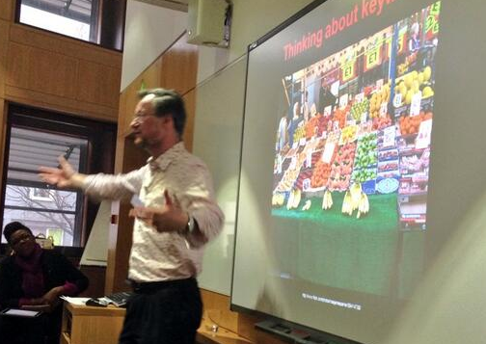
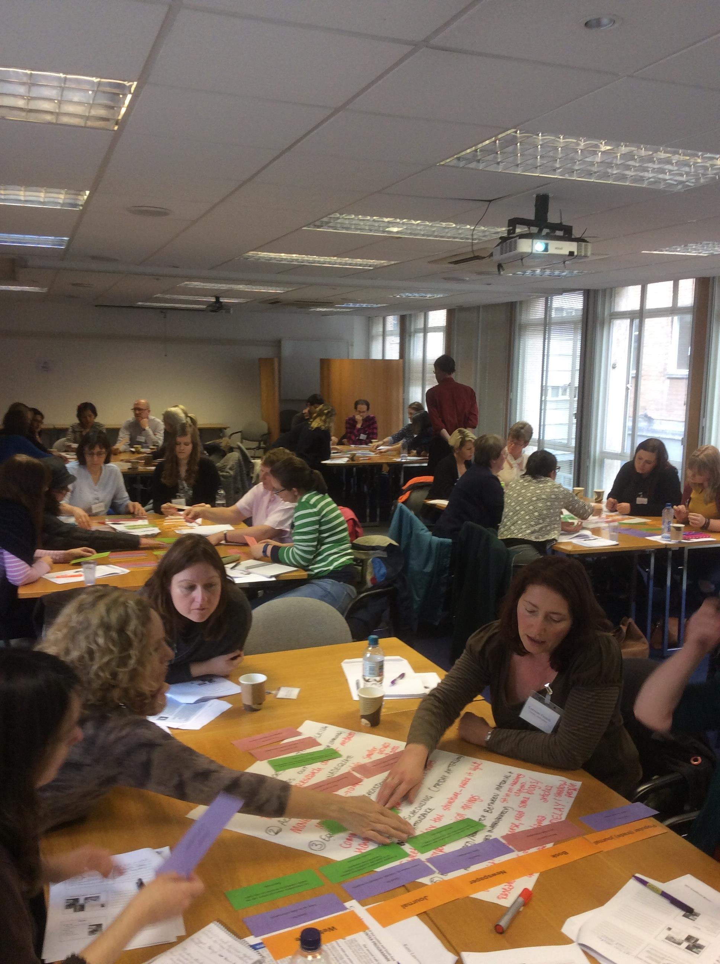
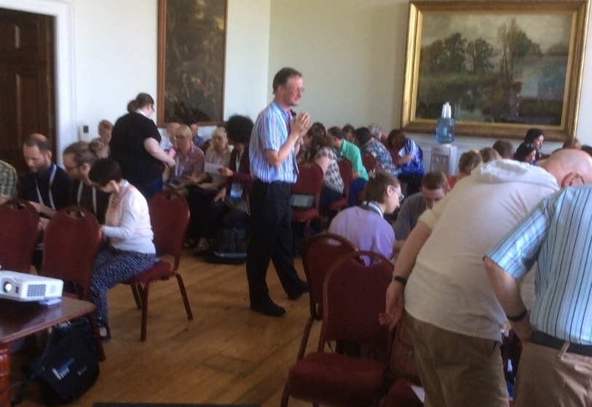
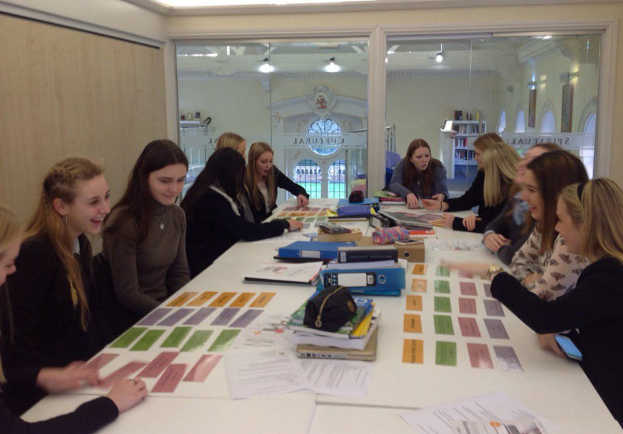
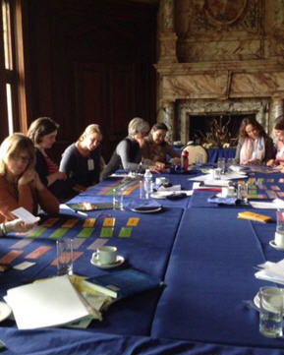
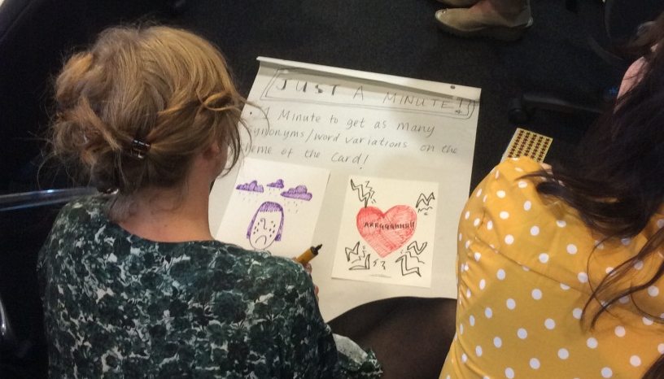
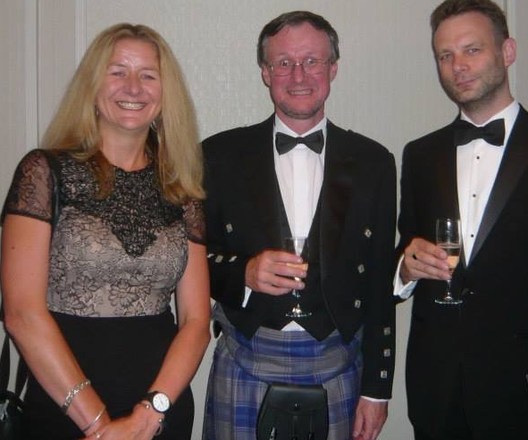
NHS workshop Sept 2014
British Library Jan 2014
CILIP SLG Nov 2015
Wellington School 2016
CILIP conference 2015
NHS workshop Sept 2014
THELMAs June 2014
LISSEE Mar 2016
Notes:
AE
The use of games and our changed pedagogy seemed to work. We got good feedback from lecturers and students formally and informally.
Students’ marks even seemed to improve.
So we started to share our ideas and wrote up the early success of our games and activities in an article in the journal Sconul Focus.
The first time we shared our changed pedagogical practice to a live audience was at a Middlesex University Learning and Teaching conference in 2012.
The next time was at LILAC 2013……the conference that had so inspired me two years before.
One thing lead to another and we have subsequently presented and ran workshops for:
CPD25
ARLIS
University Science and Technology Librarians Group
HEA STEM conference
The librarians at Queen Mary University London
British Library
Proquest
Summon
CILIP Conference and the CILIP School Library’s Group
IFLA
NHS
And various groups of school librarians.
We have also published a number of papers and were shortlisted for a THELMA in 2014.
Following requests for more information about our games we made the templates for our games, instructions for their use and lesson plans available on JORUM and following JORUM’s demise, MERLOT. In a three year period these were downloaded nearly 12,000 times and according to JORUM stats we have a few fans in Puerto Rico.
We have also had a number of visits and teaching observations from librarians from the University of Bath, Bucks New University and Regents University London.
To date our games are being used widely in UK institutions including LSE, Surrey, Cardiff Met, Regents University London, Huddersfield and in Sweden as well as in school and NHS libraries.
The NHS are now offering their own workshop based on what they learnt from us.
Much to our amazement people were listening to us and we realised that we were inspiring others to do what we had done a few years earlier i.e: rethinking our professional and pedagogical practice.
Ultimately we had done what we set out to achieve i.e. changing our own pedagogical practice to make teaching more fun and effective.
What we hadn’t bargained on was embarking on a Doctorate in Professional Studies by Public Works through the Institute of Work-based Learning at Middlesex University……a qualification more commonly known as a DProf.

Slide 6
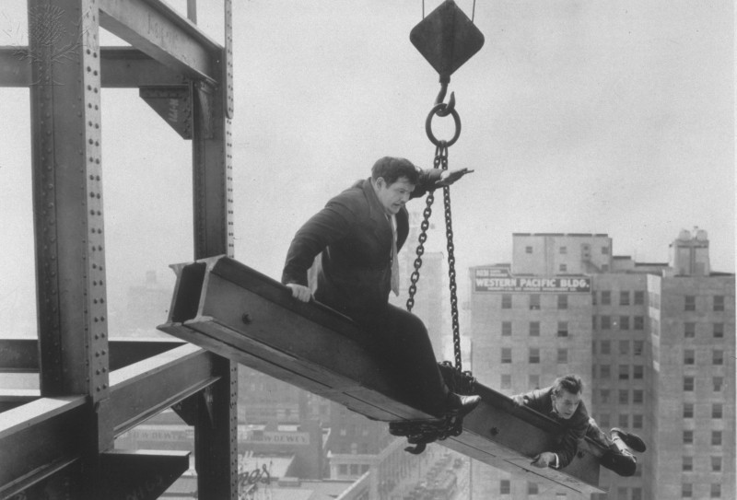
http://www.mdx.ac.uk/courses/postgraduate-research-degrees/iwbl-dprof-public-works
http://quest.eb.com.ezproxy.mdx.ac.uk/search/laurel-and-hardy/1/115_882375/Laurel-And-Hardy
Notes:
AE
So how did this happen…….after all we were just librarians getting on with our job, teaching, buying books etc, but as Kate Maguire the Head of DProfs was to tell us later:
Rocket scientists forget that rocket science isn’t rocket science to rocket scientists.
Well its all my fault. Caffeine has a lot to answer for.
To cut another long story short I had a cup of coffee with Kate Maguire in late 2013.
Having discussed all the things that we have been doing Kate suggested that this all sounded like the perfect basis for a DProf by Public Works….the public work being our enhanced pedagogy for improved information literacy and all the outreach we had done.
There isn’t time today to tell you more about the DProf or the process but in the words of the Institute for Work-based learning
“The DProf by Public Works acknowledges at Doctoral level the contribution made to knowledge and practice by innovators who have brought influential thinking and practice into the public domain”.
Fast forward 2 months and we are both signed up ……. unbeknown to us it was possible to do a joint DProf and although this is fairly unusual, a joint DProf by Public Works was a university first. No pressure then.
And so we embarked on a rollercoaster ride of inspirational mentoring by Kate who took us intellectually to places we had never imagined which culminated in us graduating as Doctors last July. There was an awful lot of research and reading in between.
Anyone interested in a DProf can get more information from the link on the screen.

Slide 7

http://quest.eb.com/search/light-bulb/1/132_1447093/Light-bulb
Notes:
AE
55,000 words or so later we hope that what we wrote can further influence and inspire our profession.
Downloads of the DProf from our University’s repository suggest that people are interested in what we have written.
We recently attended LILAC 2017 at Swansea University where we were presenting a paper on our practitioner research in the hope of inspiring others to undertake such research.
What we had to say was well received, but more gratifying to us was that a number of the delegates spoke to us about how we had inspired them to change their professional practice, rethink their library workshops, had validated their own thoughts on information literacy and so on.
In the same way that we had experienced light bulb moments of clarity, so now were others.

Slide 8
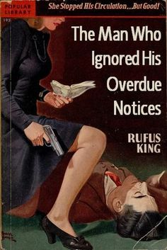
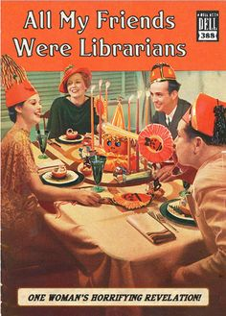
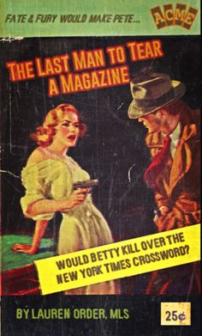
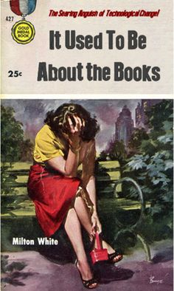
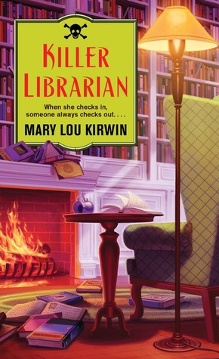
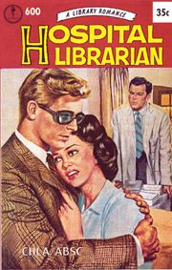
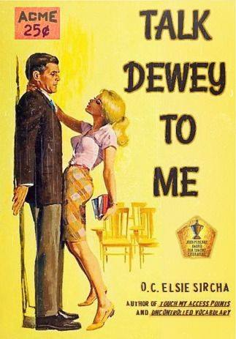
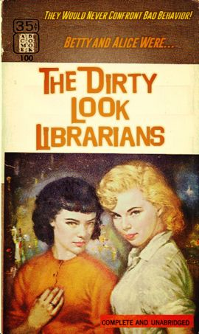
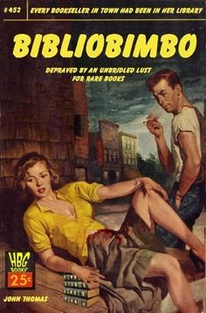

Notes:
VH
As our DProf progressed, we realised that the librarian of the futures needs to move from being seen in a traditional role (as illustrated!) on the margins of research processes and academia.
Instead we need to move to collaboratively working across different domains in a transdisciplinary way- as skilled navigators and translators, filling gaps in knowledge, experience and practice in collaborative “researchship”.
So how can we transform our own profession?
Librarians need to think bigger about their role for example as Emma Coonan puts it “Rather than merely demonstrating resources, we need to be able to articulate how the use of those resources might support the academic journey as an on-going process of making sense, constructing meaning, creating conceptual relationships and even negotiating one’s own identity within a community of practice” (Coonan 2014)
We have gone some way down this route but could do more. At Middlesex University new academic staff and librarians are expected to undertake a PG Cert HE providing the opportunity for them to explore pedagogical issues together. This enable librarians to understand the context and language used in H.E. and develop effective relationships as learning partners.
Crucially, IL is not understood by academic staff. We need to break out from information literacy being something librarians talk about to each other at conferences and get this into the wider world of HE practice. As an example, Adam recently searched three key HE journals including Studies in Higher Education for articles on IL. There were only three!
We need to find ways to describe what we do in a way that academic staff will find meaningful. Perhaps we should talk in terms of Academic literacy rather than information literacy?
This is essential as we need to convince our universities to take IL seriously as a fundamental part of employability and academic literacy. Maynooth, Chester and Anglia Ruskin are already starting to do this by adapting ANCIL : A new curriculum for Information Literacy which was created by Emma Coonan and Jane Secker.
In our own institution things have started to change:
We have had an influx of new librarians from different backgrounds such as F.E. and schools.
There is a developing culture of experimentation. For example Lego is now regularly used in library workshops.
Librarians continually inspire each other and are more willing to give things a go.
This is very different to how things were at the beginning of our journey.
Adam recently wrote an article for Sconul Focus which describes what our team of librarians are doing if any of you would like to know more. Reference at the end of the presentation.

Slide 9
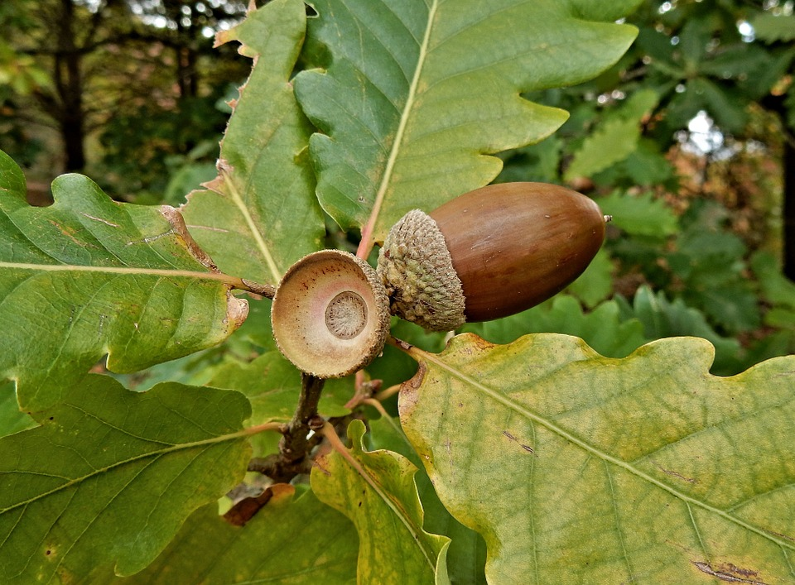
https://pixabay.com/p-746453/?no_redirect
Notes:
AE
Our journey since 2011 has been an iterative process………our professional practice has developed in ways we could not have imagined.
As a result CPD that we undertook back in 2010/11, we have both developed professionally.
We were inspired by others especially Markless and Boyle, but we continue to be inspired by our colleagues and learn from the training that we run and training that we continue to receive.
For the library managers out there, we hope that we have demonstrated the value of CPD.
However, inspiration is only a starting point. We also need the right conditions to act on that inspiration. Having a need is one way to get the ball rolling, but supportive management and the willingness to take a risk are also crucial factors.
We ended up doing a DProf…….we certainly didn’t anticipate this. As a result, our new status has inspired some of our academic colleagues to think of us in a different light and this has lead to some new collaboration including a journal article and involvement in the PG Cert HE.
Professionally we are equipped with new insights, ideas, language and knowledge- all of which can help and feed further innovation.
We hope the image on the screen speak for itself.

Slide 10

Dr Adam Edwards a.edwards@mdx.ac.uk
Dr Vanessa Hill v.hill@mdx.ac.uk
Notes:
AE

Slide 11
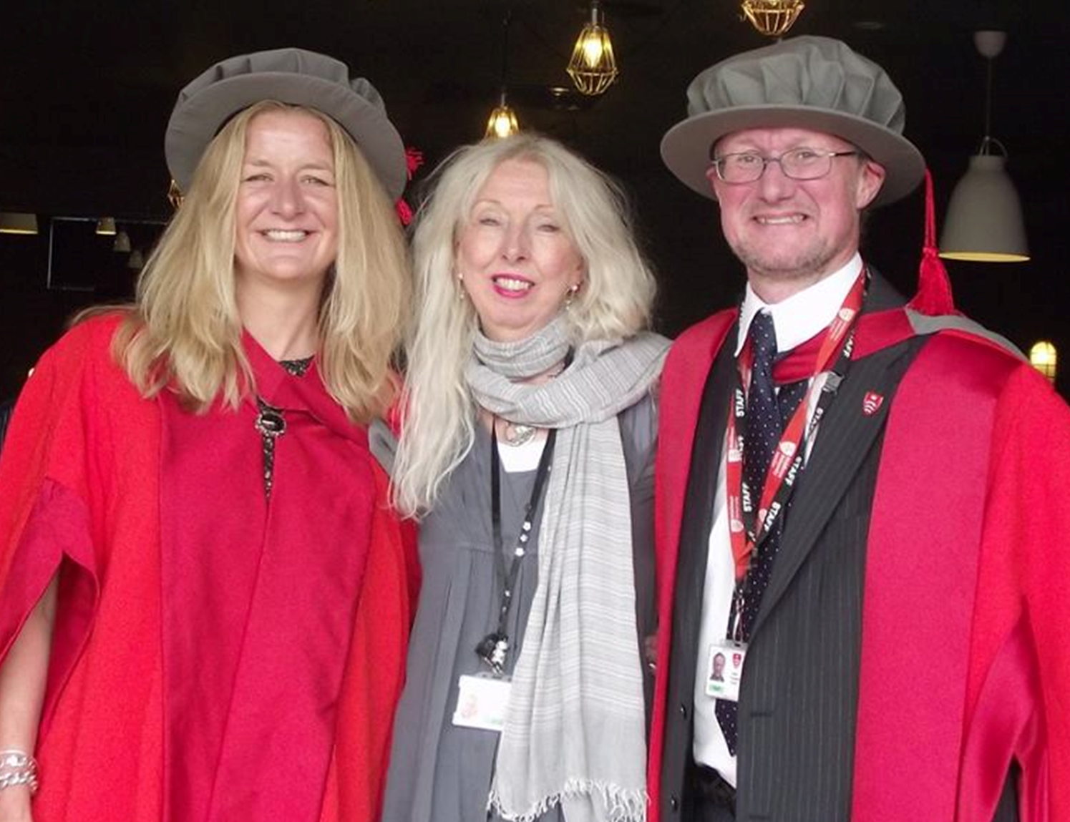
http://www.mdx.ac.uk/courses/postgraduate-research-degrees/iwbl-dprof-public-works
Notes:
And just to prove we actually did it….

Slide 12

Notes:
AE

Slide 13
References
Coonan, E. (2014). The 'F' word: information literacy, 'find', and other verbs. Academia.edu. Available at https://www.academia.edu/9261623/The_F_word_information_literacy_find_and_other_verbs
Edwards, J. A. (2017) ‘Evolving pedagogical practice at Middlesex University: the state of our art’. SCONUL Focus (68). pp. 47-57. Available at http://eprints.mdx.ac.uk/21072/
Edwards, J. A. and Hill, V. (2012) ‘Does it really improve their marks? : a brief foray into measuring the impact of information literacy training at Middlesex University’. SCONUL Focus (56). pp. 27-28. Available at http://eprints.mdx.ac.uk/10230/
Edwards, J. A. and Hill, V. (2016). Demythologising librarianship: future librarians in a changing literacy landscape. DProf. Middlesex University. Available at http://eprints.mdx.ac.uk/18944/
Rahanu,H., Georgiadou, E., Khan, N., Colson, R., Hill, V. and Edwards, A. (2016). ‘The development of student learning and information literacy: a case study.’ Education for Information, 32(3). pp.1-14. Available at http://eprints.mdx.ac.uk/19416/
Notes:
AE

