Slide 1
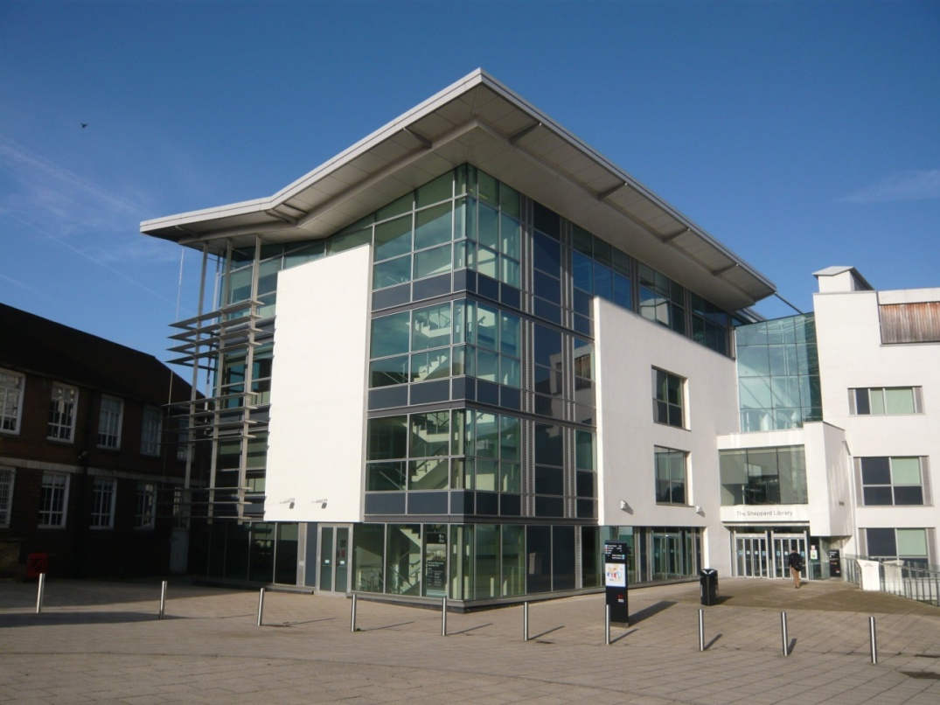
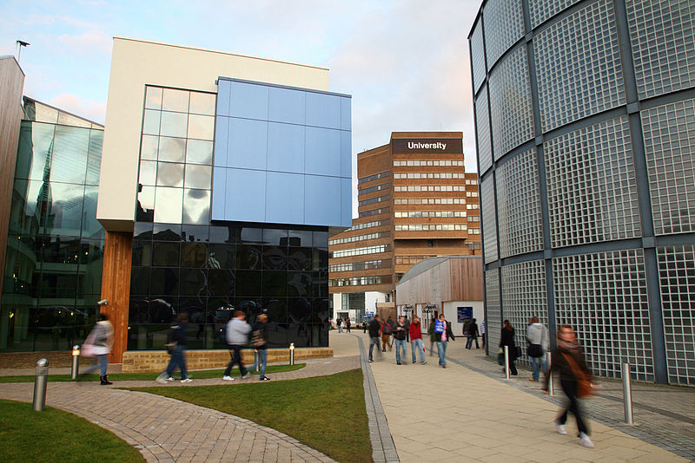
Games and gamification for information literacy
Adam Edwards @WBLLibrarian
Andrew Walsh @andywalsh999
Vanessa Hill @SATLbrarian
LILAC 2013
Adam Edwards and Vanessa Hill
Notes:
14:00
AE:
Who we are

Slide 2
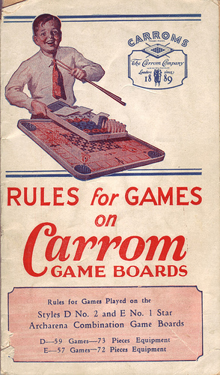
Game plan
Issues
Inspiration
Solutions
Play time
Sharing
http://www.flickr.com/photos/ajourneyroundmyskull/4788590225/
Notes:
AE
How we have been inspired to change the way we teach and address the problems
What we have done
And having a go at some of our games

Slide 3
Get the ball rolling
Move from
  “ …lifting and transporting textual substance from one location, the library, to another, their teacher’s briefcases.”
To
  “..searching, analyzing, evaluating, synthesizing, selecting, rejecting…”
Kleine (1987)
Notes:
AE
From PG Cert. Summarises how we have to change what we do.
Moving from didactic behaviour driven teaching to learning by doing, as we shall see.

Slide 4

Inspiration
Active Learning
Making libraries fun
Gamification work
Doing things simply
http://advedupsyfall09.wikispaces.com/Sara+Woodard
Notes:
1405
AW
Similar constructivist approach for me – strongly believe in “learning by doing”, an Active Learning approach.
Regularly used play / bits of games in teaching... Started to think I should start to consider “proper” games.
Doing Lemontree helped build confidence in trying this.
Seen other very worthy games & was inspired to do things a lot more simply!

Slide 5
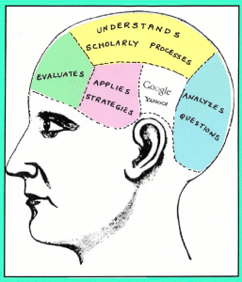
Inspiration
Less is more
Cloning
Discussion
Learning by doing
Learners, not the taught
Games
Deep learning
http://advedupsyfall09.wikispaces.com/Sara+Woodard
Chen and Lin (2011), Markless (2010)
Notes:
1410
VH
VH had concerns about the way we present our sessions.
Inspired by ‘Teaching information literacy in HE workshop’. Attended at CILIP.
Best staff development event ever!
We teach 3-5 times too much
When planning sessions we need to consider what will make the biggest difference given time limit
We try to clone our expertise
We can’t distil our own experience into a one hour session.
We don’t need to show students how to search databases, but we do need to show them how to appreciate the value of academic resources, search effectively, evaluate the information found and how to use it ethically
Discussion is powerful:
Find out how the students already find info, what they already know, what they want
Learn/discover together: don’t plan searches/demos in advance
Peer learning
We can learn a lot about student’s understanding from the questions they ask
Learning by doing is empowering:
No demos
Encourage active participation through a variety of activities eg. trying things out, getting feedback, solving problems, peer discussion, reflecting on mistakes etc
Uninvolved students are less likely to learn
Interaction and exploration
Students should be learners, not the taught:
Our role to support and facilitate
Disciplinary context is a key influence on student learning ie. one method does not fit all….devised different sessions for PDE students
Problem based
Games
Inspiration from LILAC 2011

Slide 6
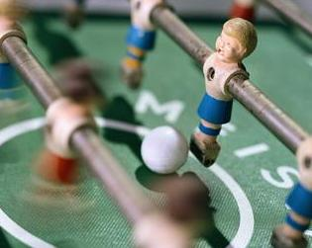
Games should be...
Fun
Quick
Simple
Easy
Need or objective
Adapted from Susan Boyle, Lilac 2011
Boyle at LILAC 2011
Notes:
VH
Inspiration from LILAC 2011
Development of games with KH and VH
Games rolled-out
Taking it further
Games should be:
Fun
Quick
Simple
Easy to grasp and play
Meet a specific need or objective

Slide 7





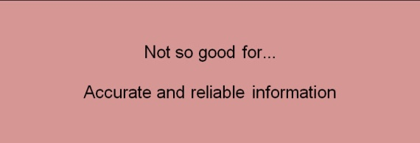
Example workshop
Thinking about resources
Keywords
Searching
Evaluation
Notes:
Thinking about resources game
Keywords: using image to get students thinking about keywords (specific, alternative, related) and then using real example
The real thing: relate learning to a project
Searching (Different things for different years)
1st years = Summon
3rd years = Summon plus other databases
PG = Summon, databases, plus citation searching
Evaluation using sample search results (website, newspaper article, trade journal, academic journal)

Slide 8
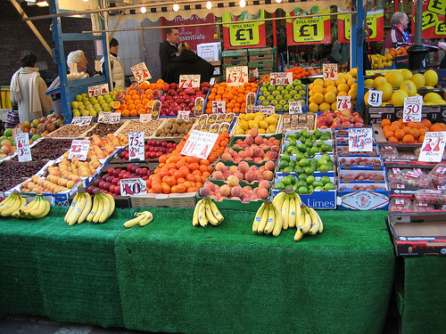
Thinking about keywords
http://www.flickr.com/photos/rossjamesparker/89414788/
Notes:
VH 14:15
What do you see in the picture etc
Handouts available.

Slide 9

The real thing
Your first piece of coursework for CCM2426 will be based on the Cornish Villages 4G trial
Keywords
Alternative keywords
More specific keywords
Related subjects
http://www.flickr.com/photos/sidelong/300188454/
Notes:
VH
Explain how we move on from Market Stall picture and run the same exercise but using current project.
What are the keywords? Cornish, villages, 4G, trial
What are the alternative keywords?
Cornish: Cornwall, West Country, West of England
Villages: Village, rural communities, countryside
4G: Fourth generation technology, cellular wireless standards, networking technology,
Trial: test, evaluation
What terms can you use to make your search more specific?
Internet access
Fixed and mobile subscribers
Frequency and bandwidth
Infrastructure
BT and Everything Everywhere
Routers, antennas, and dongles
Radio spectrum
IP based mobile broadband
Services eg. ultra-broadband internet access, IP telephony, gaming services, streamed multimedia
LTE (Long term evolution)
IMT (International mobile telecommunications) advanced compliance
What are the related subjects?
Rural internet access
UK digital agenda, Digital Britain
Digital inclusion
Telecommunications
3G and 2G
Laptop computer wireless modems, smart phones, mobile devices

Slide 10
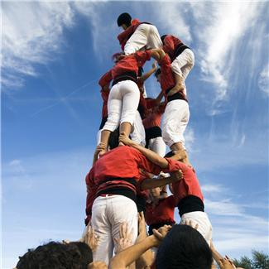
Play time
Shelf check
Thinking about resources
Variations
Notes:
1420
Shelf check VH - Understanding Dewey card game, with audience sorting card held by volunteers into the correct order. Includes loan periods , different editions and locations plus what to do if not on the shelf
Thinking about resources (card game) AE - card sorting game in teams to understand the basics of different types of resources.
Developed for same skills at different levels to avoid repetition or to address needs of specific groups
Third year direct entry based on “I need info” scenarios
Evaluation card game for 3rd years
Evaluation real items with template to complete
5 mins each game +Questions 14:20-14:35

Slide 11
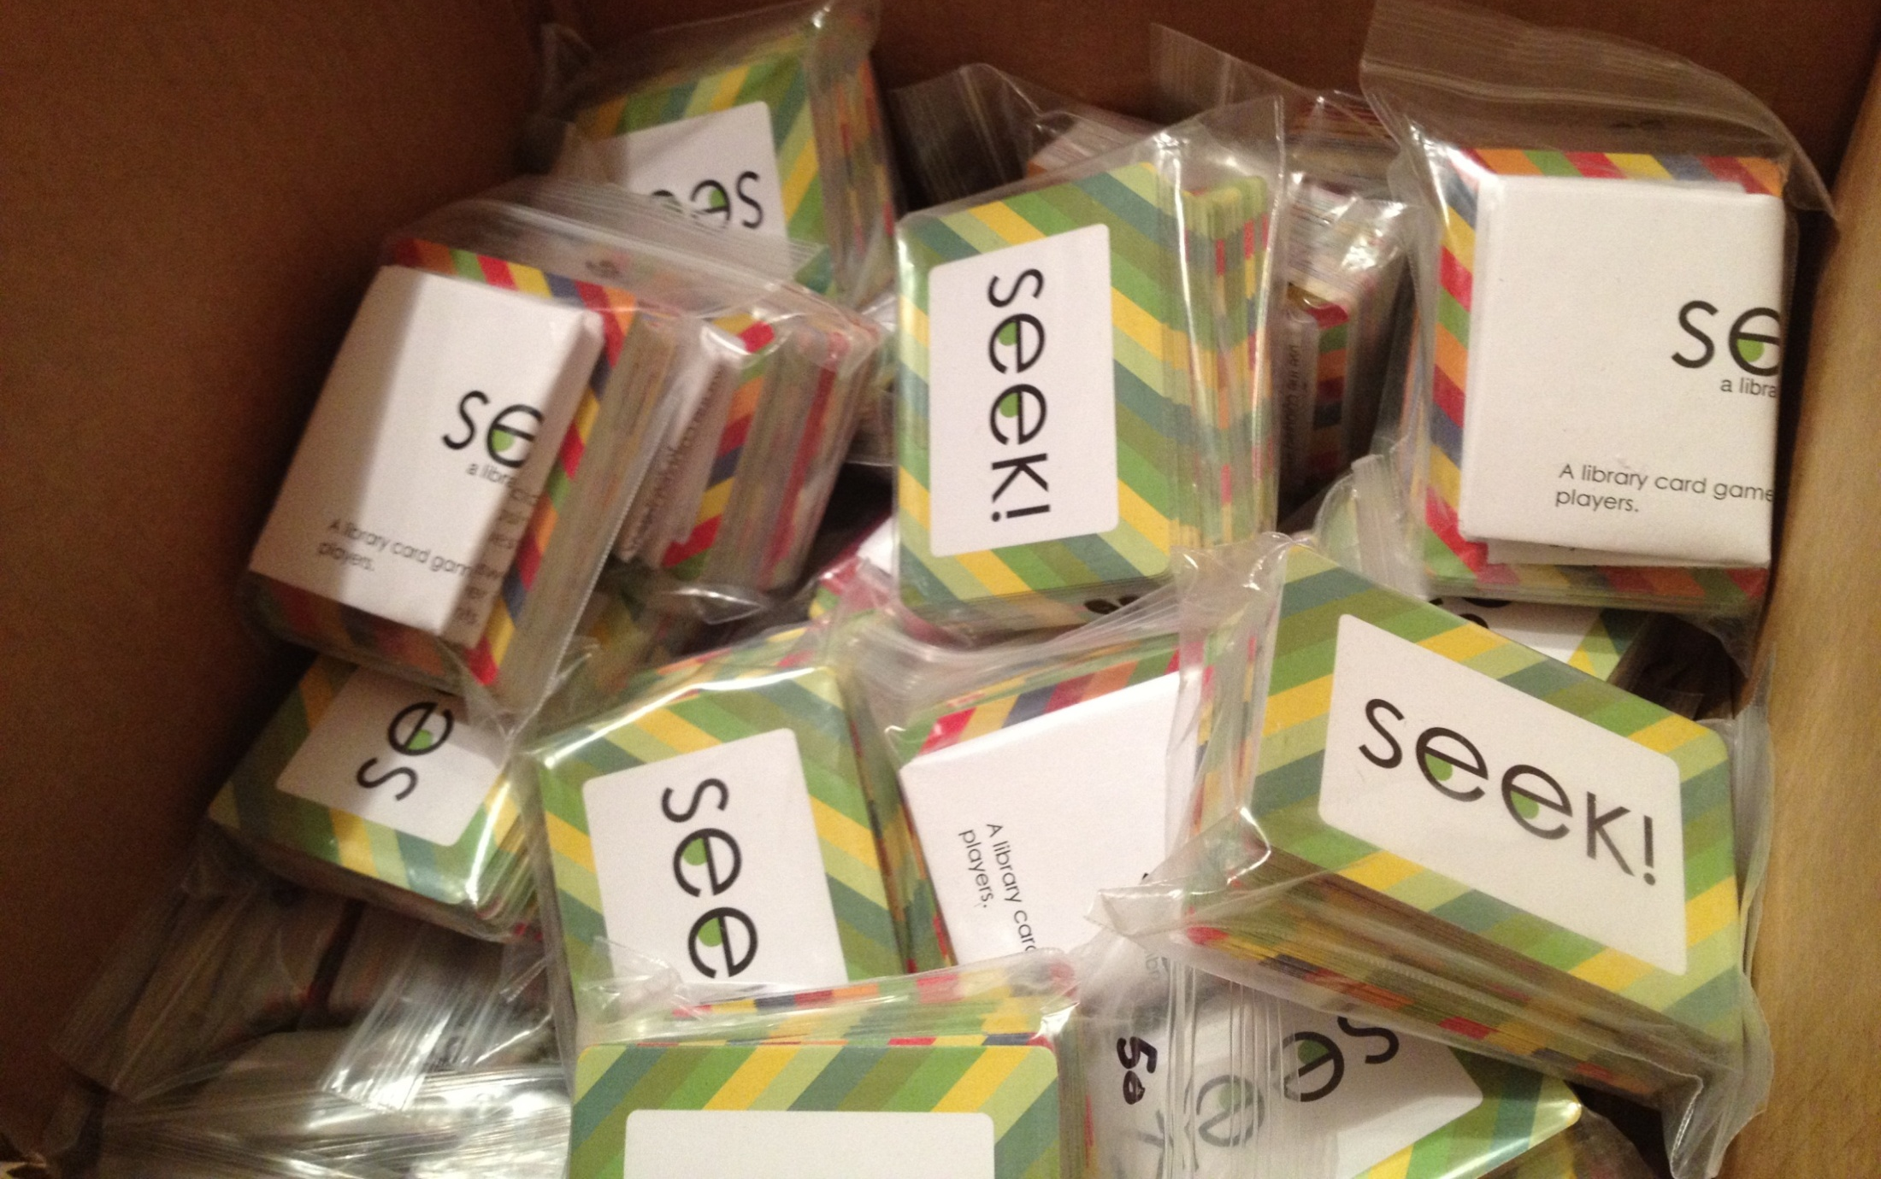
SEEK!
Notes:
14:35-14:50
AW
Quite like 5 or 10 minutes to talk about creating SEEK! and get people to play with it – stick this wherever you think most appropriate!

Slide 12
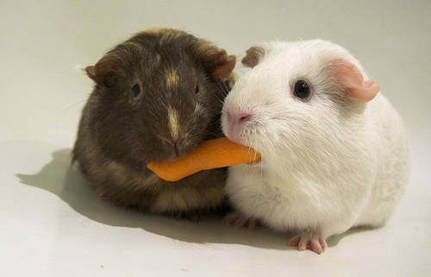
Sharing
http://www.flickr.com/photos/ryanr/142455033/
Notes:
1450
AW
Place holder to draw attention that we are moving on

Slide 13

Lemontree
Notes:
AW
Quick mention of Lemontree... And gamification as an idea.
Will fit in wherever you think appropriate!

Slide 14
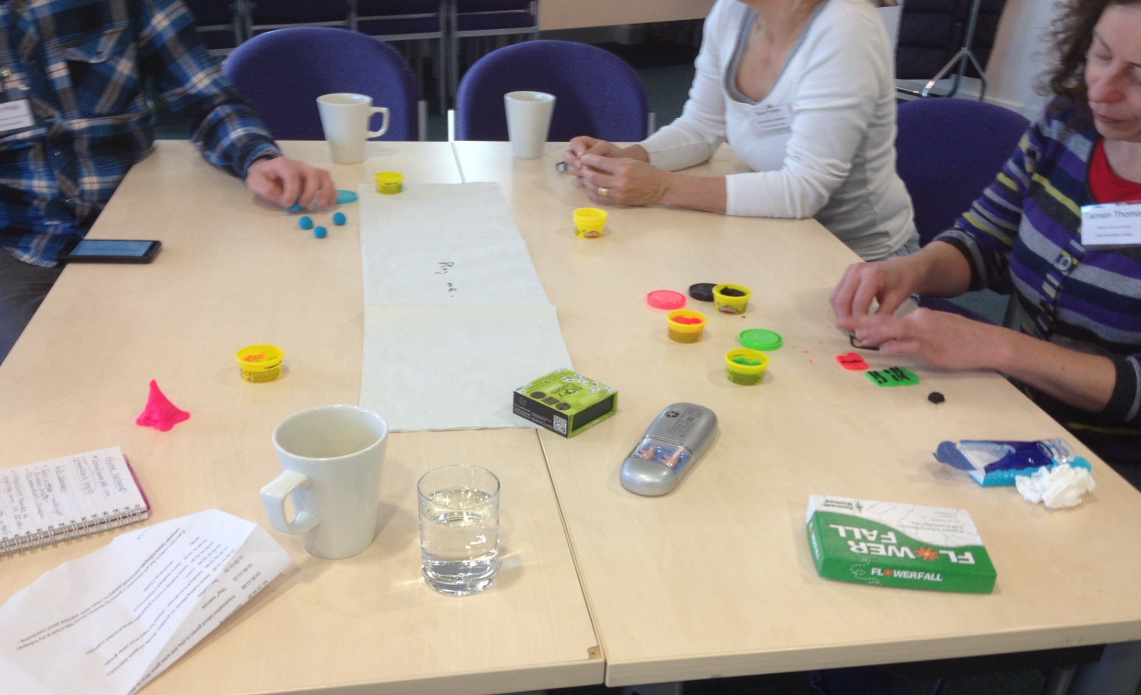
Making games for libraries
Notes:
AW –
Mention I’ve run some making games for libraries workshops – as much material as poss is up on the blog (link on last slide!).
Will only take a couple of minutes for this...

Slide 15

Sharing
Adam Edwards
Liaison Manager
Middlesex University
a.edwards@mdx.ac.uk
Andrew Walsh
Academic Librarian / Teaching Fellow
University of Huddersfield
a.p.walsh@hud.ac.uk
Vanessa Hill
Liaison Librarian / Teaching Fellow
Middlesex University
v.hill@mdx.ac.uk
Slides available at: http://eprints......
For Andrew’s games see: http://innovativelibraries.org.uk/games/
Games 4 Libraries workshops - http://gamesforlibraries.blogspot.co.uk/
Notes:
14:55 end
AW
We’d like to share with you and you to share with us. So please get in touch and use the links

Slide 16
References
Boyle, S. (2011) Using games to enhance information literacy sessions, Presented at LILAC 2011. http://www.slideshare.net/infolit_group/boyle-using-games-to-enchance-information-literacy
Chen, K. and Lin, P. (2011), Information in university library user education, Aslib Proceedings, 63 (4) 405.
Diekema, A.R., Holliday, W. and Leary, H (2011), Re-framing information literacy: Problem based learning as informed learning, Library and Information Science Research, 33, 261-268.
Kleine, M. (1987), What is it we do when we write articles like this one-Or how can we get students to join us?, Writing Instructor 6, 151.
Lemontree at: http://library.hud.ac.uk/lemontree
Markless, S., (2010), Teaching information literacy in HE: What? Where? How?, presented at King’s College London, 9/12/10. [Notes taken at the event.]
Wang, L. (2007), Sociocultural learning theories and information literacy teaching activities in Higher Education, Reference and User Services Quarterly, 47 (2), 150.

