Slide 1
Community-teater, aktivism & AIDS
Ola Johansson
Centre for Resaerch Into Creation in the Performing Arts
MIDDLESEX UNIVERSITY

Slide 2
Helen Nicholsons typologi
Educational theatre
Political theatre
Communal theatre
(H. Nicholson, Applied Drama: The Gift of Theatre, 2005)
Notes:
Drama in education in Hyderabad, India
Theatre for development in Bukoba, Tanzania
Political Theatre with Yes Men in Stockholm, Sweden

Slide 3
Notes:
FINDINGS:
CBT is a ‘best practice’ in HIV prevention
theatre is a contemporary ritual of affliction
CT is the most adaptable mode of HIV prevention
relational agency
UNSOLVED PROBLEMS:
theatre’s lack of political mandate
young people need political functions (coordination)
feminist awareness

Slide 4
“nyumba ndogo”

Slide 5
Petra Kuppers: community performance
”…to define, is an act that opposes many of the principles of community performance work itself…”
CP is community created
CP rests in process rather than product
CP is a form of political labour, ”facilitating creative expression as a means to newly analyze and understand life situations, and to empower people to value themselves and shape a more egalitarian and diverse future.” (p. 6)

Slide 6
Definition of Applied Theatre
Focus on multiple perspectives
Disregard for sequence as fundamental to effective structure
Endings that remain open for questioning
Less reliance on words; more exploration of movement and image
Greater reliance on polished improvisation
Theatre as a close, direct reflection of actual life with an overt political intent to raise awareness and to generate change
A collective approach to creating theatre pieces in which the makers themselves become aware and capable of change
Issues of local importance that may or may not be transferable to other communities
Audience as an important and active participant in the creation of understanding and, often, of the action
(Prendergast & Saxton 2009: 11)
Notes:
Umbrella term, unraveled by examples of practices rather than conceptual descriptions.

Slide 7
Post-performance discussion

Slide 8
Post-performance discussion

Slide 9
Akademiska dikotomier
Processual Performative
Affective Effective
Reasserting Undermining
Liberating Confrontational
Integral Accidental

Slide 10
Utvärderingskriterier
CFSC measurement tools must be community-based and participatory
The tools/methods must be SUM: Simple, Understandable and Measurable
The tools/methods must be developed with input from people from developing countries
M&E must be closely linked to development of the communication plans in each trial country
Assessment should look at impact on the short-term, intermediary and long-term
Ultimate users want a menu of tools – not just one set of methods with no other options
This M&E work must build upon work done to date. For example: JHU’s Integrated Model of CFSC, UNAIDS Framework for Communication, Behavior Surveillance Surveys.

Slide 11
Community-teater i Afrika
Travelling theatre movements (1960s)
Theatre for Development (1970s)
Community theatre as social process (1980s)
Community theatre as HIV prevention (1990s - )
Notes:
TTM – university groups with aim of reviving pre-colonial cultures and communities in rural Africa (Soyinka, Ngugi wa Thiongo, South Africa, etc.)
TFD – Laedza Batanani, ABU, Ngugi wa Thiongo (semi-participatory): developmental agendas like poverty, education, corruption
CT – Mlama, Zakes Mda
CT as HIV prevention – revealed a lot: gender issues, human, children’s and women’s rights, aligned programmes, linking local and global components
LINK to Practice as Research! The gradual shift from superimposed expert implementation to community owned action programs develops in a similar manner in HIV prevention and community theatre projects. It is a democratic paradigm shift, from doctrinal models and counsel to grassroots life skills. Or, put differently, a shift from an traditional generalized or even academic knowledge to a practical knowledge/knowledge in action. What was needed was to pay attention to (1) examples of risk situations rather than factual statements about risk factors according to ”well-formed formulas”; (2) judgments in action rather than the ability to reiterate received pieces of information; (3) reflexions rather than theoretization; (4) dialogues rather than one-way communicative messages; and (5) case studies/fieldwork rather than sociological analyses.

Slide 12
Tre steg mot frigörelse
Freires tre steg mot permanent frigörelse:
Dialog
Medvetenhet (Coscientization)
Praxis

Slide 13
dialog
- to treat teaching and learning as lived experience, in the form of dialogue (cf. pedagogy with the oppressed, not for; p. 48); dialogue in the form of ‘critical thinking’.

Slide 14
conscientization
- to become aware (conscientized) of the oppressive state. “Humankind emerge from their submersion and acquire the ability to intervene in reality as it is unveiled. Intervention in reality – historical awareness itself – thus represents a step forward from emergence, and results from the conscientization of the situation. Coscientization is the deepening of the attitude of awareness characteristic of all emergence.

Slide 15
praxis
- to transform a passive state through praxis, which implies a permanent process of liberating cultural action. “Only human beings are praxis – the praxis which, as the reflection and action which truly transform reality, is the source of knowledge and creation.”

Slide 16
James Thompson: Theatre Action Research
TITLE:
”Theatre action research: a democracy of the ground”
FOCUS:
Applied theatre, understood as a social-research method.
A move from the specifics of past practice to an advocacy of possible practice.
Assessment of existing interventions to advocate Theatre action research for future projects.

Slide 17
The pursuit of issues and problems (cf. Freire)
Pooling of knowledge is the starting point, not the definition of the problem. Everyday problems of the participants meet the research technique of the researcher.
Then problems can be defined.
Action and research are incorporated into the structure of a workshop, rehearsal or devised theatre project.
The pursuit of relevant issues and problems is an action research spiral. Reflections lead to further actions, again reflected upon. No clear ending.
If the participants are looking for solutions, they needs to go back and see how they have been sought in previous projects.

Slide 18
The functions of TAR
TAR is used to
discover its research questions
gather data
develop proposals for change

Slide 19
So what does TAR do?
This is not an intervention of theatre. TAR is done in order to specify what kind of intervention is needed. Then comes the evaluations of impact.
TAR may lead to theatre as intervention. It promotes a particular focus for programmes like applied theatre, Theatre for social change, etc.
The groups themselves have the power to critically examine their projects.

Slide 20
Finding the ground
Local and historical behaviour. How to use bodies. This is the first stage.
Where do we apply which performance styles and practices? Fragments of learnt behaviour. Exercises.
To understand a series of roles. Role play is not the exhibition of a fixed role but a creation of a pattern of action in a given situation from the raw ‘bits of behaviour’ intermeshed with the action of others.
We start with small actions and gradually elaborate more complex actions in the life of the community. Proposals for change occur in improvisations of raw behaviour.

Slide 21
Communal perspectives
How is my actions seen by an audience? By exploring your own actions you get access to others. [cf. Playback theatre] Lines of the general and specific must be found. Multiple differences. A walk in public vs. private. All sorts of behaviour and everyday rituals. Which are power-laden vs. affectionate?
Simple sequences will then turn into small rituals. How bits of behaviour binds the community together. Traditional practices can be debated in rigorous terms. TAR turns everyday behaviour into ritual.
Building a story, which will become a “full account” when the group has decided that the scene or scenes adequately demonstrates the problem. Still partial, but a full version of the story the group wants to construct.

Slide 22
Conclusion: the TAR process
TAR process is about asking questions continually with the group
action components of their lives
constructed forms of routines, rituals, etc.
how the latter make up the larger parts of their lives
specific and general strands of life in the stories

Slide 23
Typology of applied theatre
INTERVENTION EDUCATION PARTICIPATION COMMUNITY
Invisible theatre Image theatre Playback theatre Site-specific perf.
Newspaper theatre Theatre for health edu. Devising Forum theatre
Street theatre Museum theatre Prison theatre Theatre for develop.
Civil disobedience Reminiscence perf Drama therapy Thea action research
Agit Prop Verbatim theatre Process drama Carnevalesque perf

Slide 24
osynlig teater

Slide 25
osynlig teater

Slide 26
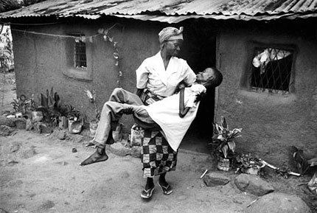

Slide 27
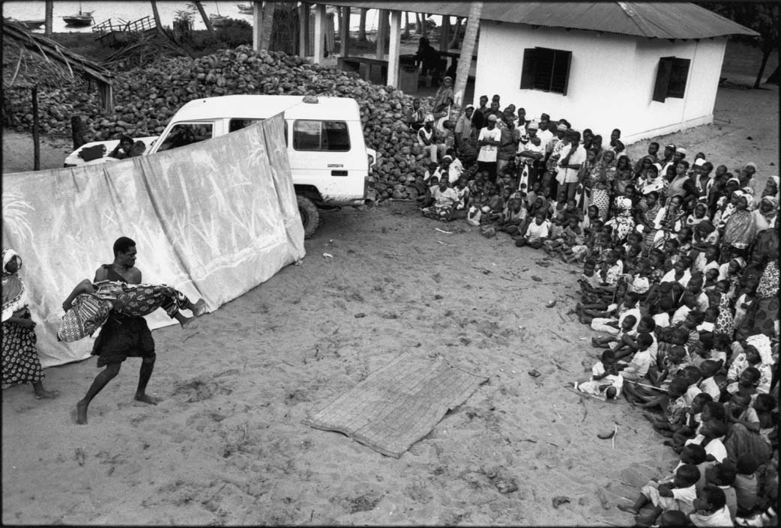

Slide 28
The development of HIV prevention
Psychological and social psychological theories conceptualized in models:
- Health Belief Model
- Social Learning Theory
- Theory of Reasoned Action
Notes:
These approaches posit that appropriate information, about risk behaviour and the risks involved in unprotected sex, to an individual will result in behaviour change. Such models and theories were developed in North America and Europe and have been criticised, even when applied in Northern industrialised societies, for neglecting the social contexts in which particular actions become meaningful (Singer and Weeks 1996) as well as for the assumptions they make about rationality (Aggleton 1996). Applying these models and theories to an African context poses even greater difficulties. For example, social norms, duties and obligations may be different in strength and kind to those encountered in Northern societies. Furthermore, these models may be inadequate in explaining sexual risk-taking in contexts where decision-making may be rooted in group processes of understandings and norms (Aggleton 1996).

Slide 29
Prevention models in education campaigns
Abstain, Be faithful, use Condoms (ABC)
Knowledge, Attitudes, Practices (KAP studies)
Information, Education, Commmunication (IEC)
Behavioural Change Communication (BCC models)
Notes:
SOFT PREVENTION PROGRAMMES (alongside medicine and contraceptives)
ABC – Uganda in the 1980s
KAP – favourite methodology is surveys
IEC – Pamphlets and other mainly written material (Johns Hopkins)
BCC – Turn towards culture-specific messages through various communicative means and practices in the 1990s
As soon as COMMUNICATION is involved, projects will turn around. Communicative disease, in a medical as well as social sense. Communication need to be culture-specific in Africa: not only knowledgeable language, but action driven, by traditional as well as contemporary means. THIS LEADS TO THEATRE

Slide 30
Classic conflict dialectics

Slide 31
Boal’s reversed dialectics

Slide 34
AIDS Quilt / The Name Project

Slide 35
AIDS Quilt / The Name Project

Slide 36
Community theatre as HIV prevention
Social mobilization
Info on HIV and AIDS
Community mapping and other forms of situation analysis
Training of dramatic skills lead by artistic facilitators
Writing rough scripts based on mapped/analyzed scenarios
Improvisation and rehearsals of the scenarios, involving traditional expressions as well as contemporary performance styles
Presentations of performances between groups and to the community
Post-performance discussions
Evaluations and follow-up programs coordinated with schools, hospitals, NGOs, women’s groups, PLWHA/orphan groups, faith-based organizations, elders, etc.

Slide 42
Research methodology

Slide 43
Gender laden AIDS stats
Cumulative AIDS cases by age and sex 1987-2004
Male 15-19: 1.6 % Female 15-19: 4.5 %
Male 20-24: 7.4 % Female 20-24: 16.5 %
Estimated thousands living with HIV/AIDS 2000-2006
Male 15-19 2000: 40 Male 15-19 2004: 40 Male 15-19 2006: 40
Female 15-19 2000: 100 Female 15-19 2004: 100 Female 15-19 2006: 110
Male 20-24 2000: 80 Male 20-24 2004: 80 Male 20-24 2006: 90
Female 20-24 2000: 210 Female 20-24 2004: 220 Female 20-24 2006: 230
Notes:
In TZ as a whole, about twice as many women as men reported syphilis 2004.
This divergence is slightly less dramatic in the general distribution of new genital discharge syndromes, but still many more women. The same goes for other STI cases.
There an even distribution in genital ulcer disease.
2004, 55.6 % AIDS cases were married. 23.2% were single.
47.4% of TZ AIDS cases are unknown.
It took a long time for researchers and development workers to acknowledge the prime social causes of the epidemic, but since about five years there has been little doubt that the AIDS epidemic in the most affected places in Africa thrives on a critical mix of poverty and gender inequality. In some parts of southern Africa young women are five times more likely to contract HIV than men. In Tanzania the gender inequity is slightly less striking but when I went to the Minsitry of Health in Dar es Salaam in Sep, I found the following data:
Cumulative AIDS cases by age and sex 1987-2004
Estimated thousands living with HIV/AIDS 2000-2006
2004, 55.6 % AIDS cases were married. 23.2% were single.
47.4% of TZ AIDS cases are unknown.
Statistics can drain a lot of meaning from studies by its quantitative mode of appraisal, but it can also give a lot of weight to nonfigurative phenomena such as preventable mortality, gender injustice, and experiential uncertainty. These statistics invalidate previous notions about AIDS as a medical problem among certain risk groups engaged in particular risk behaviors; the data rather indicate that AIDS is a generalized syndrome that reveal social issues, especially for female strata, that have been around for much longer than the epidemic itself and that have to be coped with by means of culturally inclusive and integrated prevention schemes. Statistically, it is more dangerous to be a housewife than a soldier on the continent.

Slide 44
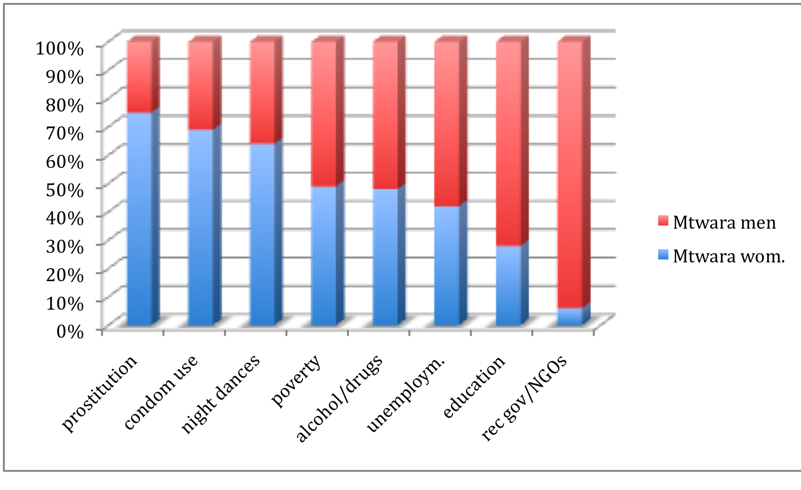
FGD TOPICS BY GENDER IN MTWARA
Notes:
Two cultures within households – and two economic levels: moderate and extreme poverty (colonial construct).
Flankerade av Henrik Ibsen och Bjørnstjerne Bjørnson styrde Anne Charlotte Leffler, Alfhild Agrell, Victoria
Benedictsson med flera rätt på samhällets varhärdar: den ojämlika äktenskapsinstitutionen ("Ett dockhem",
"Räddad") samt dubbelmoralen ("Ensam", "Dömd", "Final"). Tillsammans ringade man in den konflikt som enligt
Ibsen utmärkte nutidstragedin: "Det finns två slags andliga lagar - två slags samveten, en i mannen och en i
kvinnan. De förstår inte varandra, men kvinnan döms i det praktiska livet efter mannens lag."

