Slide 1
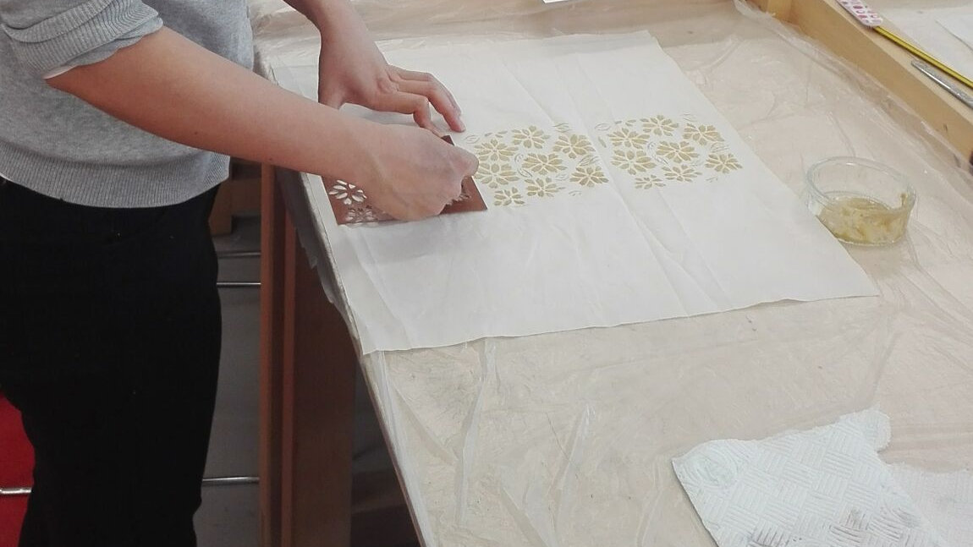
In conversation with
MoDA’s katagami:
a design dialogue initiated through making by hand
Dr Sarah Desmarais/
Museum of Domestic Design and Architecture

Slide 2
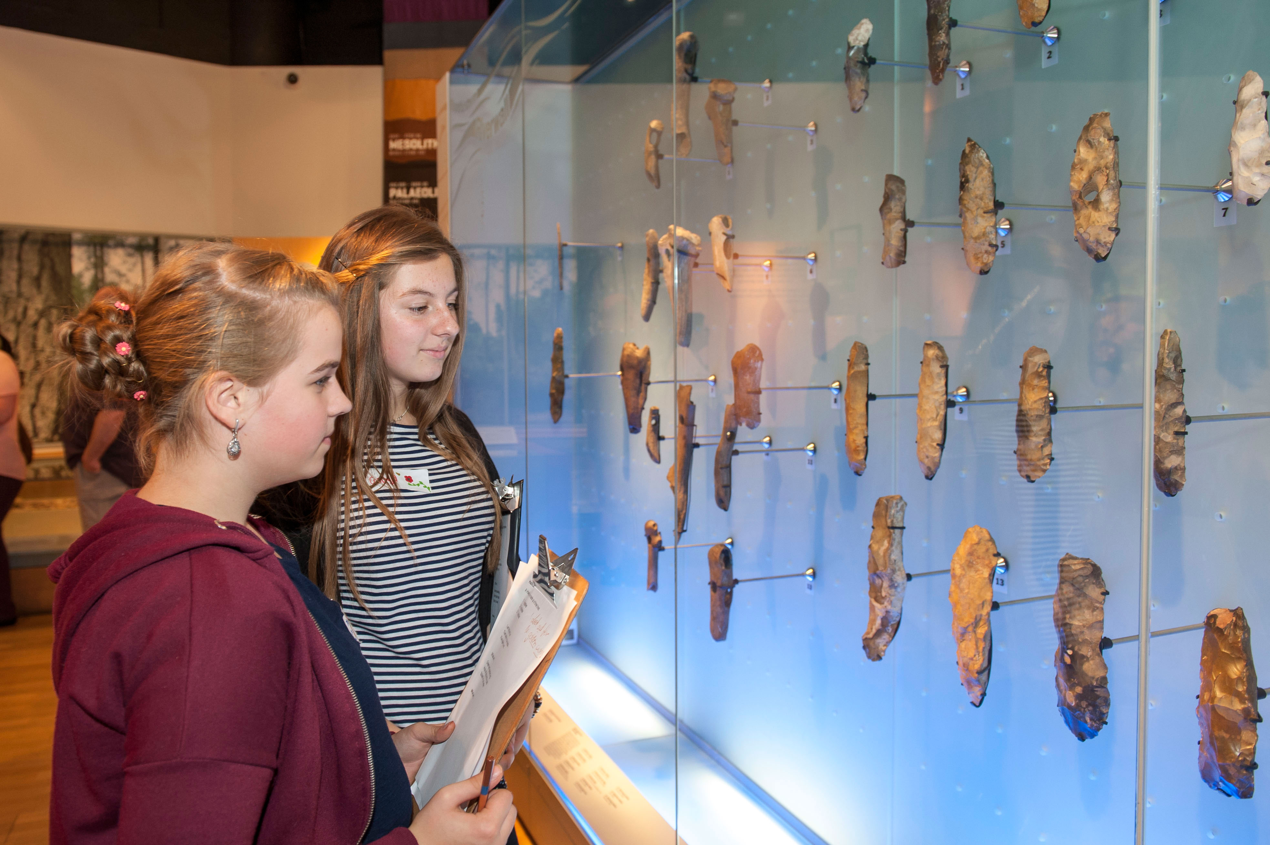
‘Students explore the London
Before London gallery,
which inspired their performances.’
Museum of London Blog

Slide 3
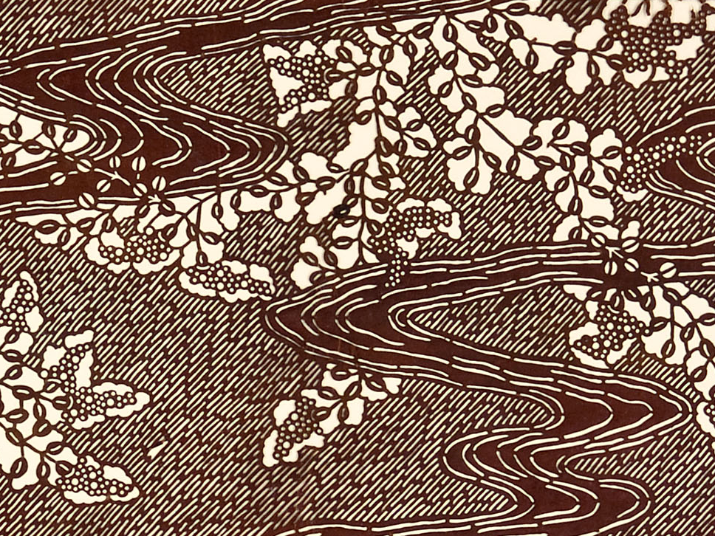

Slide 4
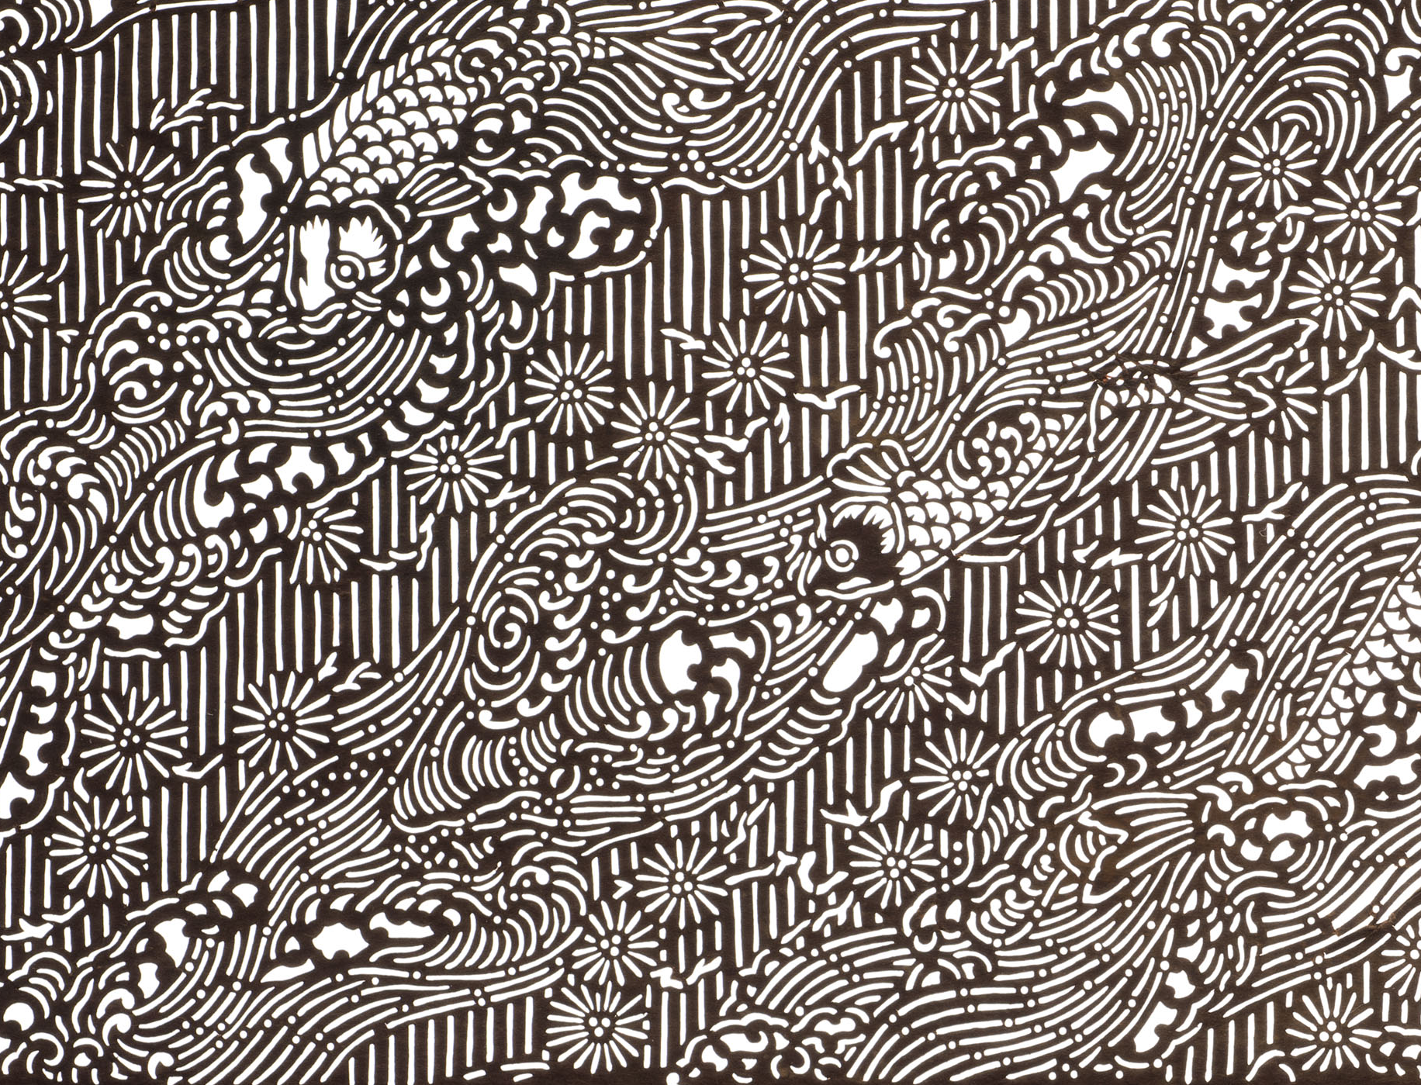

Slide 5
Autoethnography:
‘an approach to research and writing that seeks to describe and systematically analyze personal experience in order to understand cultural experience’ (Ellis, Adams and Bochner, 2010).

Slide 6
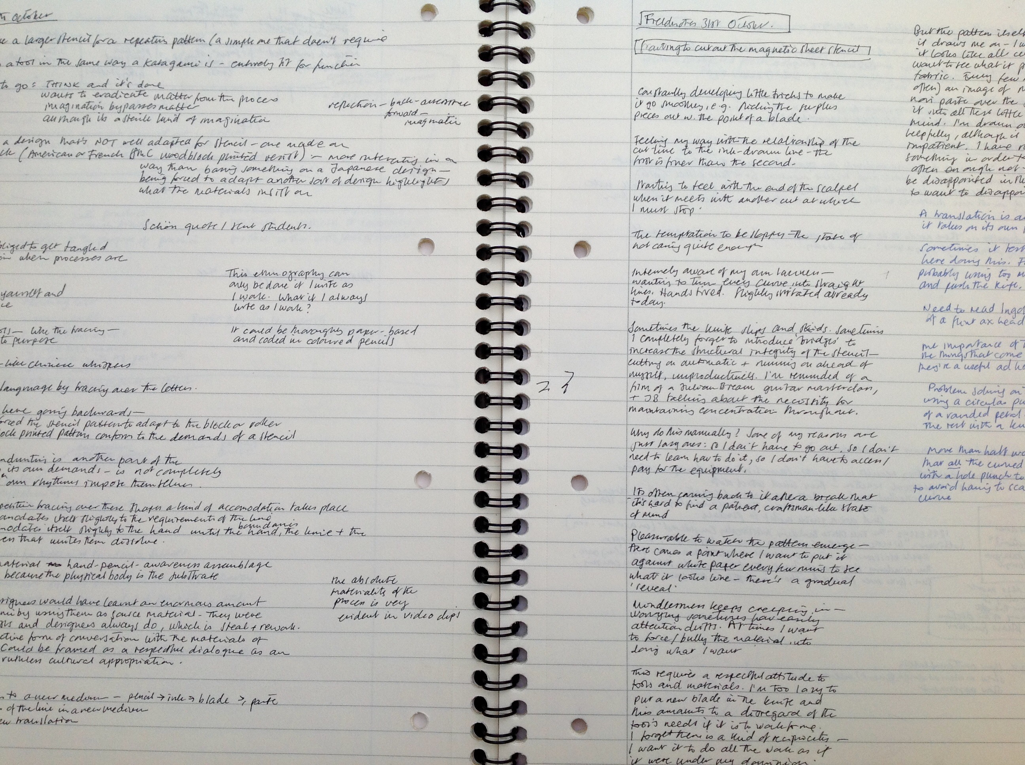

Slide 7
drawing as seeing and as thinking
making as close attention slowing things down
impatience/frustration
care/mindfulness pleasure/satisfaction
excitement surprise
from making to imagining
games and playfulness
tricks/craftiness tradition/empathy
learning from materials surrender
points of translation

Slide 8
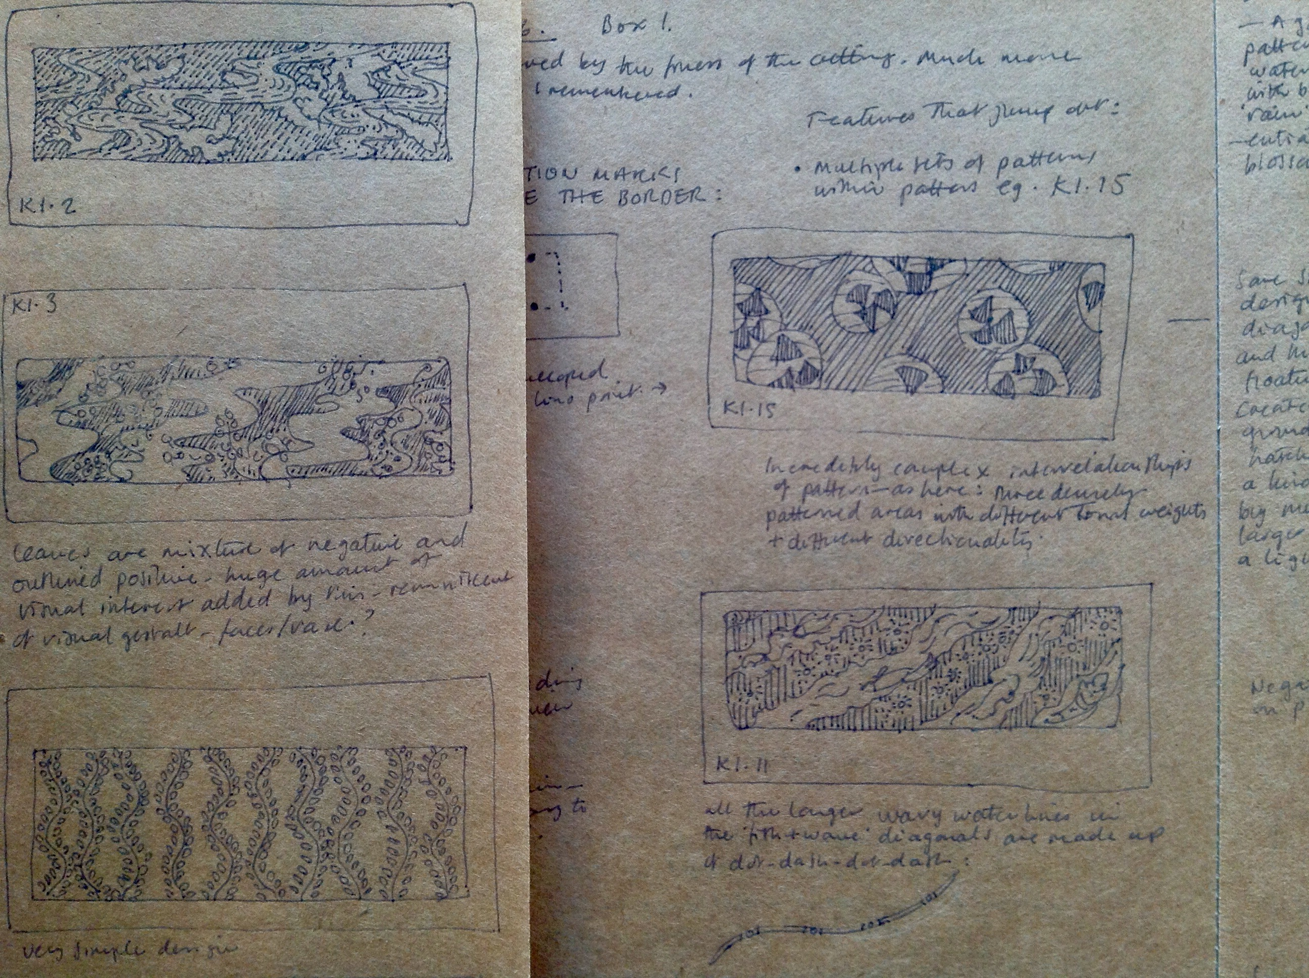

Slide 10
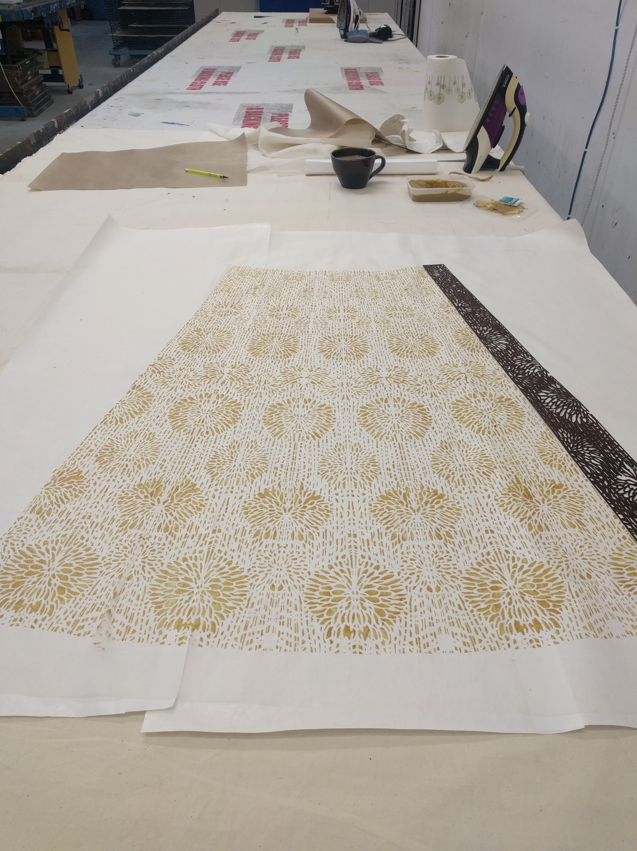
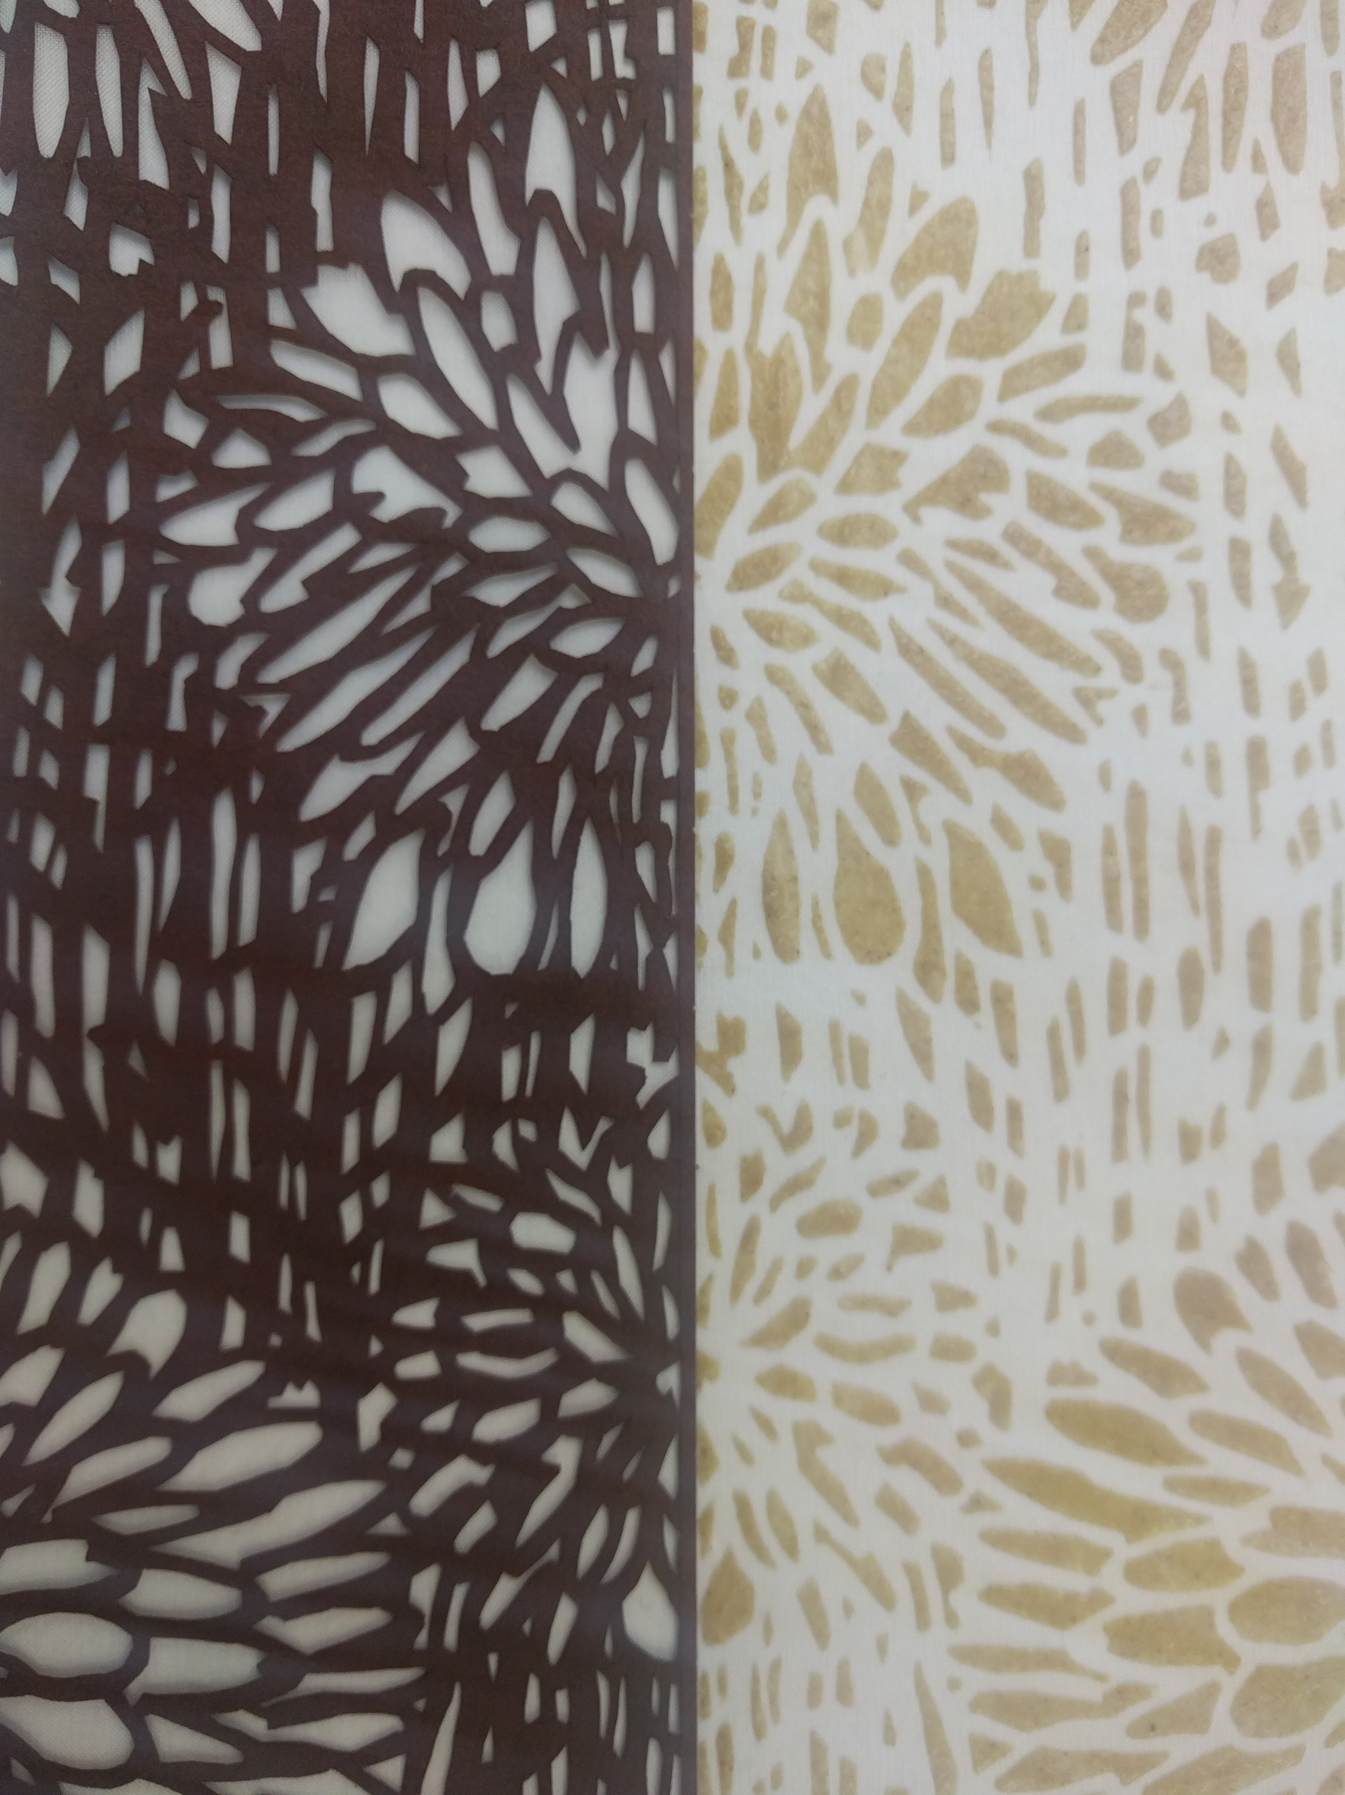

Slide 15
