Slide 1
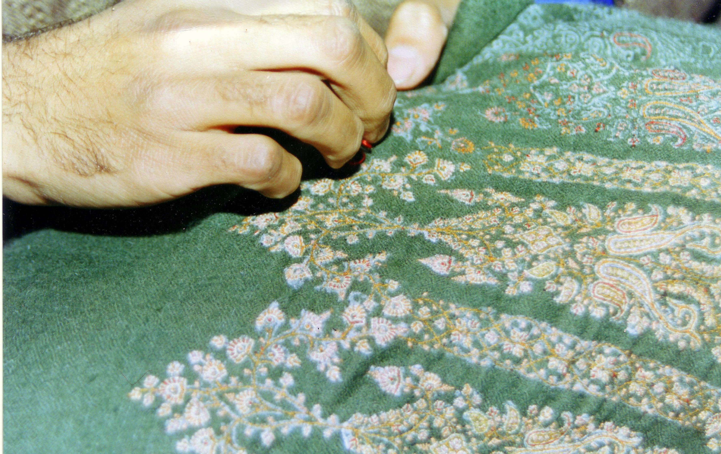
Creative Practice, Women, Peace & Security
Dr Neelam Raina
Associate Professor, Design and Development, Middlesex University London.
GCRF Challenge Leader – Protracted Conflict, Security, Displacement & Refugees

Slide 2
Communities & Knowledge
Research that takes into account the visual and material cultures of regions to understand the shifts caused therein by the conflicts in the regions of study for this hub.
We use a cultural mapping methodology to explore how communities of women, across different conflict contexts rely on coded and tacit knowledge to rebuild their lives.
This knowledge is key to understanding the dynamics of conflict and its impact on women. Larger numbers of communities than ever before are on the move and displaced from their homes, however they carry their culture with them, often in the shape of visual and material belongings, language and narratives.

Slide 3
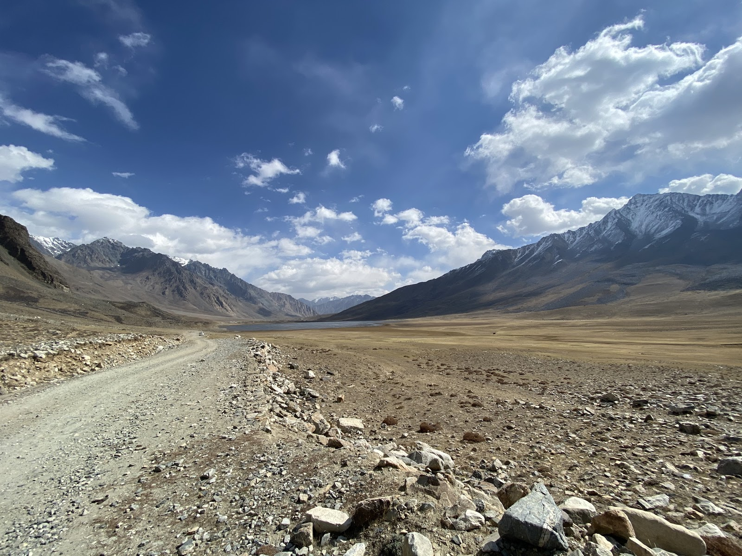
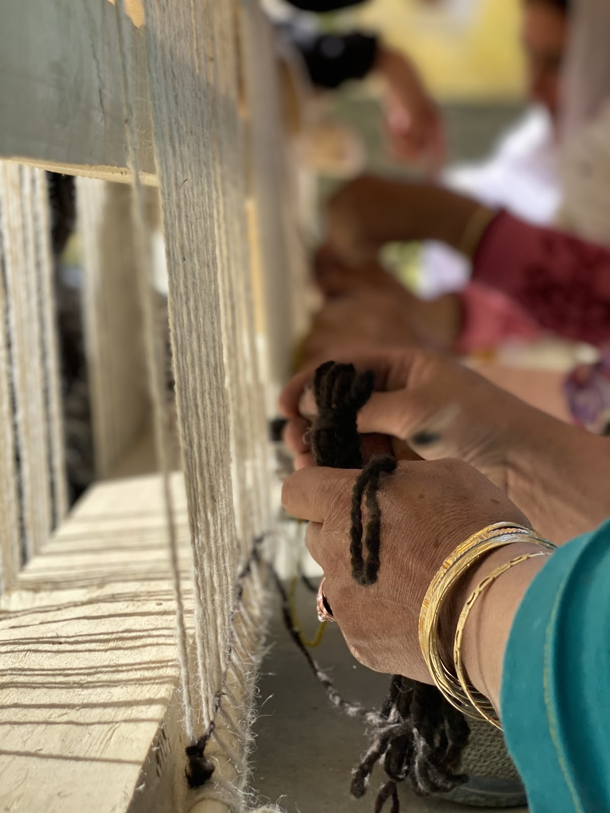

Slide 4
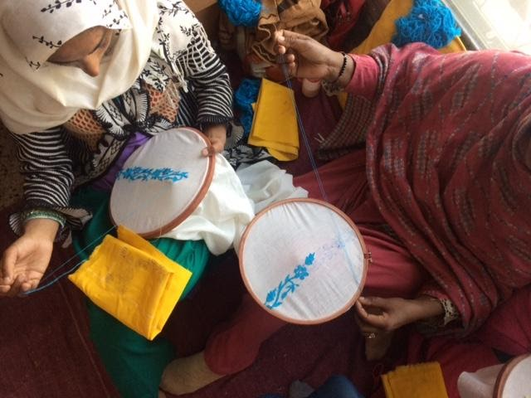

Slide 5
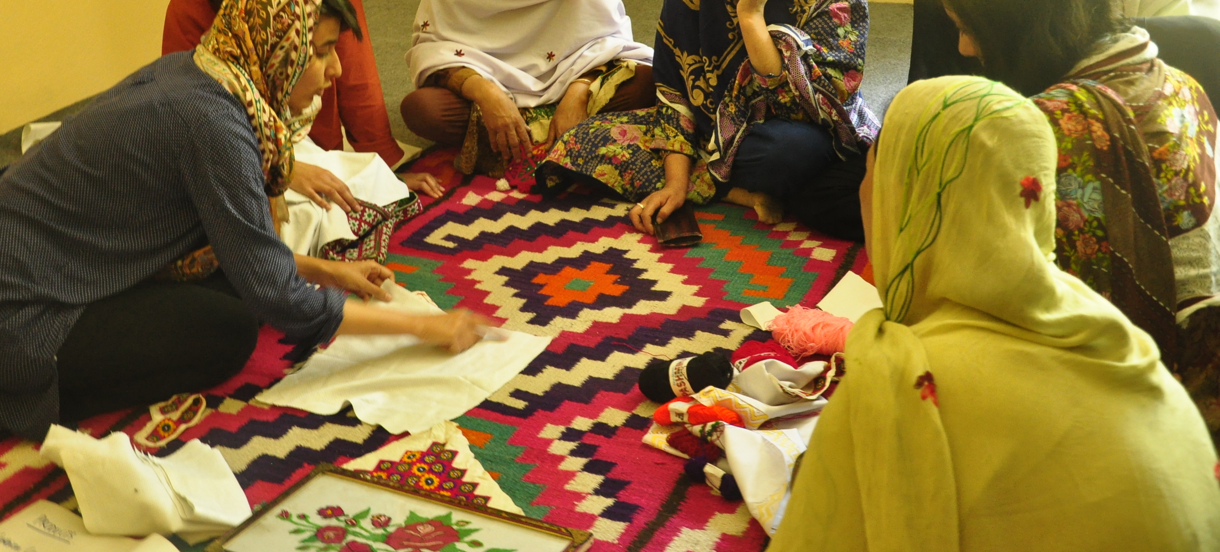

Slide 6
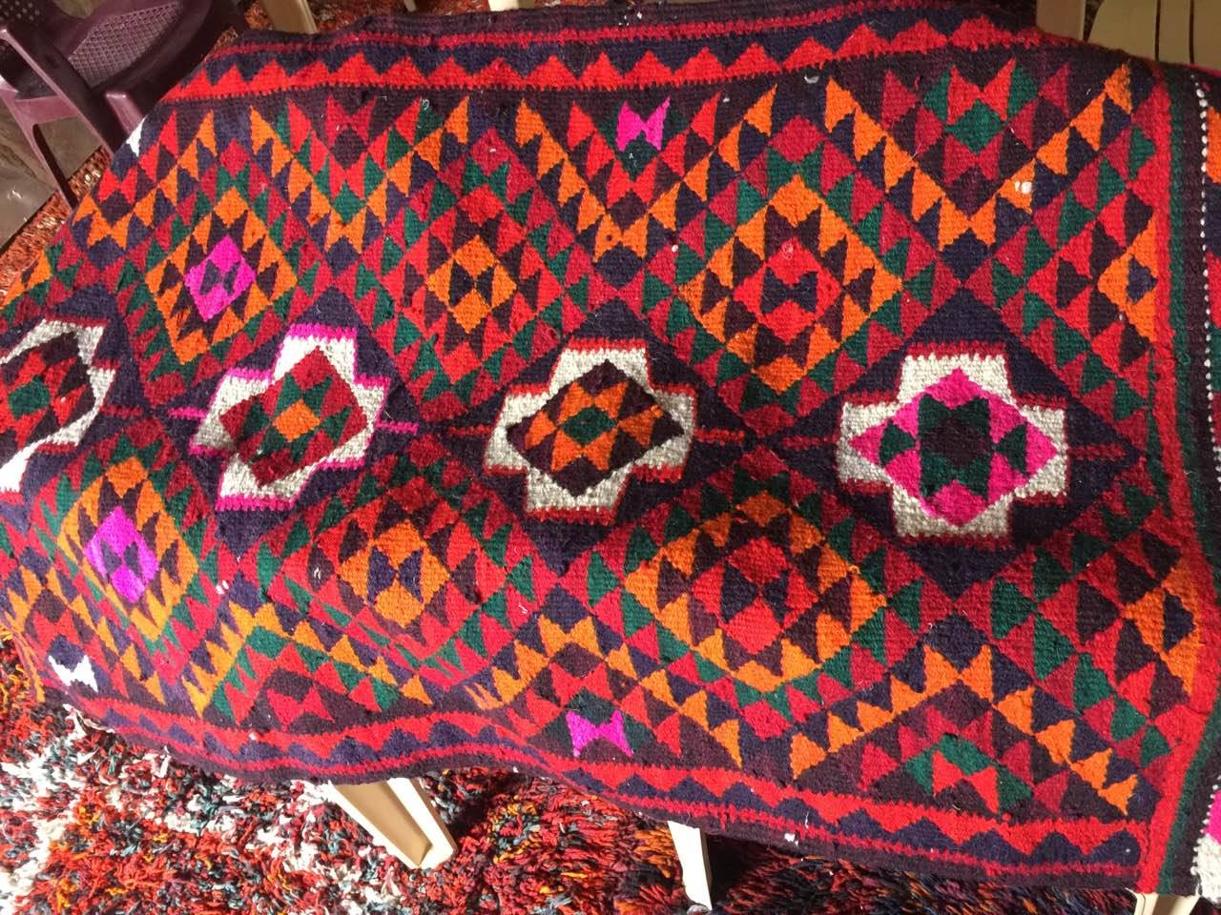

Slide 7
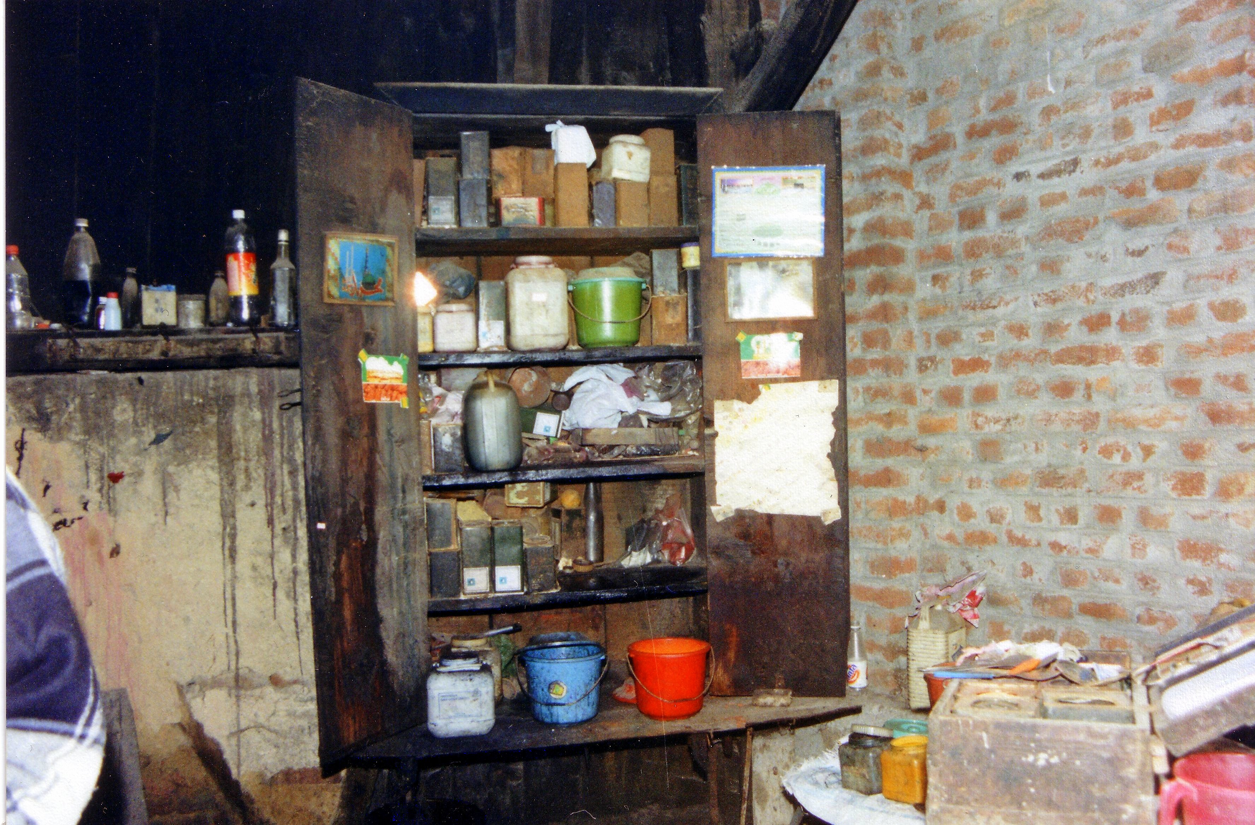

Slide 8
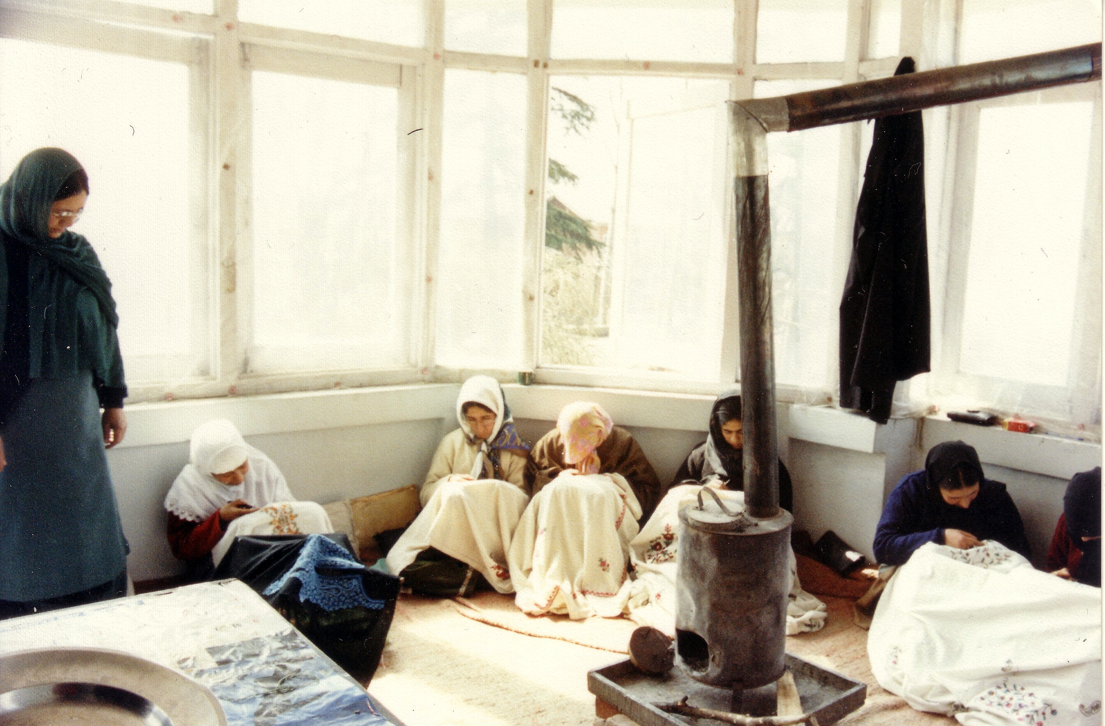

Slide 9
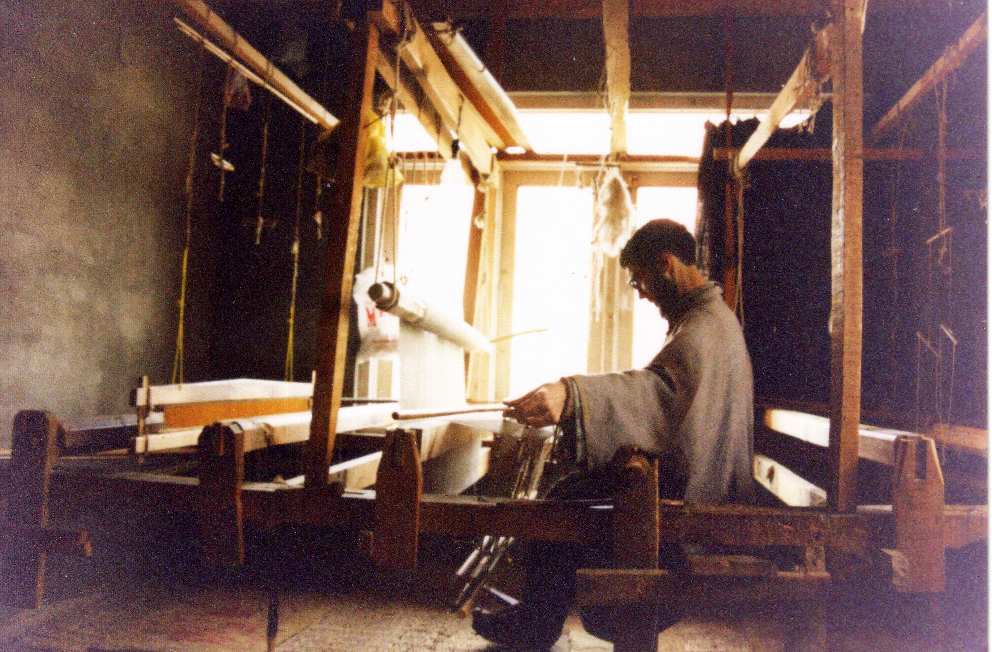

Slide 10
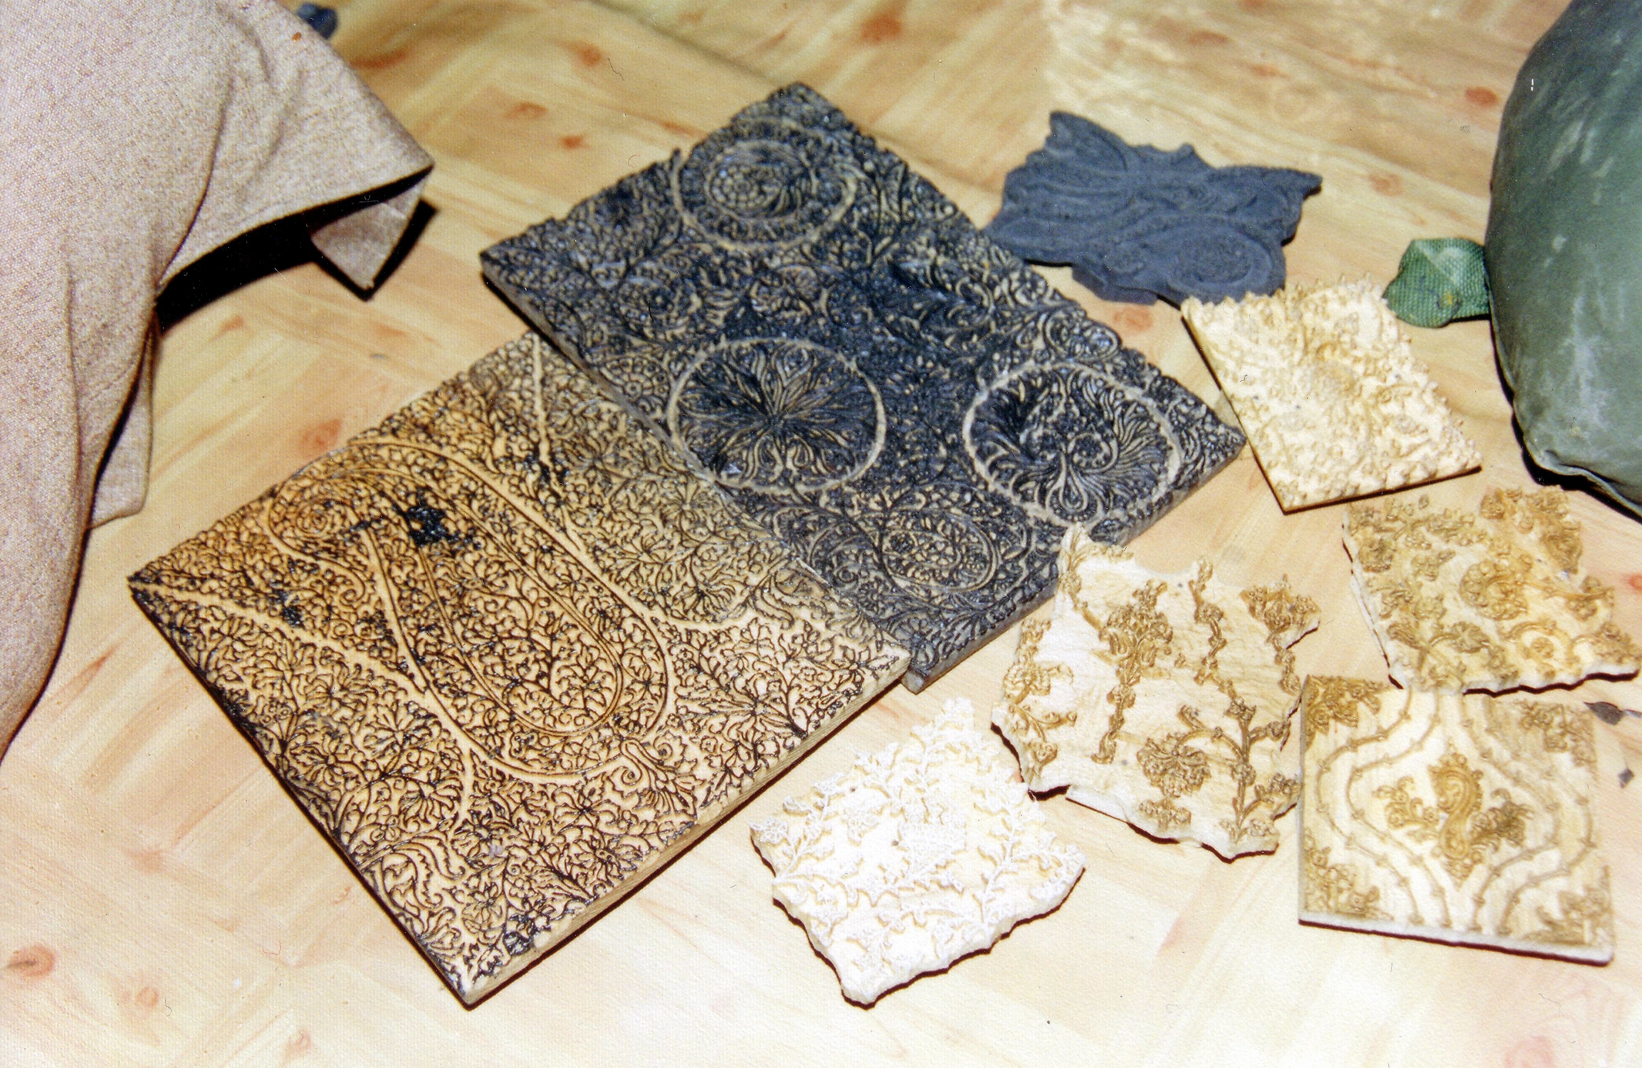

Slide 11
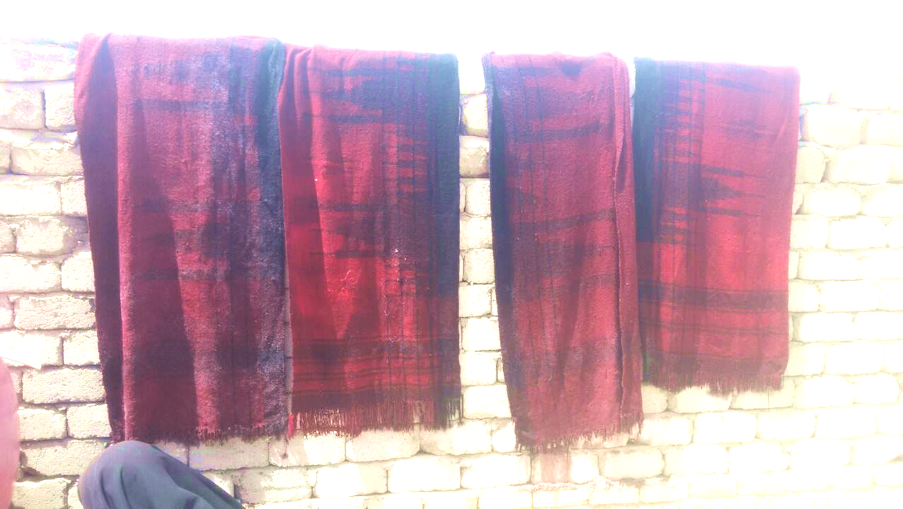

Slide 12
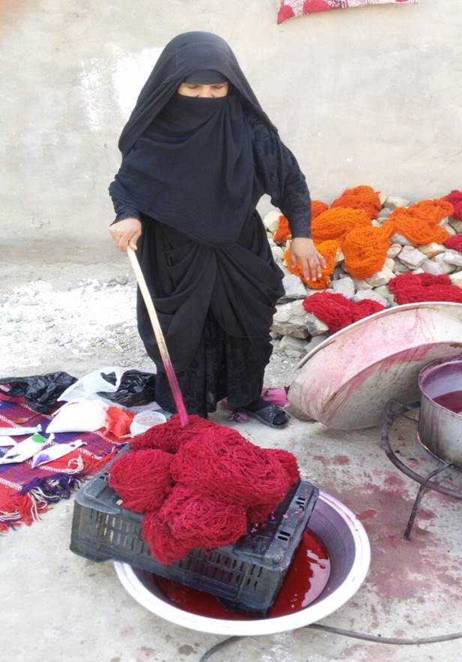
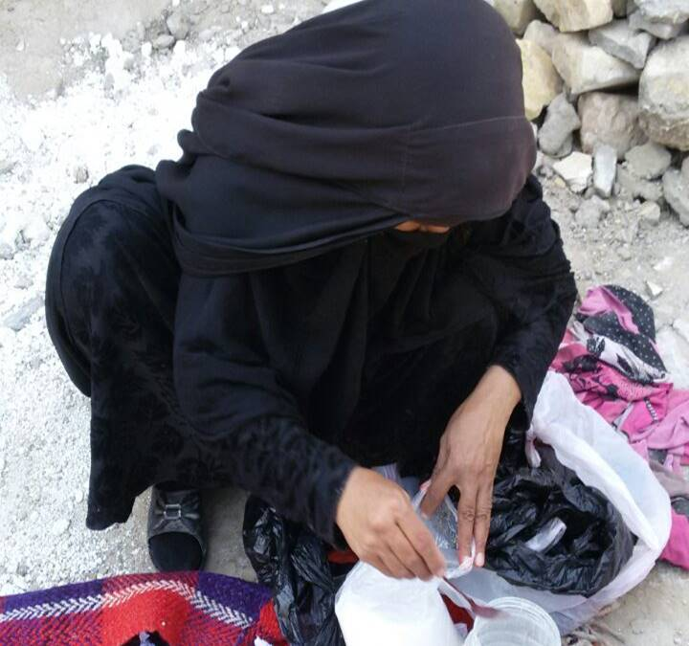

Slide 13
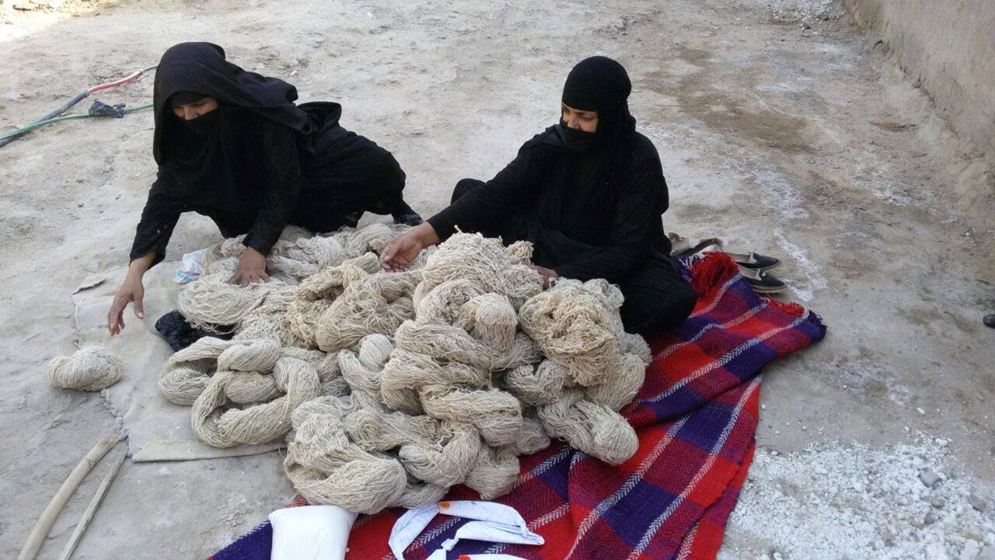

Slide 14
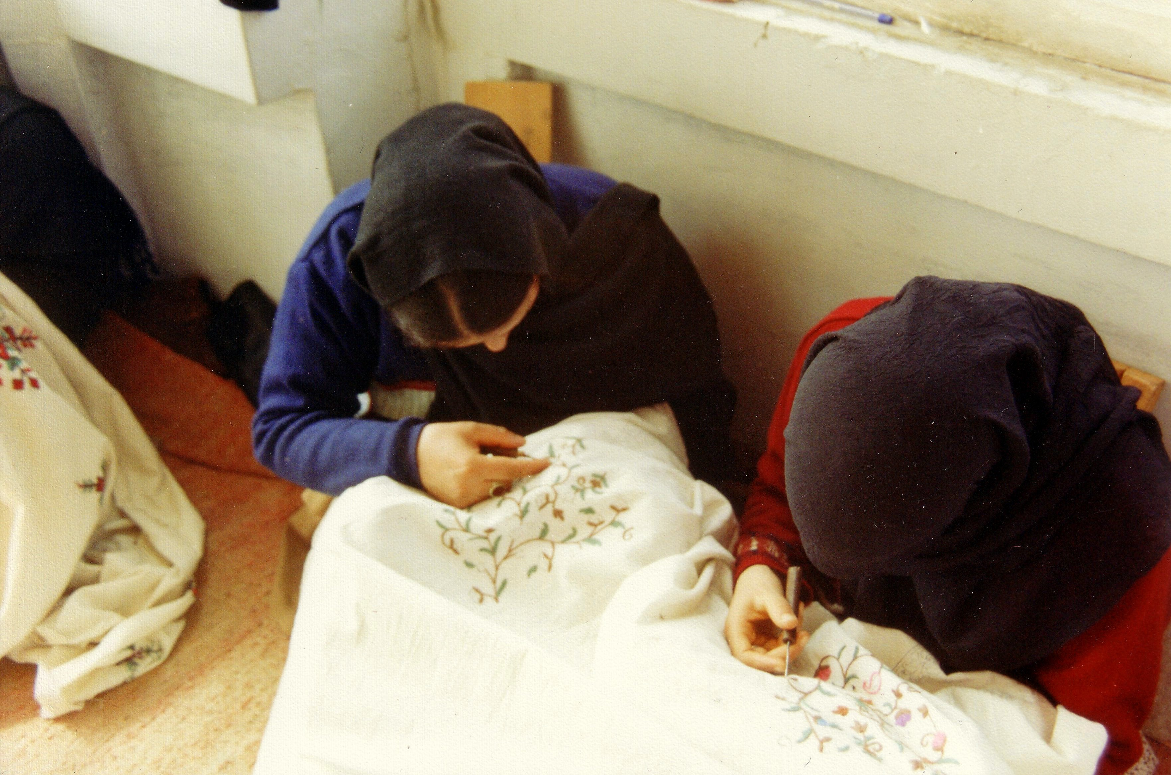

Slide 15
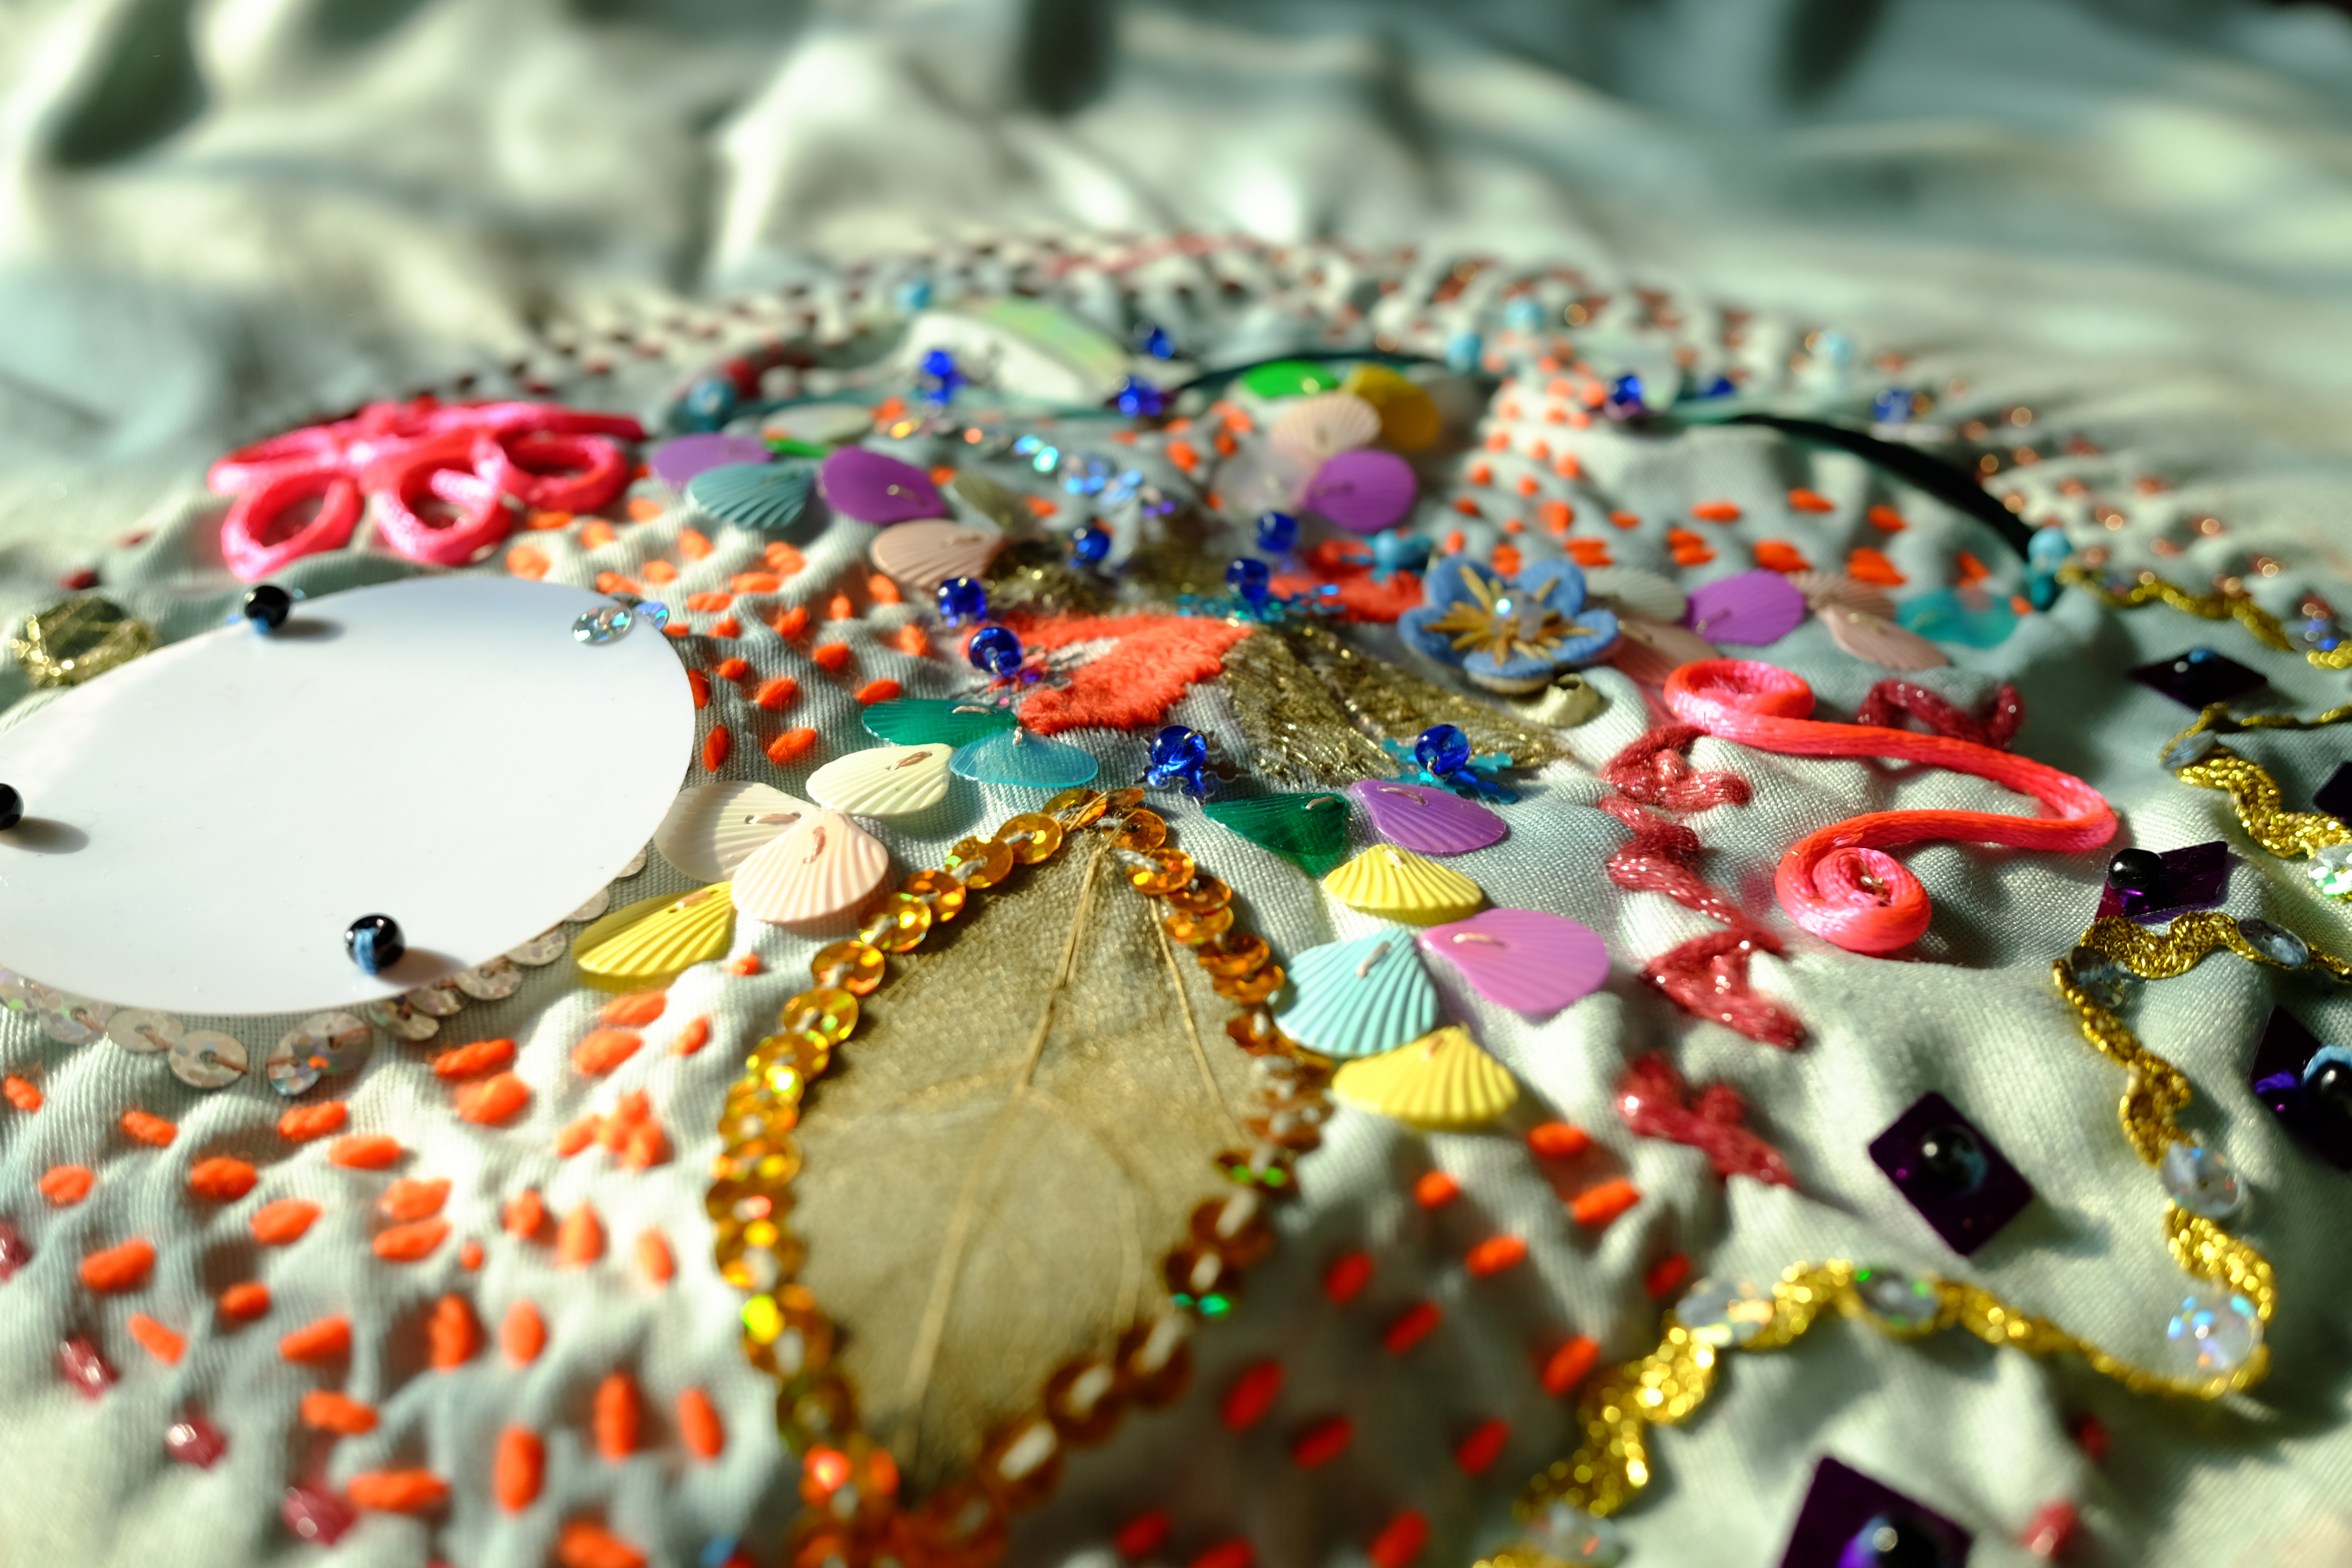

Slide 16
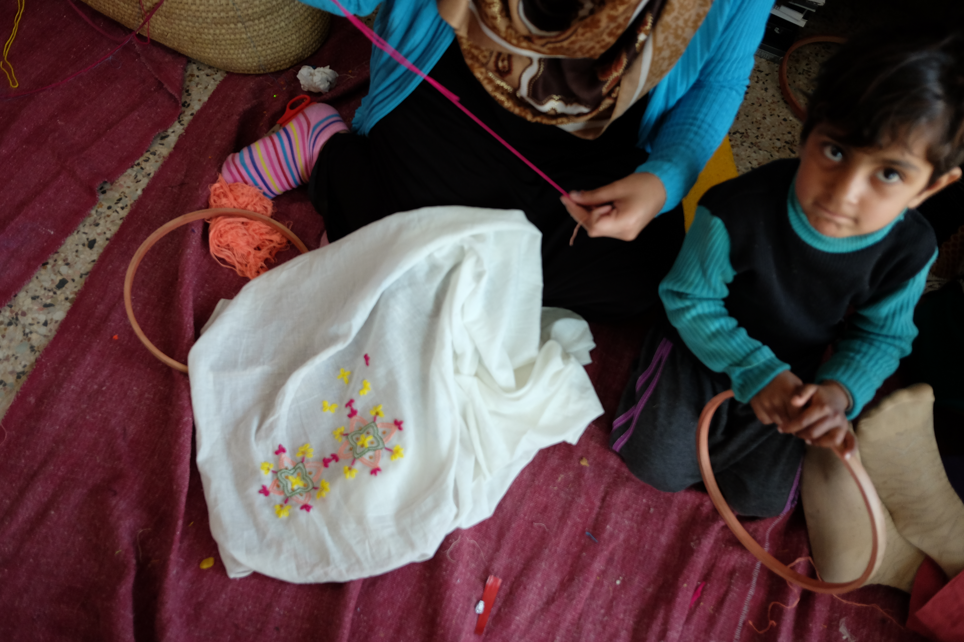

Slide 17
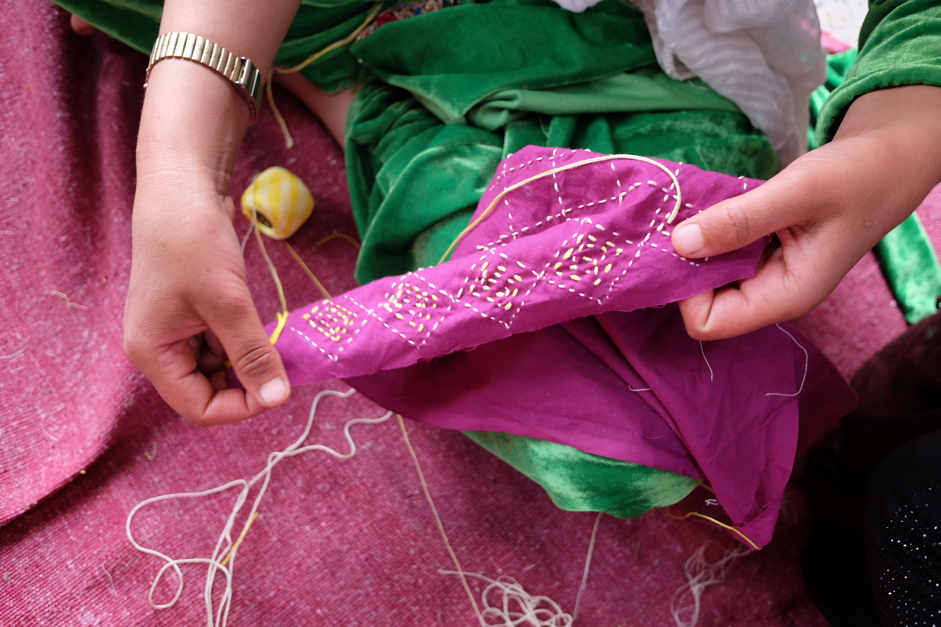

Slide 18
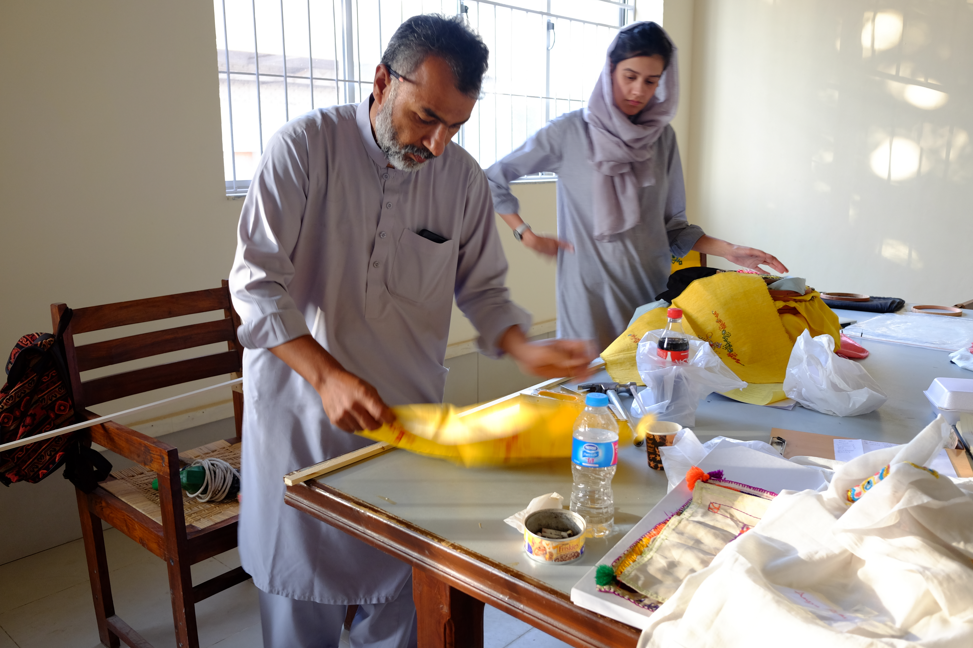

Slide 19
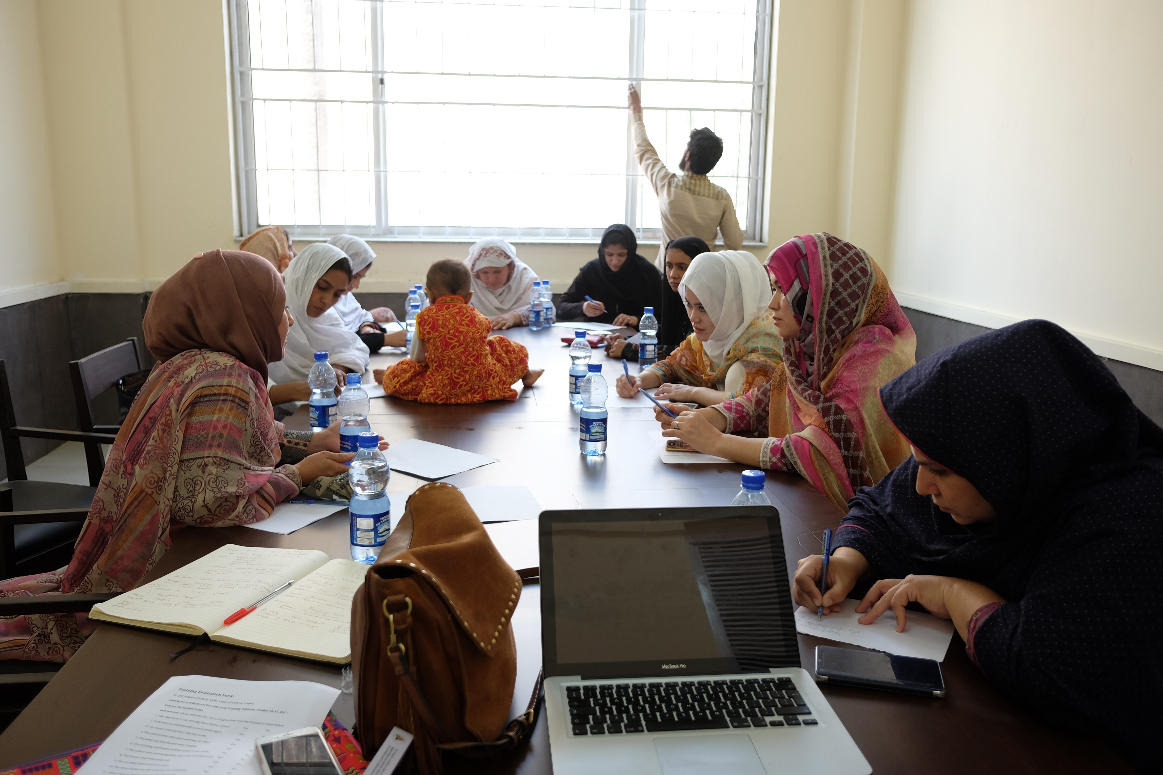

Slide 20
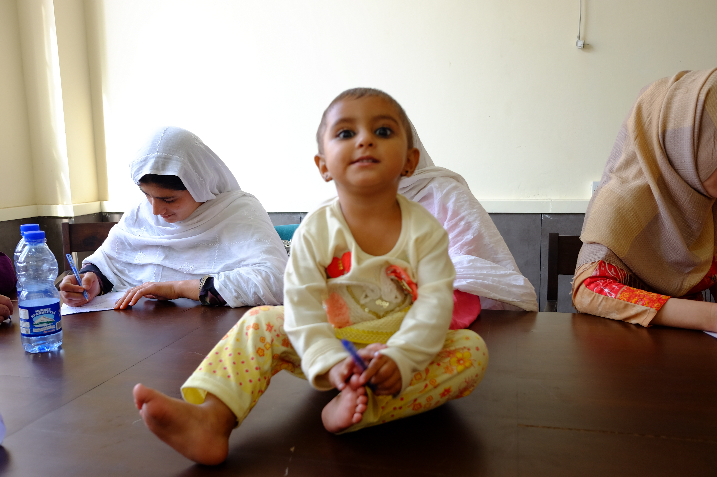
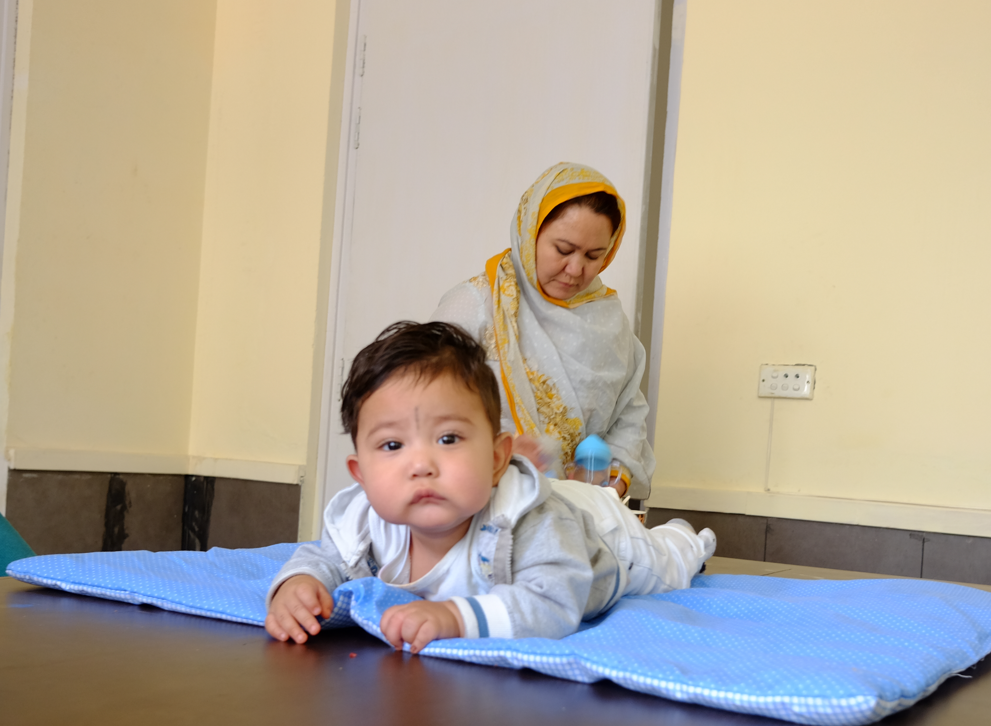
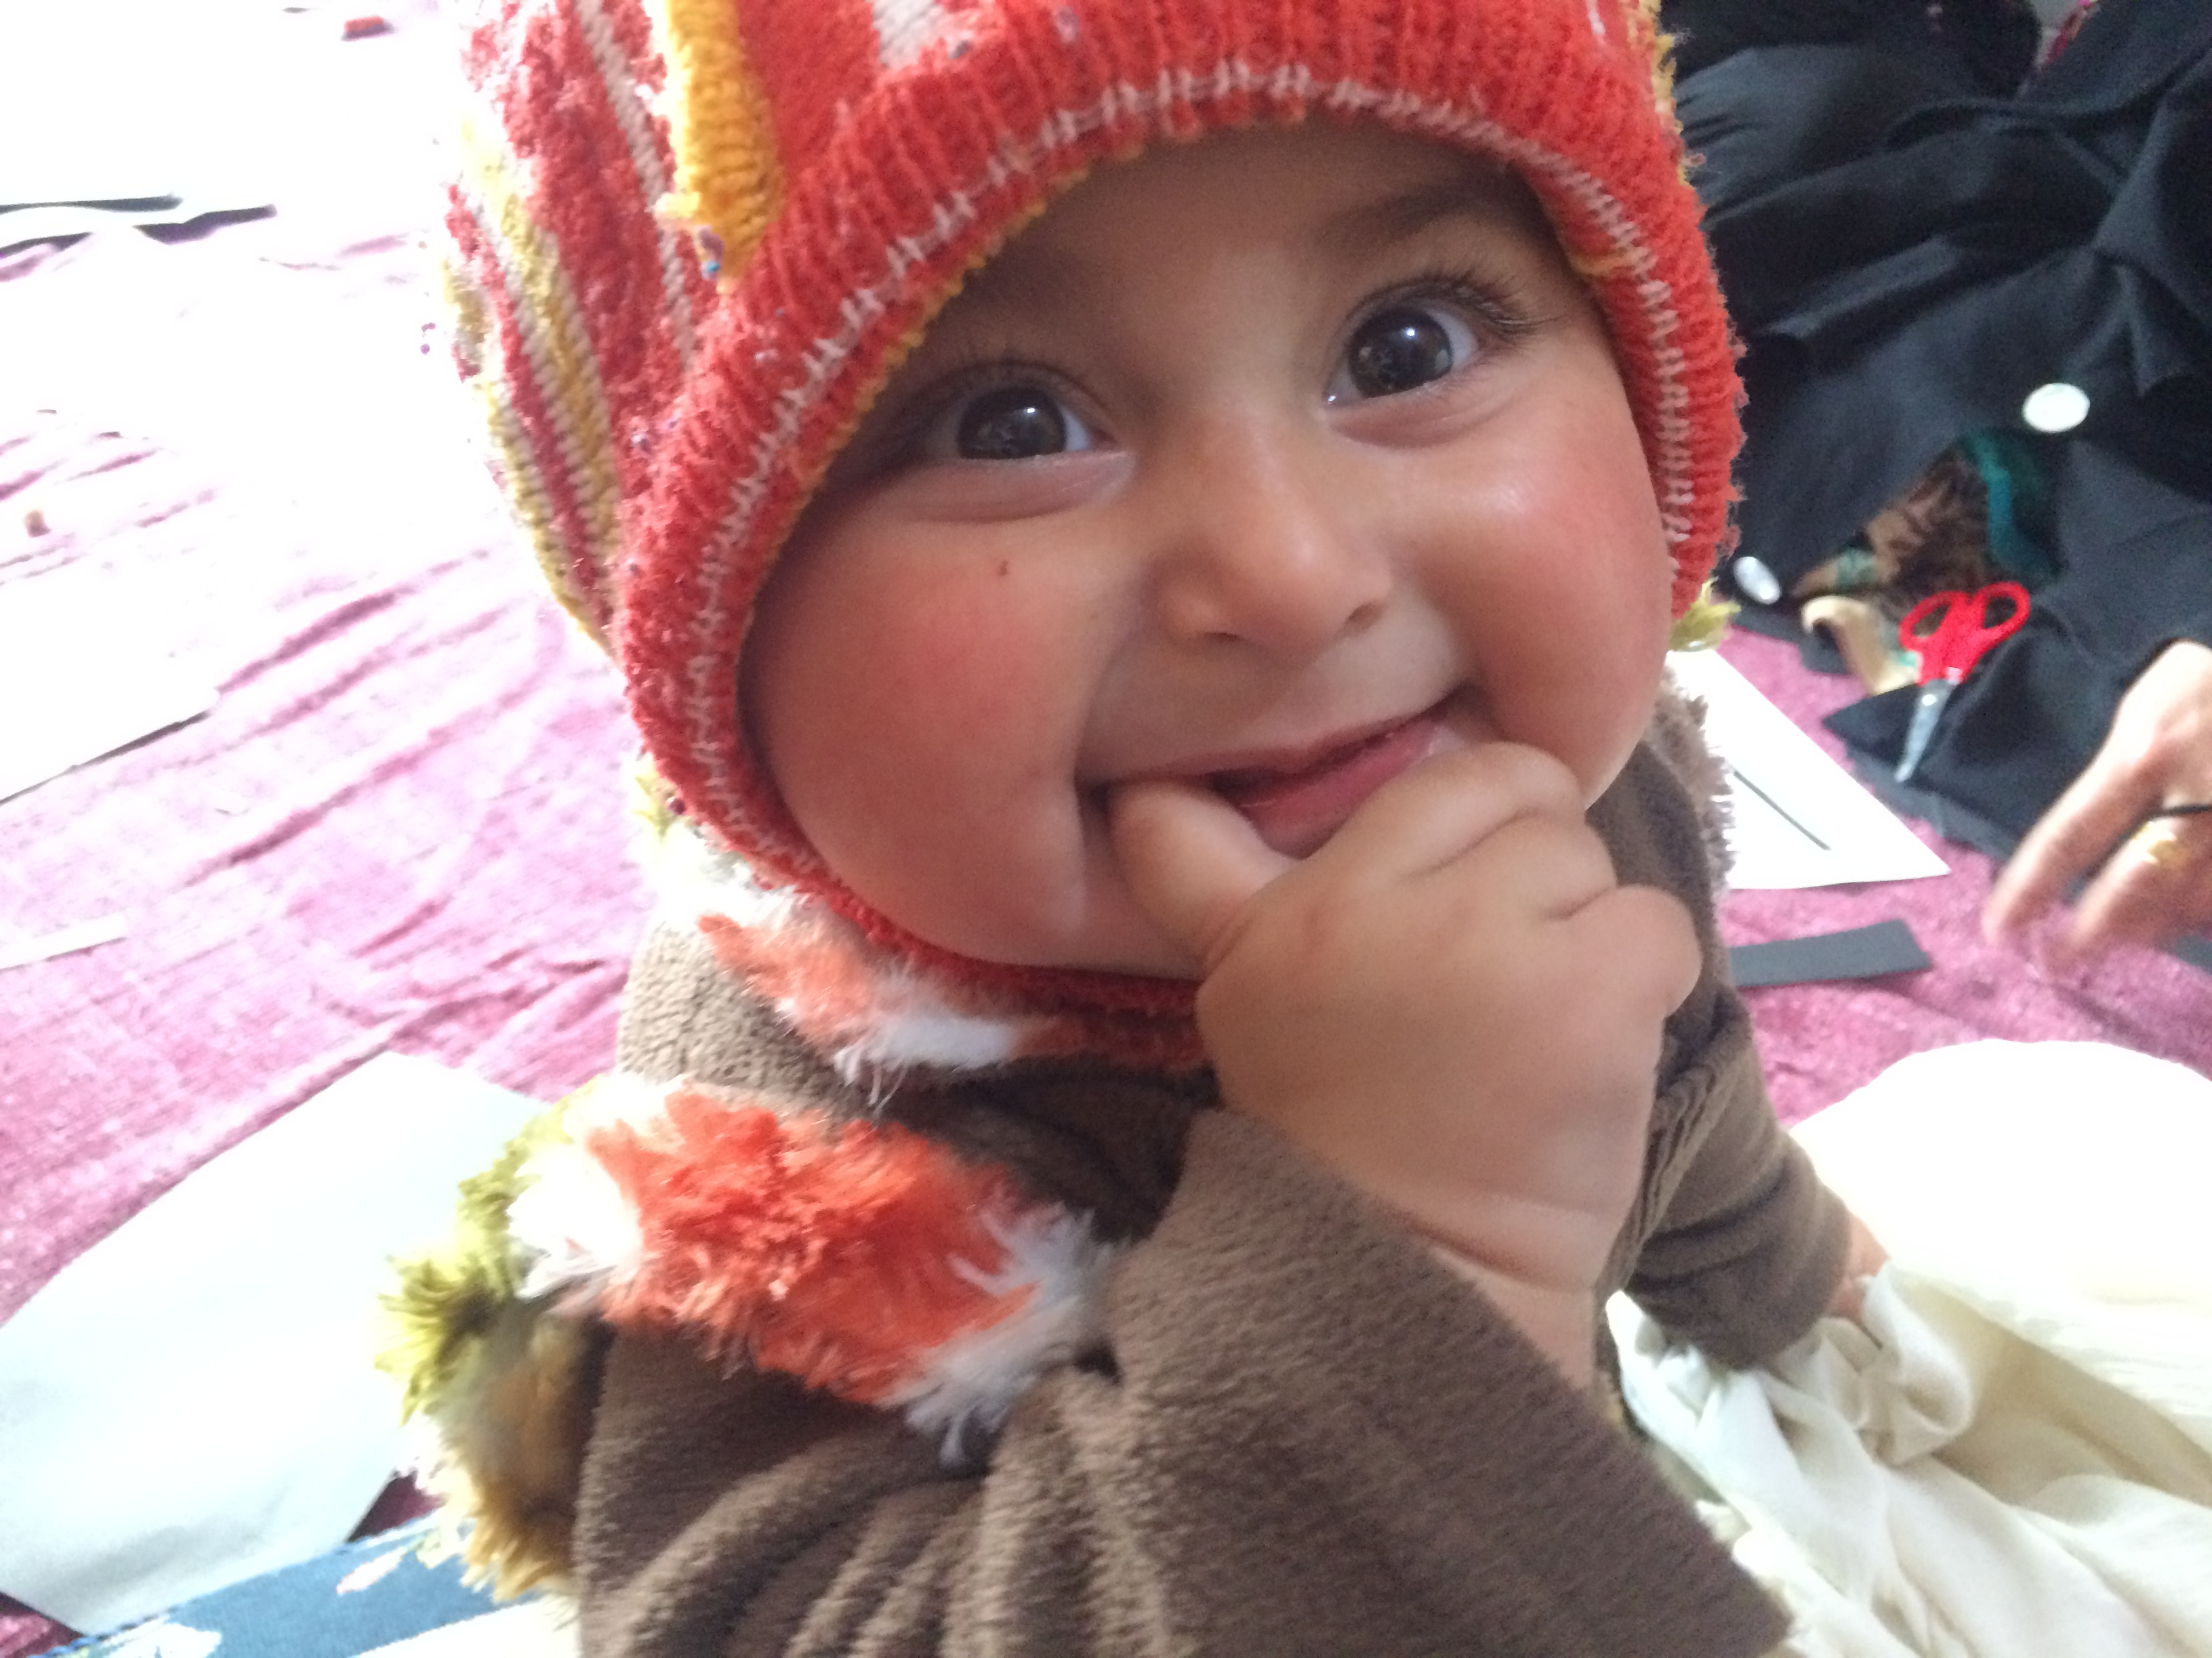
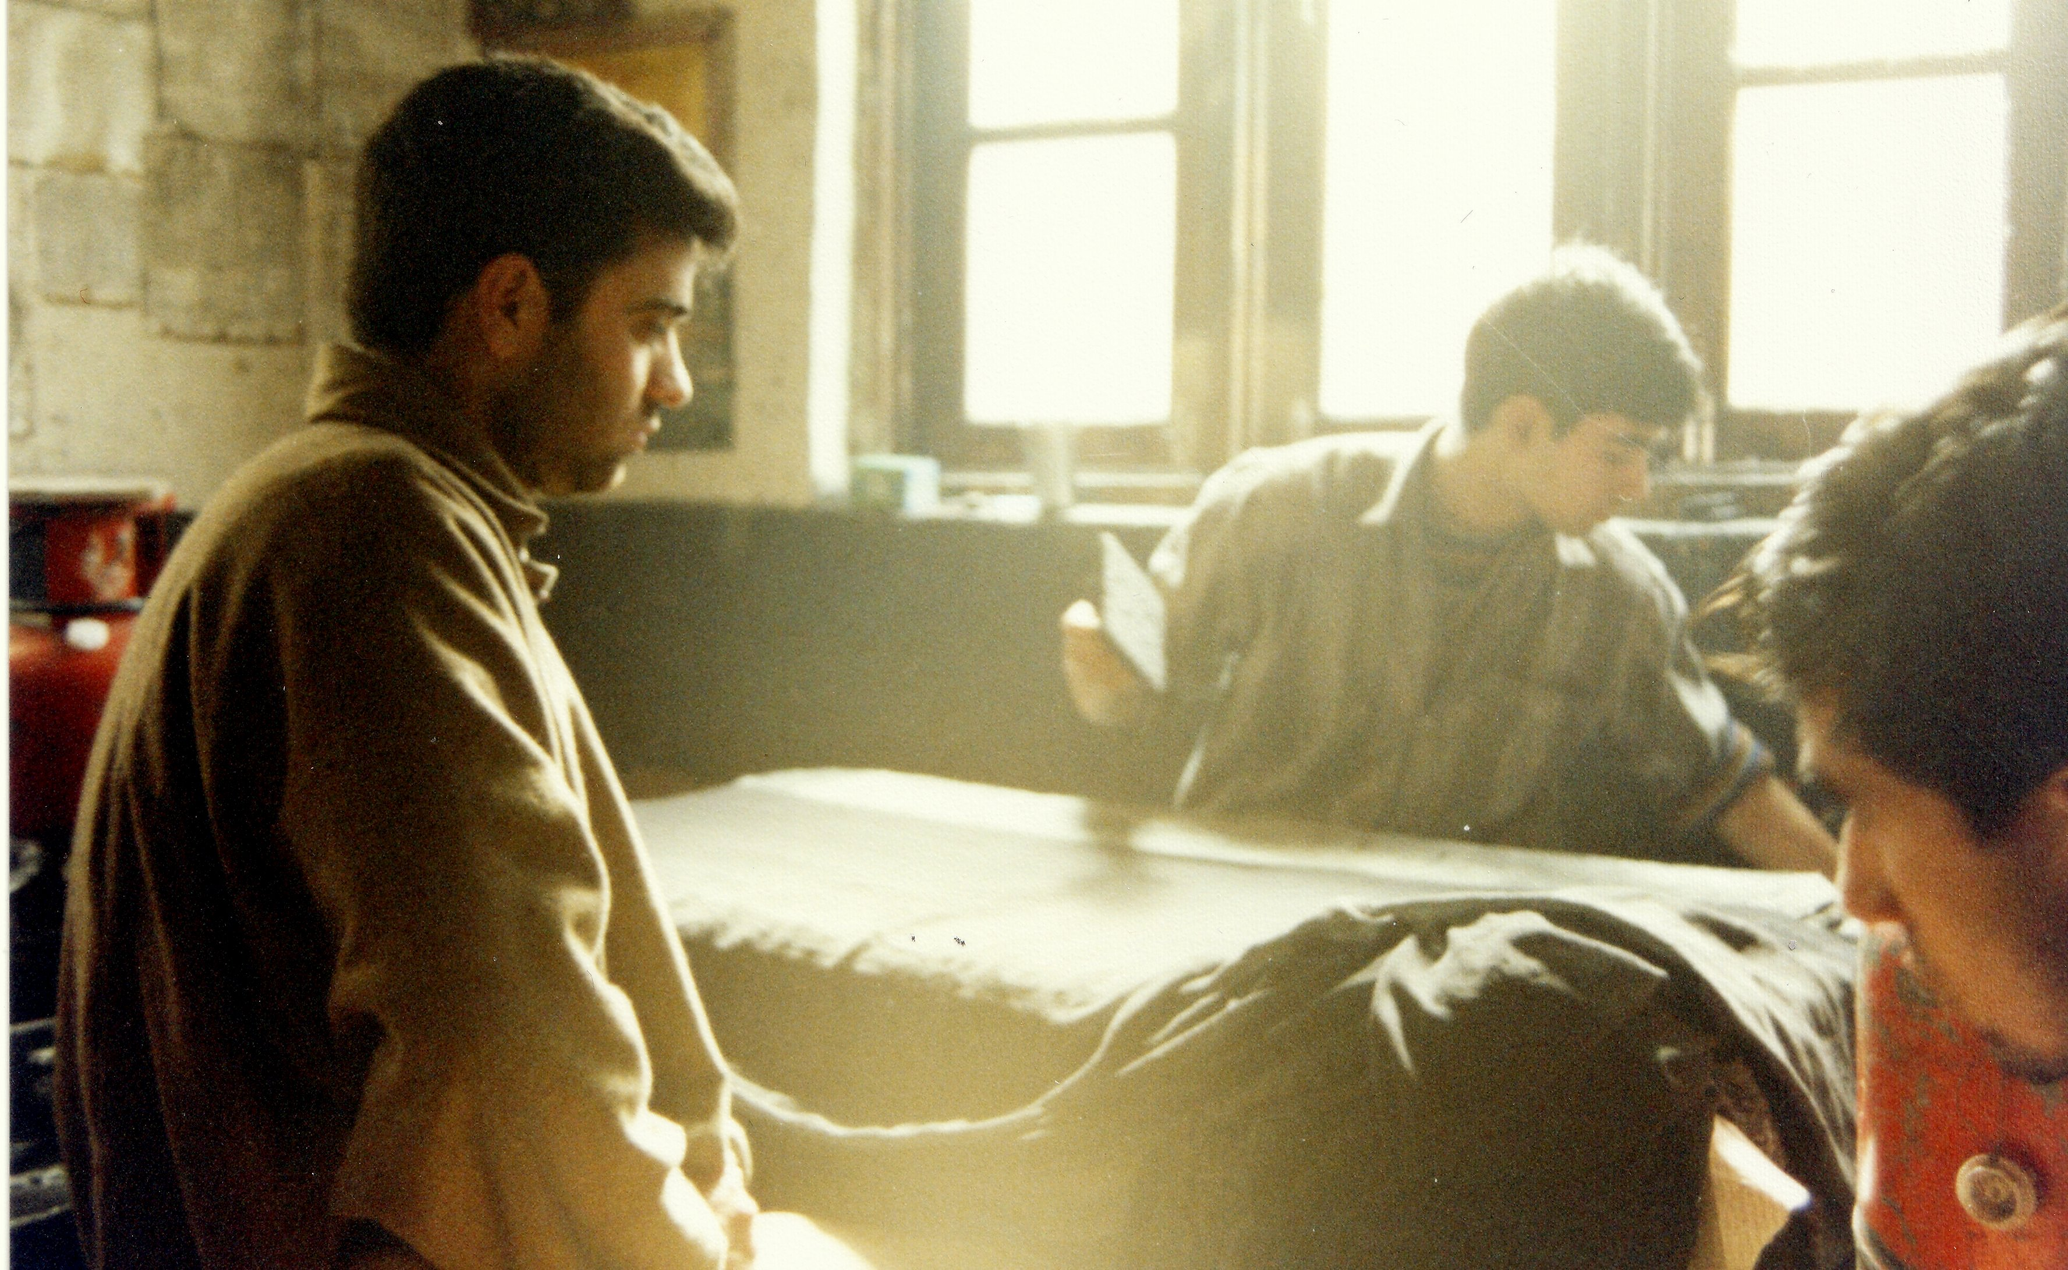
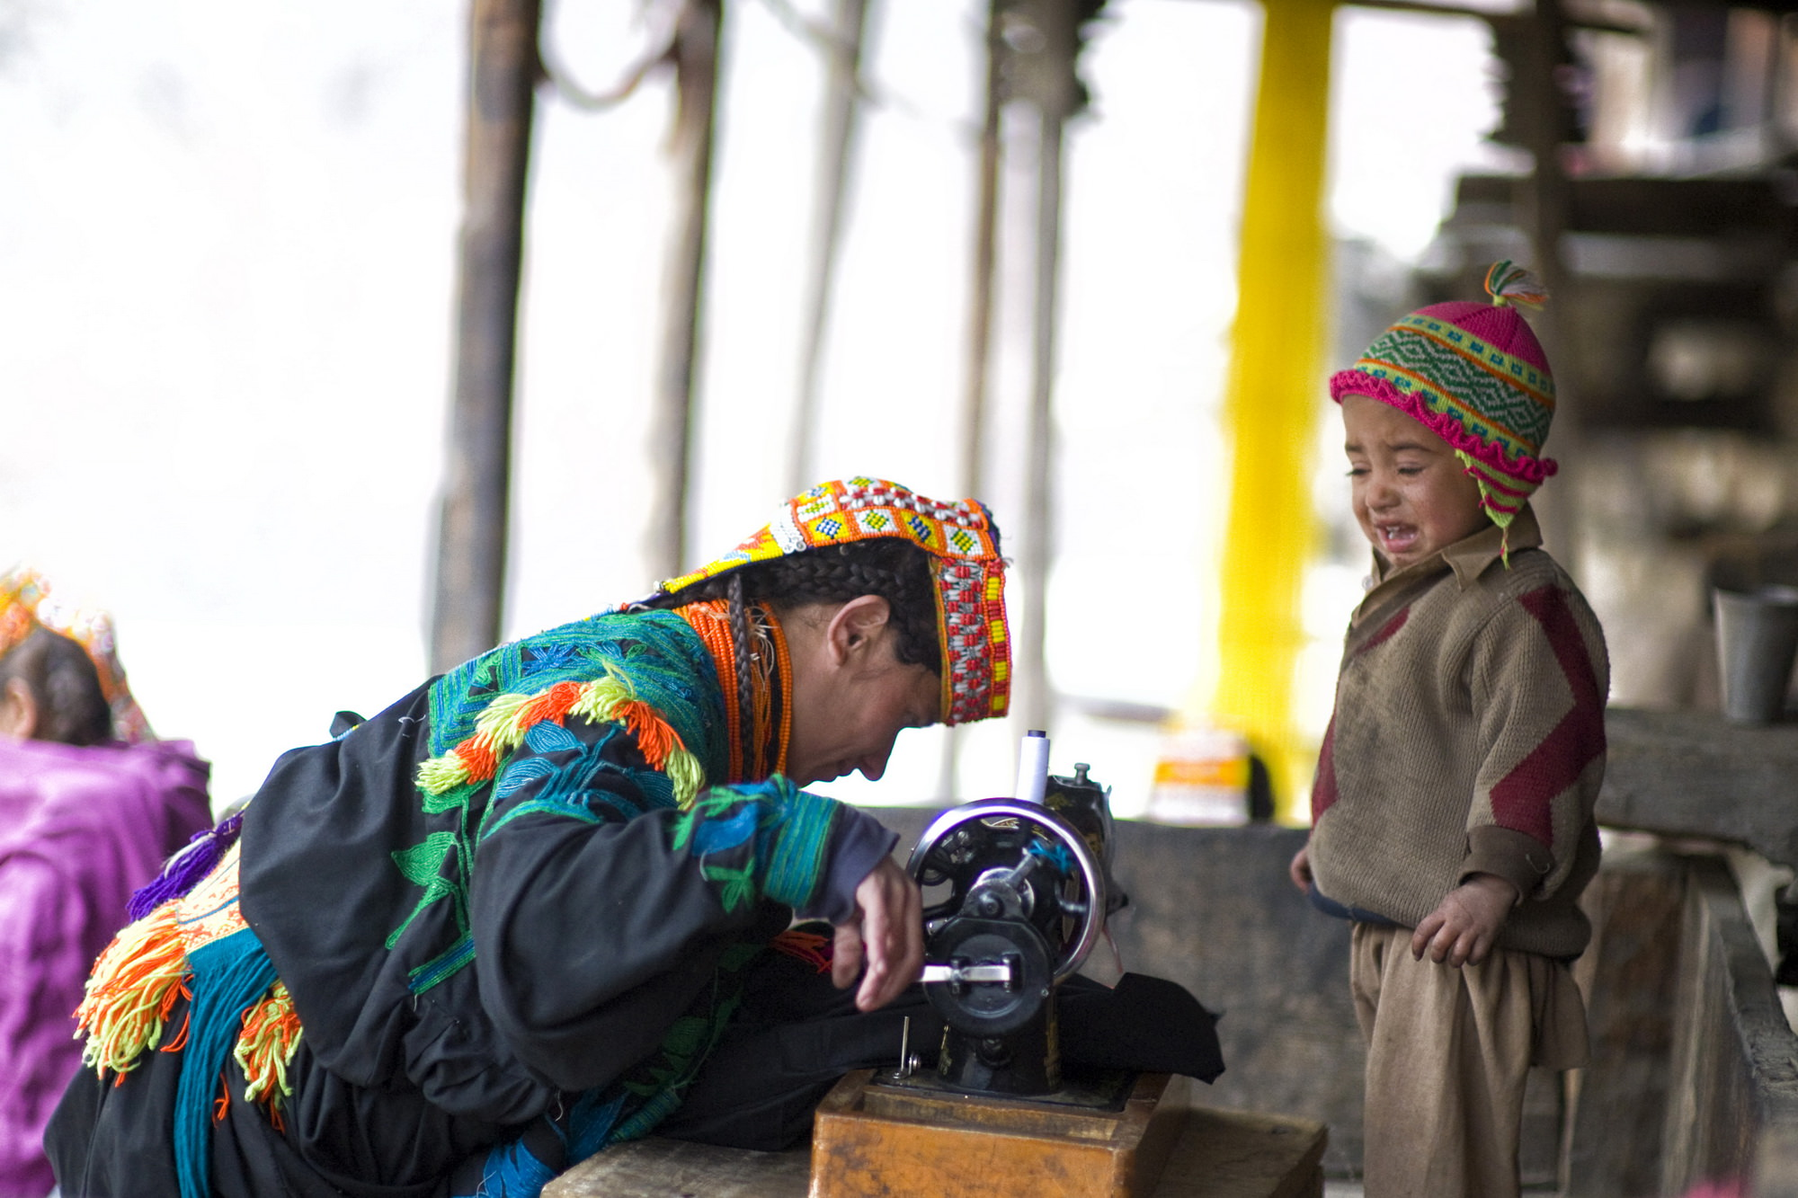

Slide 21
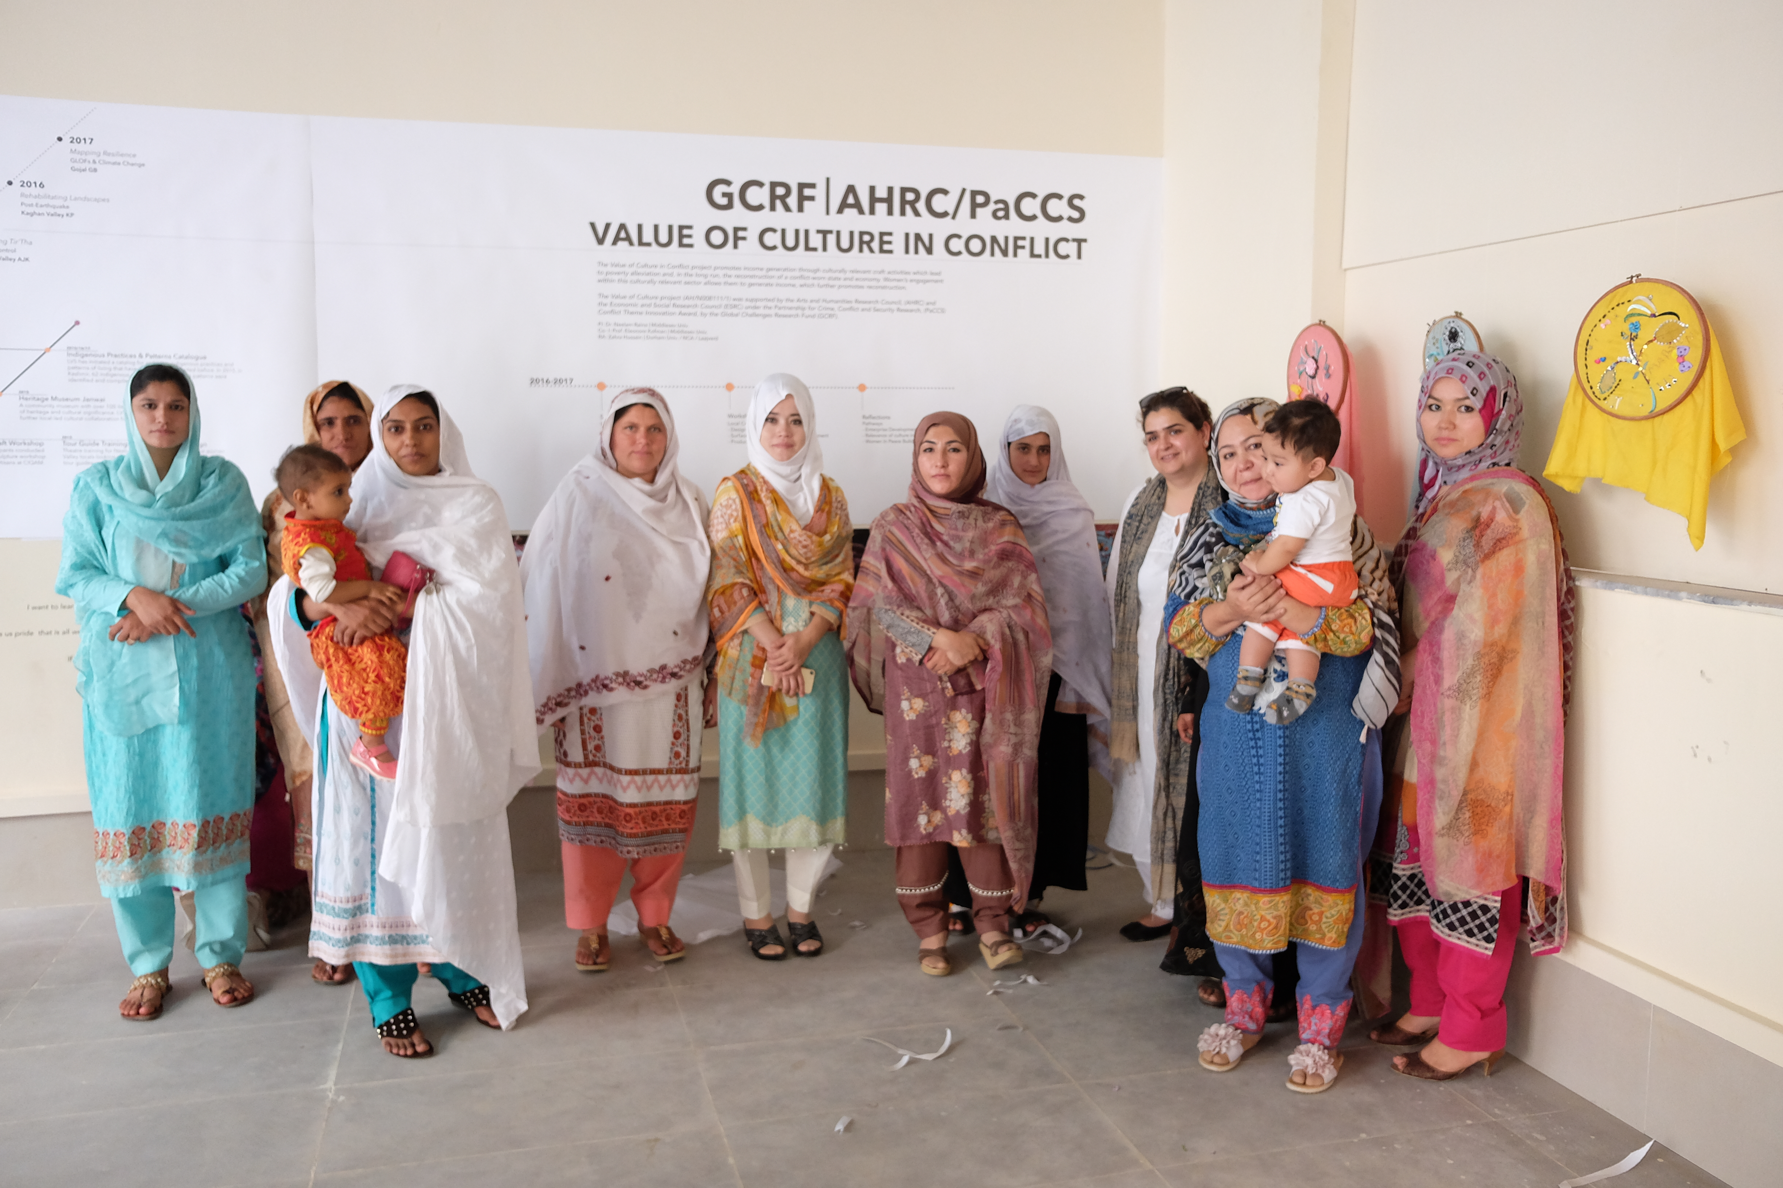

Slide 22
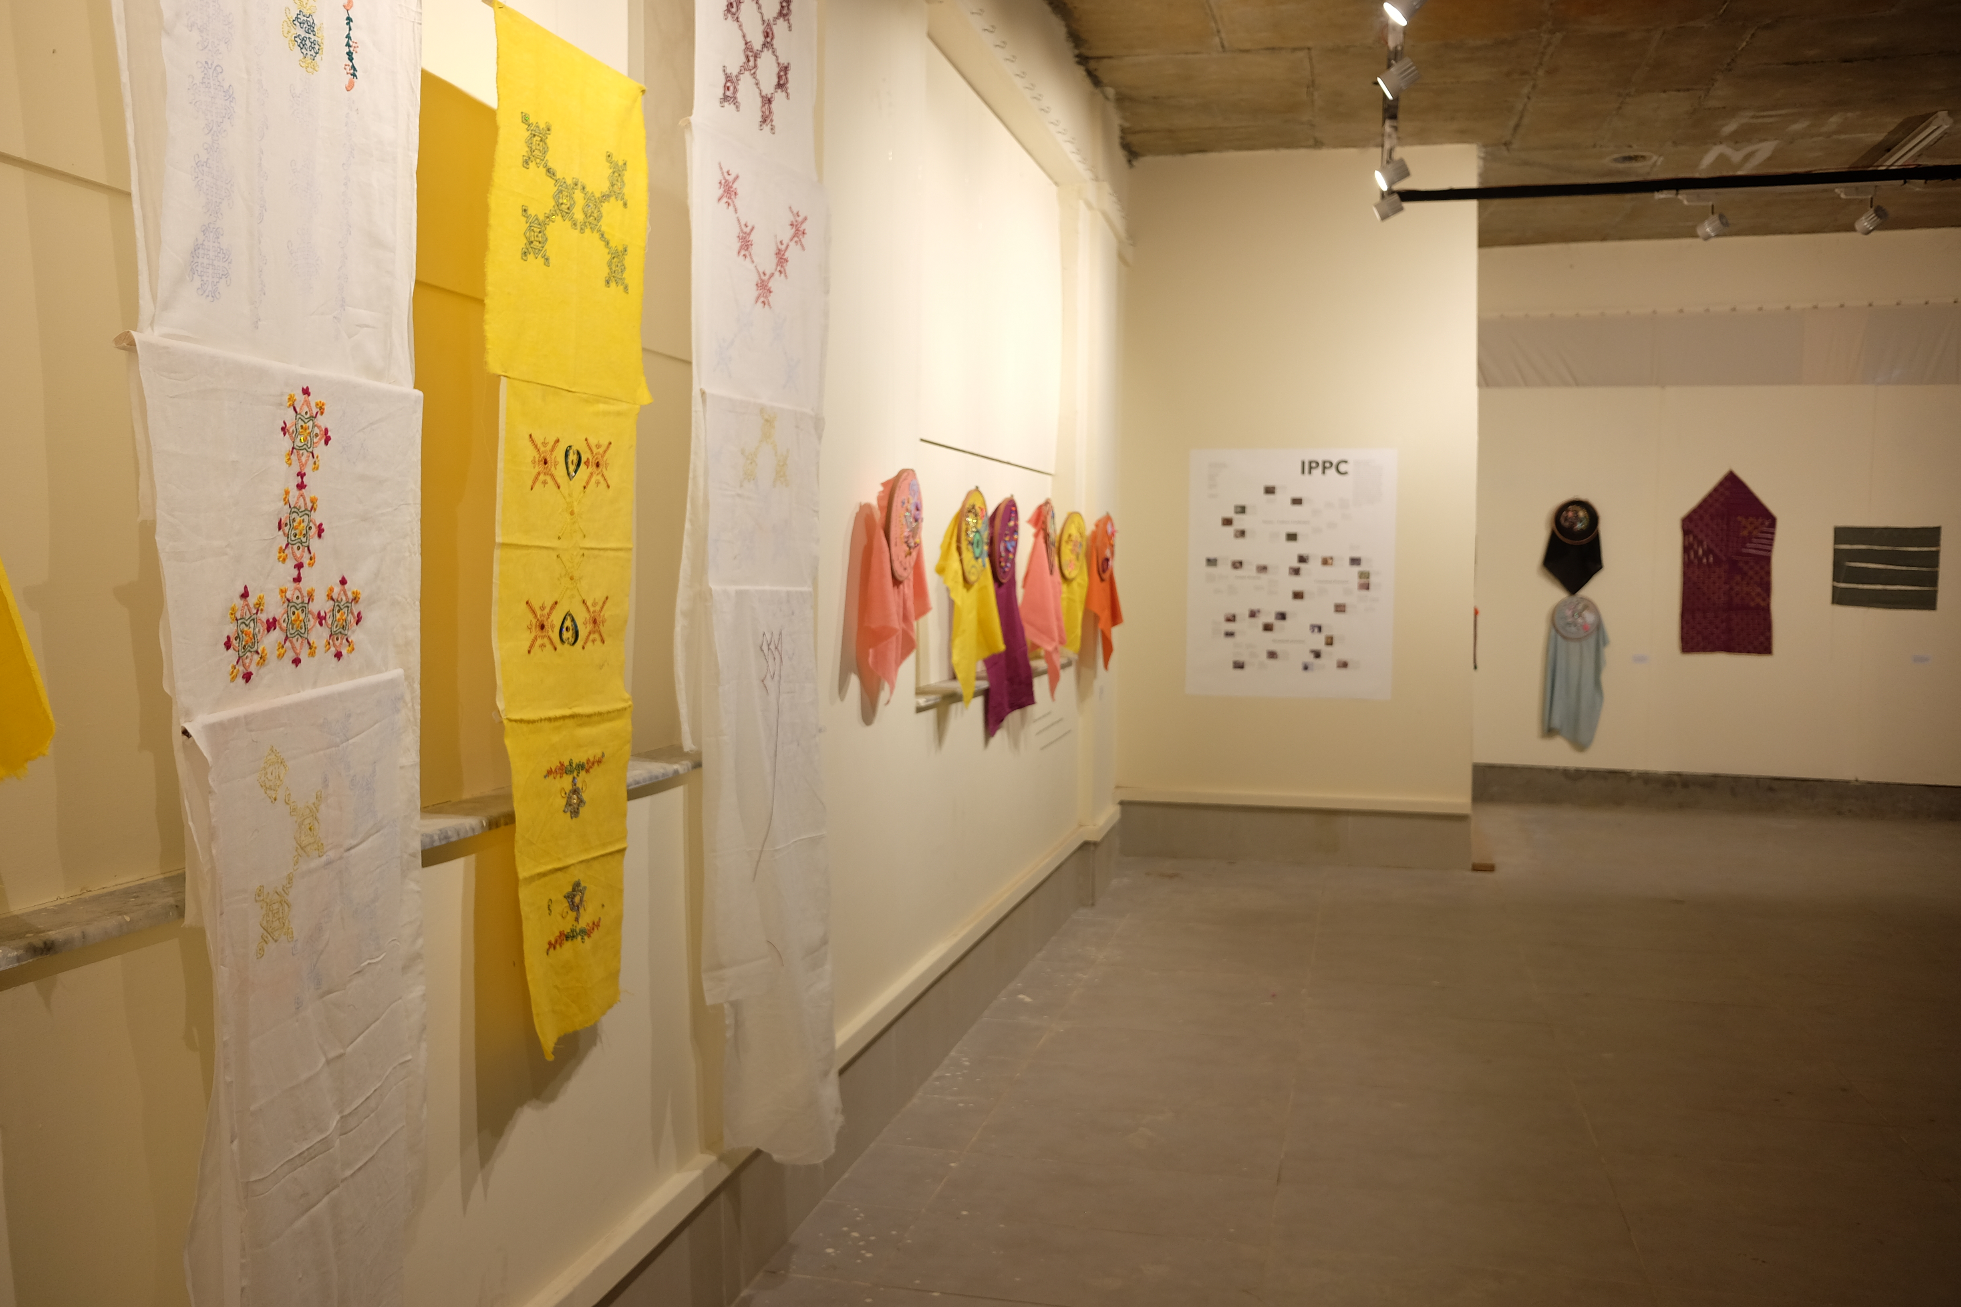

Slide 24
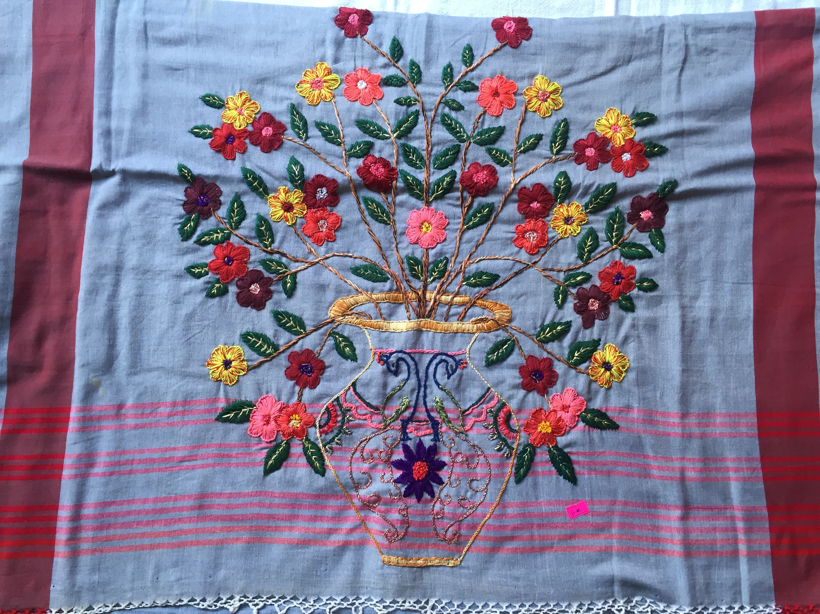

Slide 25
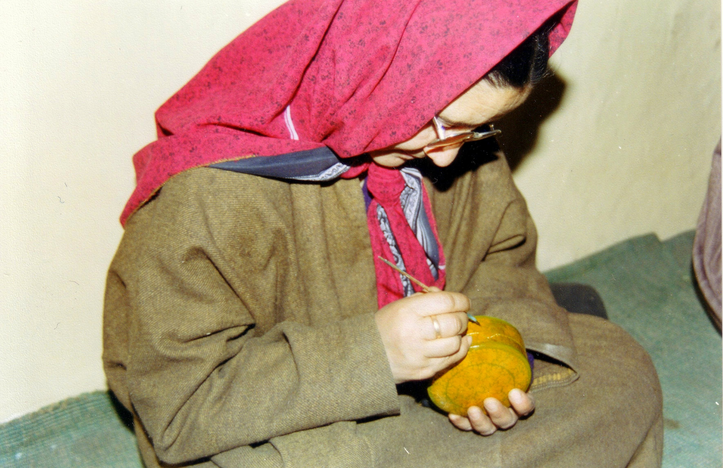

Slide 26
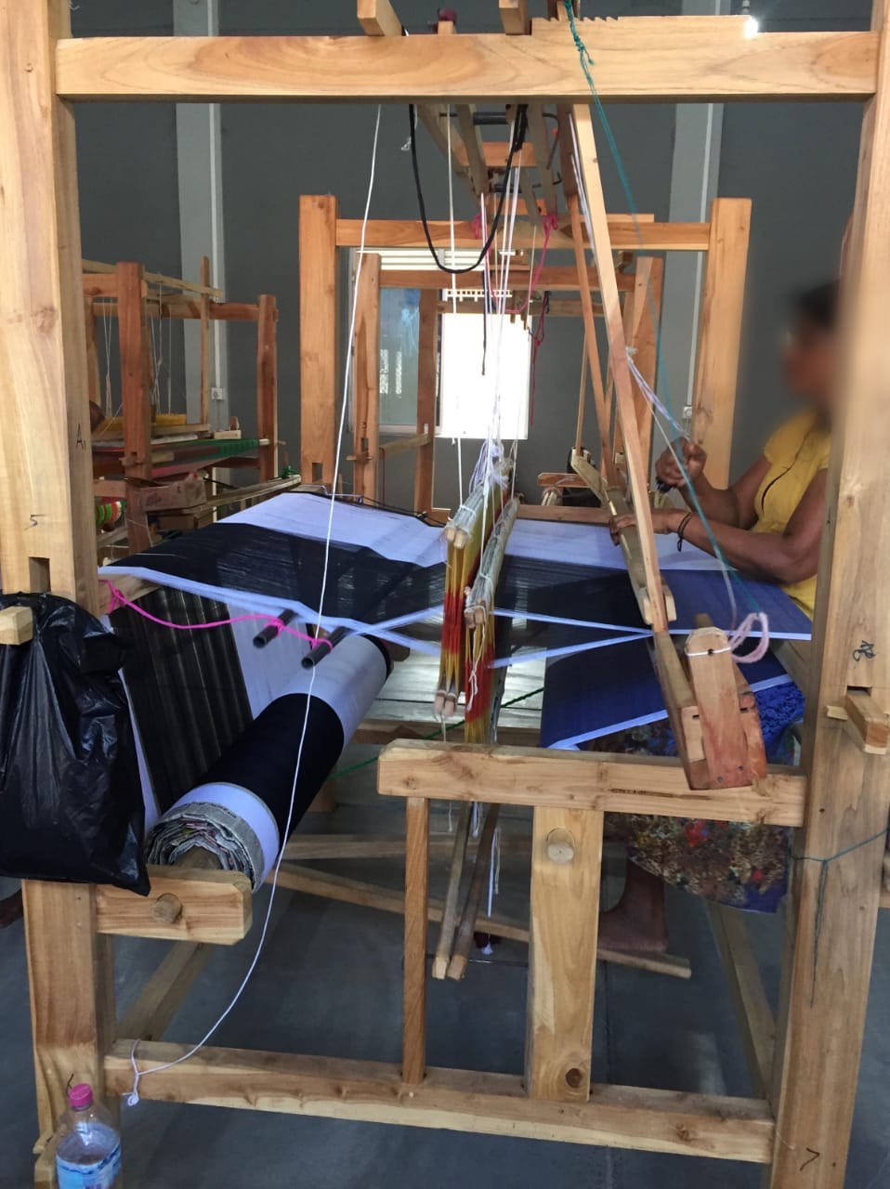
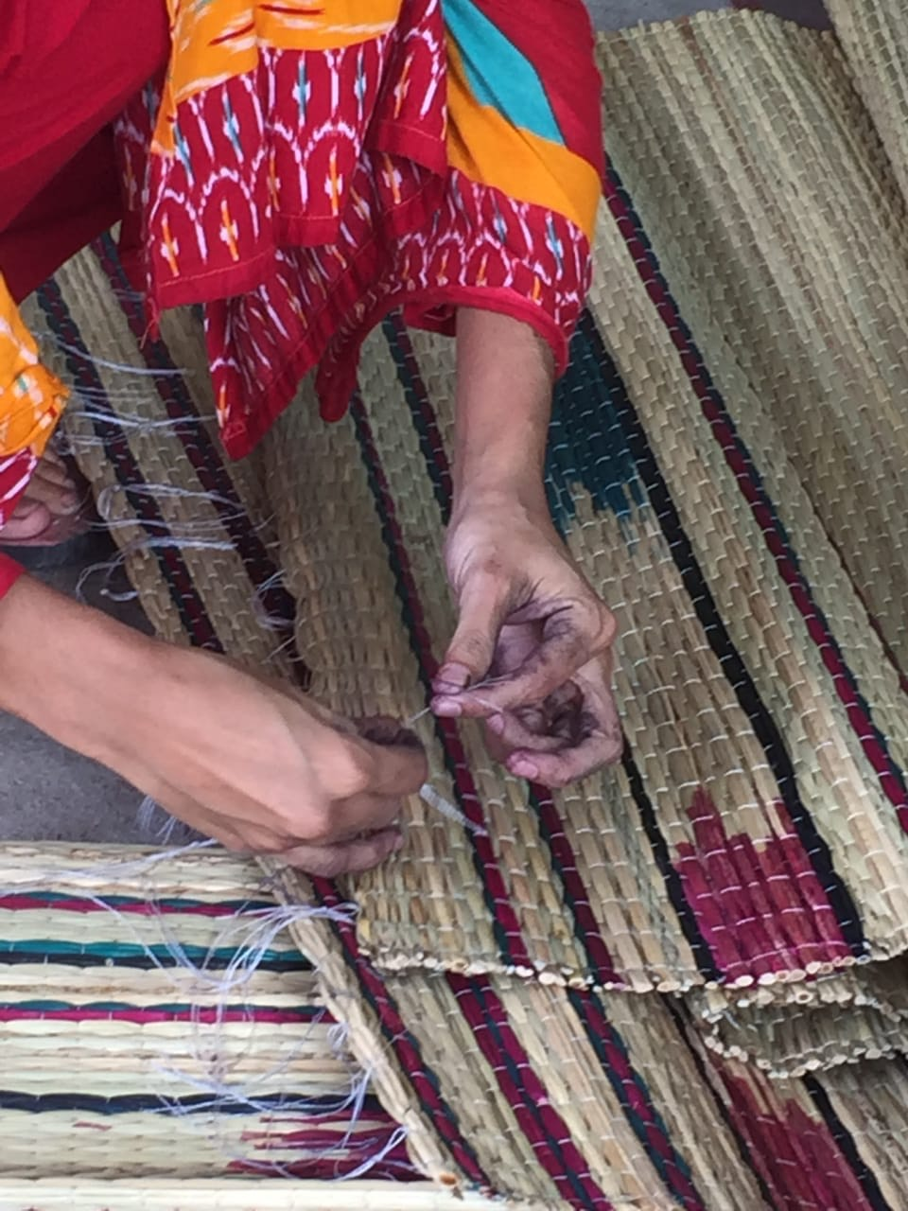

Slide 27
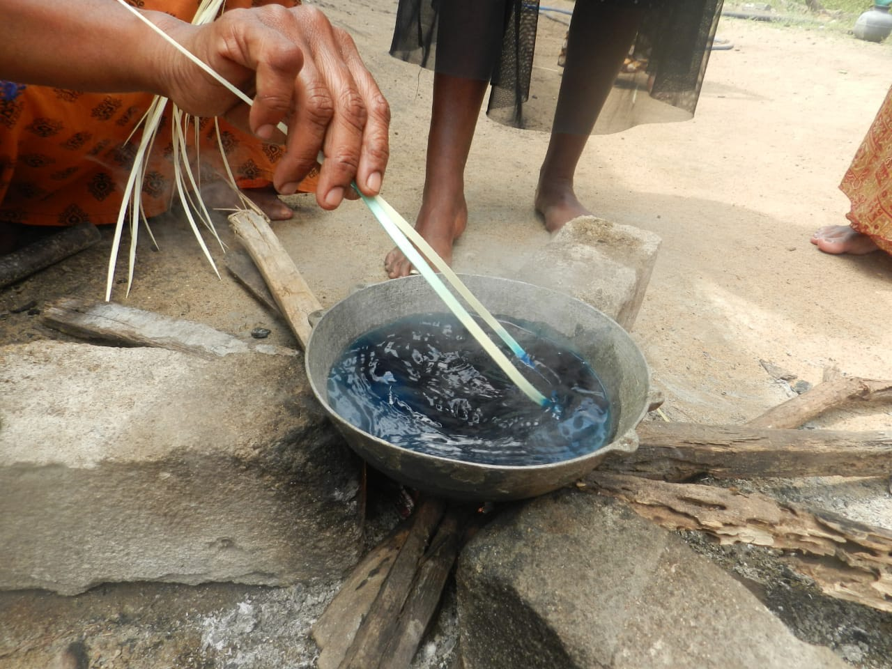

Slide 28
Art + Craft + Dignity + Livelihood = Resilience?
Kashmir Srinagar Poonch Nagrota Rajouri Jammu Kabul Kandahar Quetta Rawalpindi Charsadda Swat Laspur Kargil Muzaffarbad Kandy Colombo Batticaloa Mannar Samawaah Erbil India Iraq Afghanistan Sri Lanka Pakistan Kurdistan Khyber Pakhtun Khawa

