Slide 1
Action Learning Symposium 2021
Dr Chandana Sanyal
and
Dr Julie Haddock-Millar

Slide 2
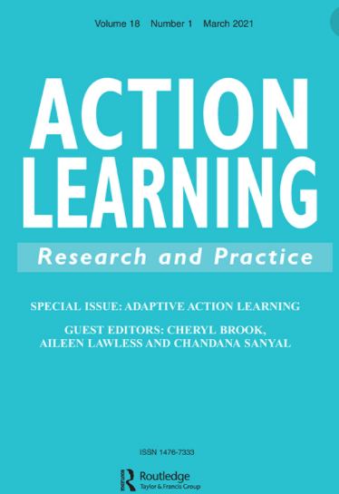
The ethos of Action Learning within a Virtual Reflective Practice Forum
An account of practice drawing connections between action learning, community of practice and supervision frameworks.

Slide 3
AGENDA
Outline the Reflective Practice Forum (RPF)
Our role as Action Learning Facilitators
Our RPF Framework and connections between Communities of Practice and Supervision frameworks.
Final thoughts

Slide 4
Reflective Practice Forum
Notes:
Over time, numerous studies have been published, and numerous definitions have emerged, such as:
“Resilience is the process, capacity or outcome of successful adaptation despite challenges or threatening circumstances … good outcomes despite high risk status, sustained competence under threat and recovery from trauma.” (Masten, Best & Garmenzy, 1990, p.426)
“Resilience … individual … refers to successful adaptation despite risk and adversity.” (Mastern, 1994, p.3)
“Capacity to overcome personal vulnerabilities and environmental stressors, to be able to ‘bounce back’ in the face of potential risks, and to maintain well-being” (Oswald, Johnson, & Howard, 2003, p. 50).
“Capacity to continue to ‘bounce back’, to recover strengths or spirit quickly and efficiently in face of adversity … a dynamic construct subject to influence by environmental, work-specific and personal contexts” (Sammons et al., 2007, p. 694).
“Resilience is the capacity to bounce back from disruptions … resilience is the capacity to continue making progress toward your current career goals with the resources and strategies you have already developed.” (Seibert, Kraimer & Heslin, 2016, p. 245).

Slide 5
Our role/s as a Facilitator of the RPF
Notes:
Over time, numerous studies have been published, and numerous definitions have emerged, such as:
“Resilience is the process, capacity or outcome of successful adaptation despite challenges or threatening circumstances … good outcomes despite high risk status, sustained competence under threat and recovery from trauma.” (Masten, Best & Garmenzy, 1990, p.426)
“Resilience … individual … refers to successful adaptation despite risk and adversity.” (Mastern, 1994, p.3)
“Capacity to overcome personal vulnerabilities and environmental stressors, to be able to ‘bounce back’ in the face of potential risks, and to maintain well-being” (Oswald, Johnson, & Howard, 2003, p. 50).
“Capacity to continue to ‘bounce back’, to recover strengths or spirit quickly and efficiently in face of adversity … a dynamic construct subject to influence by environmental, work-specific and personal contexts” (Sammons et al., 2007, p. 694).
“Resilience is the capacity to bounce back from disruptions … resilience is the capacity to continue making progress toward your current career goals with the resources and strategies you have already developed.” (Seibert, Kraimer & Heslin, 2016, p. 245).

Slide 6
Themes/issues explored by the Programme Managers
Mentor / coach and mentee / coachee ‘best fit’ match
Relation rift between the mentor / coach and mentee / coachee
Feedback to a mentor / coach that is not the right ‘fit’ for the programme
Challenges building supervision/ on-going support for mentor/ coaches within programmes
Design of impact evaluation strategies, tools and techniques
Explored working simultaneously with internal and external mentors
Impact of COVID-19 on practice

Slide 7
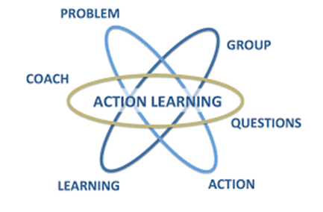
Action
Learning
Community of Practice
Supervision
Participants shared their own experiences, including challenges, asked questions and sought clarifications, leading to further insights of the practice of coaching and mentoring programme management.
We facilitated a supportive learning space to engage in and share practice experiences and offered advocacy as required to enable the participants to build competence and confidence in their practice.
Some principles and features of COP had been adapted within the RPFs to offer a space for on-going learning and building a network.

Slide 8
Ethos of Action Learning
Sharing and insight
Development and network of practice
Ongoing learning and action
Individual and collection reflection
Mutual support and growth
Reflective Practice
Forum Framework

Slide 9
Development, learning and reflection are at the core of the RPF.
RPF is a vital source of CPD for Mentoring and Coaching Programme Managers..
Notes:
Over time, numerous studies have been published, and numerous definitions have emerged, such as:
“Resilience is the process, capacity or outcome of successful adaptation despite challenges or threatening circumstances … good outcomes despite high risk status, sustained competence under threat and recovery from trauma.” (Masten, Best & Garmenzy, 1990, p.426)
“Resilience … individual … refers to successful adaptation despite risk and adversity.” (Mastern, 1994, p.3)
“Capacity to overcome personal vulnerabilities and environmental stressors, to be able to ‘bounce back’ in the face of potential risks, and to maintain well-being” (Oswald, Johnson, & Howard, 2003, p. 50).
“Capacity to continue to ‘bounce back’, to recover strengths or spirit quickly and efficiently in face of adversity … a dynamic construct subject to influence by environmental, work-specific and personal contexts” (Sammons et al., 2007, p. 694).
“Resilience is the capacity to bounce back from disruptions … resilience is the capacity to continue making progress toward your current career goals with the resources and strategies you have already developed.” (Seibert, Kraimer & Heslin, 2016, p. 245).

Slide 10
Dr Chandana Sanyal
E-mail: c.sanyal@mdx.ac.uk
Dr Julie Haddock-Millar
E-mail: j.haddock-millar@mdx.ac.uk

