Slide 1


Development Theory and Tourism: What has theory ever done for us?
David Harrison
29th August 2014: Keynote address: International conference on Tourism and Development: Growth and Diversity. Centara Duangtawan Hotel, Chiang Mai, Hosted by Centre for Tourism Studies and Academic Services, Dept. of Tourism, Faculty of Humanities, Chiang Mai University, Thailand

Slide 2
OUTLINE OF PRESENTATION
The beginnings of Development Theory
Dominant theories of the 20th century
The end of development theory?
Applications of Development Theory to Tourism
Tourism and ‘development:’ the need for a new approach
A Working Model of International Tourism, with reference to ASEAN

Slide 3
1. The Beginnings of Development Theory
Social theory of 18th & 19th centuries. Social Change = development?
Familiar fathers?
Marx: primitive communalism – capitalism – communism
Durkheim: mechanical - organic solidarity
Weber: charismatic – traditional – rational-legal society
Planning: 1914 Russian Revolution; World Wars I & II; 1959f Cuba
‘1940s ff: ‘Development,’ aid & competition for ideological allegiance of ‘new nations’ of 3rd World

Slide 4
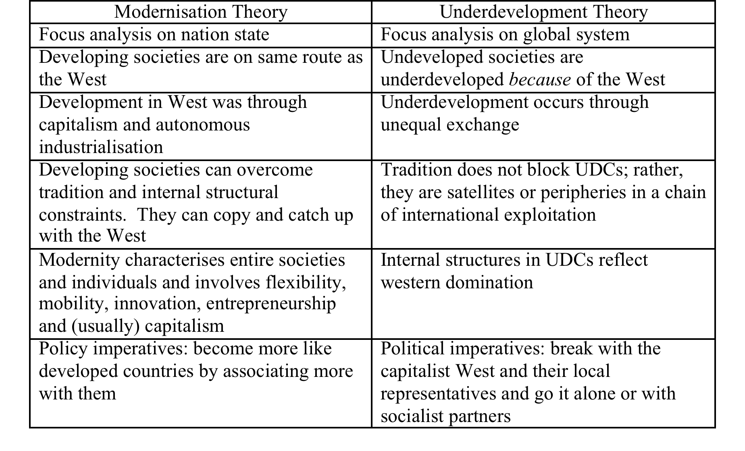
2. Dominant Theories of the Twentieth Century

Slide 5
Problems with the theory
Not ‘paradigms:’ (beliefs of scientific community or ‘disciplinary matrix’ & ‘exemplars’).
Took on cult status & became items of faith and either – or. Internal factors or External linkages?
Underplayed empirical evidence: were people better off under one system? Did benefits ‘trickle down’? Did socialist co-operation really work? Did any country successfully opt out of the world system?
Could not deal with NICs: were capitalist, with state subsidies & interventions, wanting free trade.
Were theoretically inadequate, empirically wrong & politically useless.

Slide 6
Later development theory
By 1980s, MT & UDT discredited. Confirmed by fall of Berlin Wall 1989. End of grand theory.
Neoliberalism & neostatism. Overlapped with MT & UDT & were extensions of them. Market or State? Informed by ASEAN examples.
Environmentalism/Sustainability. Since 1970s. Definition? Ambiguous. Much rhetoric. Noble aspirations but much greenwashing.
Alternative development. Residual category, inc. basic needs, participation, gender issues, poverty alleviation, human development index, etc.
Postdevelopment. Plague on all your houses. Convert? Stop consuming? Rely on technological fixes or human goodwill?

Slide 7
3. The end of development theory?
No single over-arching theory or ‘paradigm.’
‘globalisation theory’ – an umbrella term incorporating internal & external factors, economic, social, cultural & environmental variables.
Focus on empirical research & lower-level projects, e.g. poverty alleviation, participation, gender equality, etc.
  ‘Contemporary development studies, although still a sizeable academic enterprise in many Western countries, is at the same time an uncertain and under-confident discipline’ (Payne & Phillips, 2010:3).

Slide 8
4. Applications of Development Theory to Tourism
MT: Little direct theorising but default approach of most social scientists & policy makers. Commoditisation, authenticity, modernity, economic growth. Extends into neoliberal approach: tourism = increased growth = free market = development. Largely descriptive
UDT/World Systems. Preferred position of radical critics (e.g. Britton, 1989). Against international capital but rarely adopted by policymakers, who want more tourists. Advocates role for state. Exceptions: Tanzania & Jamaica in 1970s.
Sustainable tourism development. Useful guidelines but neither a theory nor a paradigm. A politically correct term to use in development plans.
Alternative tourism? Residual category = everything except mass tourism.
Ecotourism? Usually = small-scale & indigenously owned.

Slide 9
5. Tourism and ‘development:’ the need for a new approach
There is no ‘grand theory’ or ‘paradigm’ of tourism as a development tool
General focus is on empirical matters, description, increased growth etc.
In practice, MT is implicit in most policies and academics remain suspicious of tourism, especially mass tourism
MT, UDT, neoliberalism, neostatism, alternative tourism, sustainability etc. all co-exist but none dominate. Within globalisation theory, both internal factors & external linkages are considered important.
A variety of disciplines look at different facets of tourism but in disconnected ways – so we argue about ‘disciplines’ & ‘tourism studies.’

Slide 10
FOUR BASIC ASSUMPTIONS
UNDERLYING ANALYSIS OF TOURISM AND DEVELOPMENT

Slide 11
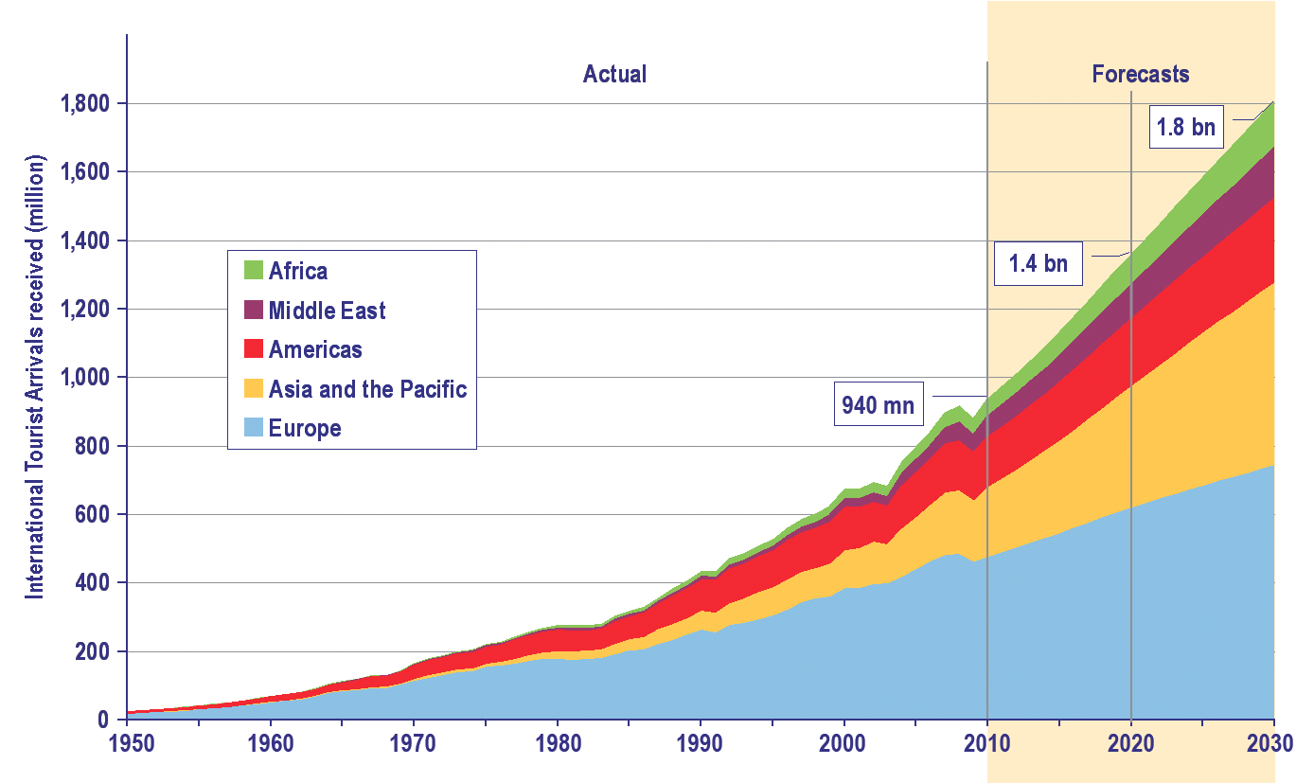
Capitalism (in some form or another) & international tourism will continue for the foreseeable future.
Tourism Trends to 2030 UNWTO 2014: 14

Slide 12
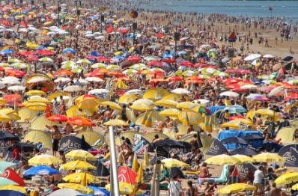
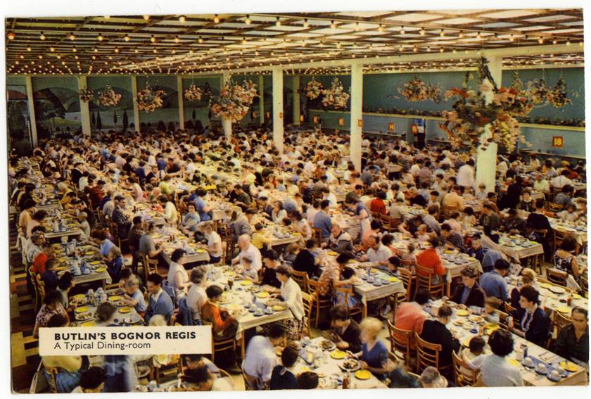
Large scale tourism is and will continue to be the norm.
Unknown beach 2000s
Butlins Holiday camp,
UK 1940s

Slide 13
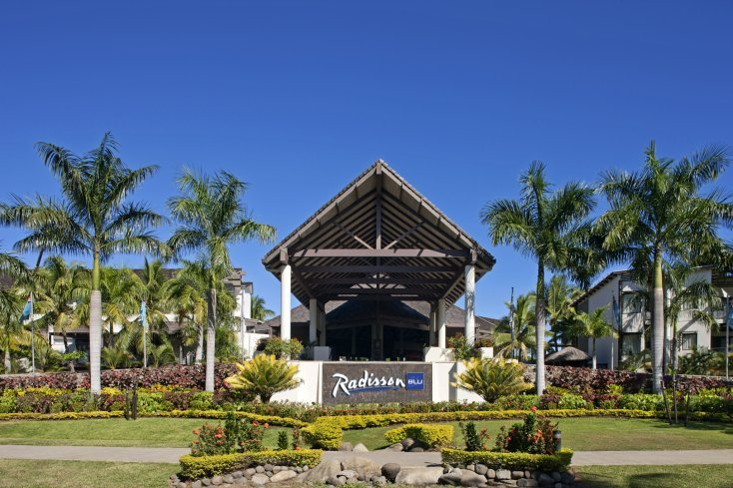
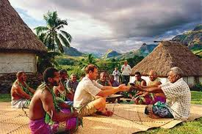
Alternative tourism is normally linked to/dependent on large-scale tourism but will not & should not replace it
Hotel guests on a
village visit in Fiji

Slide 14
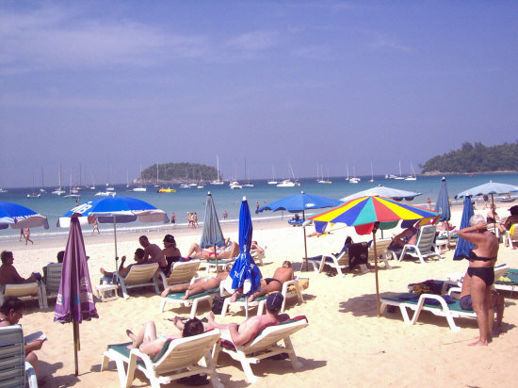
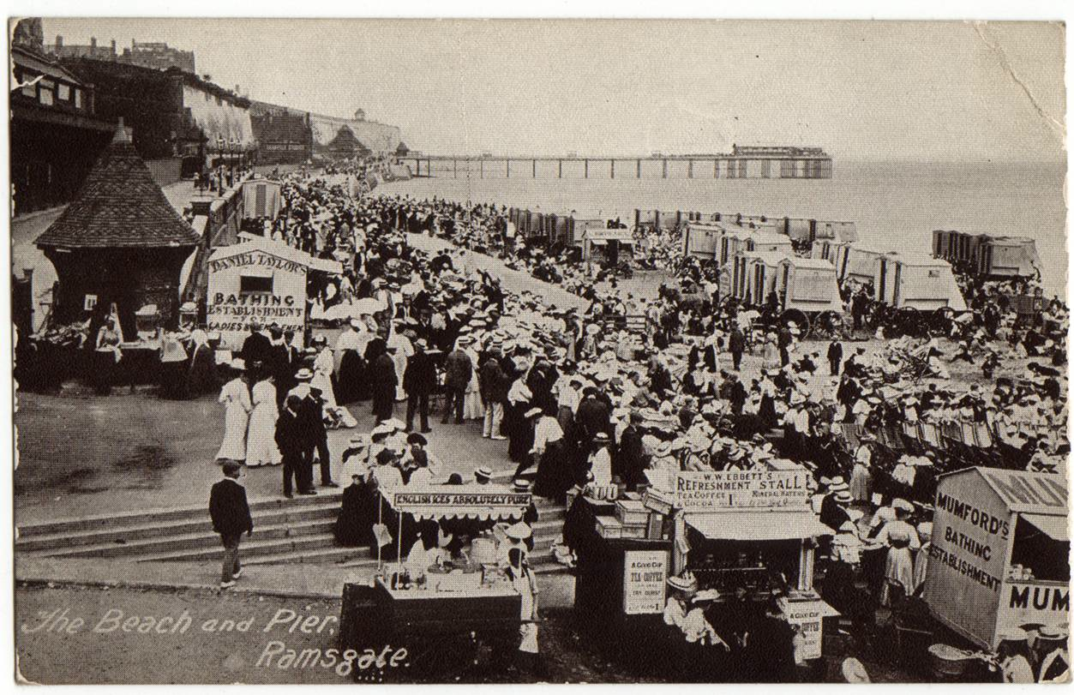
D. Tourism is international & destinations are interlinked
Kata beach Phuket
Mass tourism, Ramsgate UK: 1910s

Slide 15

A WORKING MODEL OF INTERNATiONAL TOURISM
Tourist receiving & sending societies
Tourist industry, the state, economies, social
Structures & cultures, environment, technologies
Tourism linkages & Impacts
Economic, sociocultural & environmental
Tourist motivations & Interaction Types of tourist The journey
‘push’ & ‘pull’ factors Tourists & residents Tourist typologies
International Organisations

Slide 16


Some external factors relevant to ASEAN tourism
Colonialism Spread of English language, specific social structures, development of the image’ of ‘the other,’ infrastructural development. Land ownership? Existence of a colonial class with finance capital? Colonial mode of tourism production?
1920s Changed attitudes in West to sun & health. Seaside resorts in N. Europe decline; those in S. Europe & elsewhere become more popular. Thailand now no. 1 in Global Beachfront Awards!

Slide 17
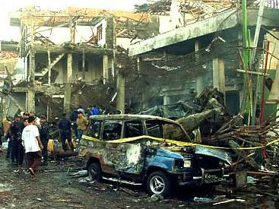
Wars Sino-Japanese Wars, WWI/Pacific War, etc. Continued tensions among China, Japan, Korea etc. Reduces potential for tourism.
American/Vietnamese War 1959-1975. Thailand & R & R. Changing state tourism policies in Viet Nam, Cambodia & Lao PDR.
1990sf Increased militant, Islamic
fundamentlism
Bali bombings
Now Increasing awareness of global warming & climate change. Impacts still unclear. El Nino & other climate patterns
‘Good’ weather in source societies: less outbound tourism.
2007 Global Financial Crisis. relatively little effect on ASEAN tourism?

Slide 18
Now National holiday periods for schools & workers. e.g. Spring Festival (Chinese New Year) & Labour Day period, China (Viet Nam, Korea, etc.) A global phenomenon affecting seasonality.
Influence of media, e.g. Lost in Thailand (2012)
Now Economic growth in neighbours, especially China. Removal of travel restrictions; rise of middle class with disposable income.
Sociocultural change in sending societies. e.g. ‘new tourism’ in West; changing cultural context affects motivations and types of tourists
Now Slash & burn agriculture in Indonesia – the ‘haze’ affecting Malaysia, Singapore etc.
  Loss of MH370 on 8th March.
  Loss of MH17 on 17th July over Ukraine – an external event with major local & regional consequences

Slide 19
Some internal/external linkages
Provision of ‘forbidden’ services in destination areas. e.g. gambling in Macau & Hong Kong, prostitution in Thailand
Health problems in specific countries, e.g. SARS & Avian Influenza in 2003; Ebola virus in West Africa.
Domestic or regional unrest. e.g. coups in Thailand. Pattern: reduced tourism, discount pricing & reduced receipts from tourism.
Changing overseas perceptions & domestic politics. Myanmar.
Changes in government policies re tourism. e.g. in Lao PDR, Thailand & Viet Nam; debates over foreign investment, e.g. Thailand.
Changing attitudes to hedonistic tourism, e.g. Vang Vieng in Lao PDR

Slide 20
TO SUMMARISE
Tourism development in one place is always linked to processes & events elsewhere.
We cannot understand tourism in our region or nation state unless we also understand what has happened & what is happening elsewhere.
In this sense, UDT is correct: external linkages are important.
State action can also make a difference, for good or ill. Our tourism destinies are (to some extent) in our own hands.
Social change is a global phenomenon and social change defined as progress, as ‘development,’ is desired everywhere. For many, this means economic growth and modernity and tourism is a way of achieving them.
No development theory that provides all the answers but there are models that enable us to ask the most pertinent questions.
And start with mass tourism! The elephant is in the room!

Slide 21
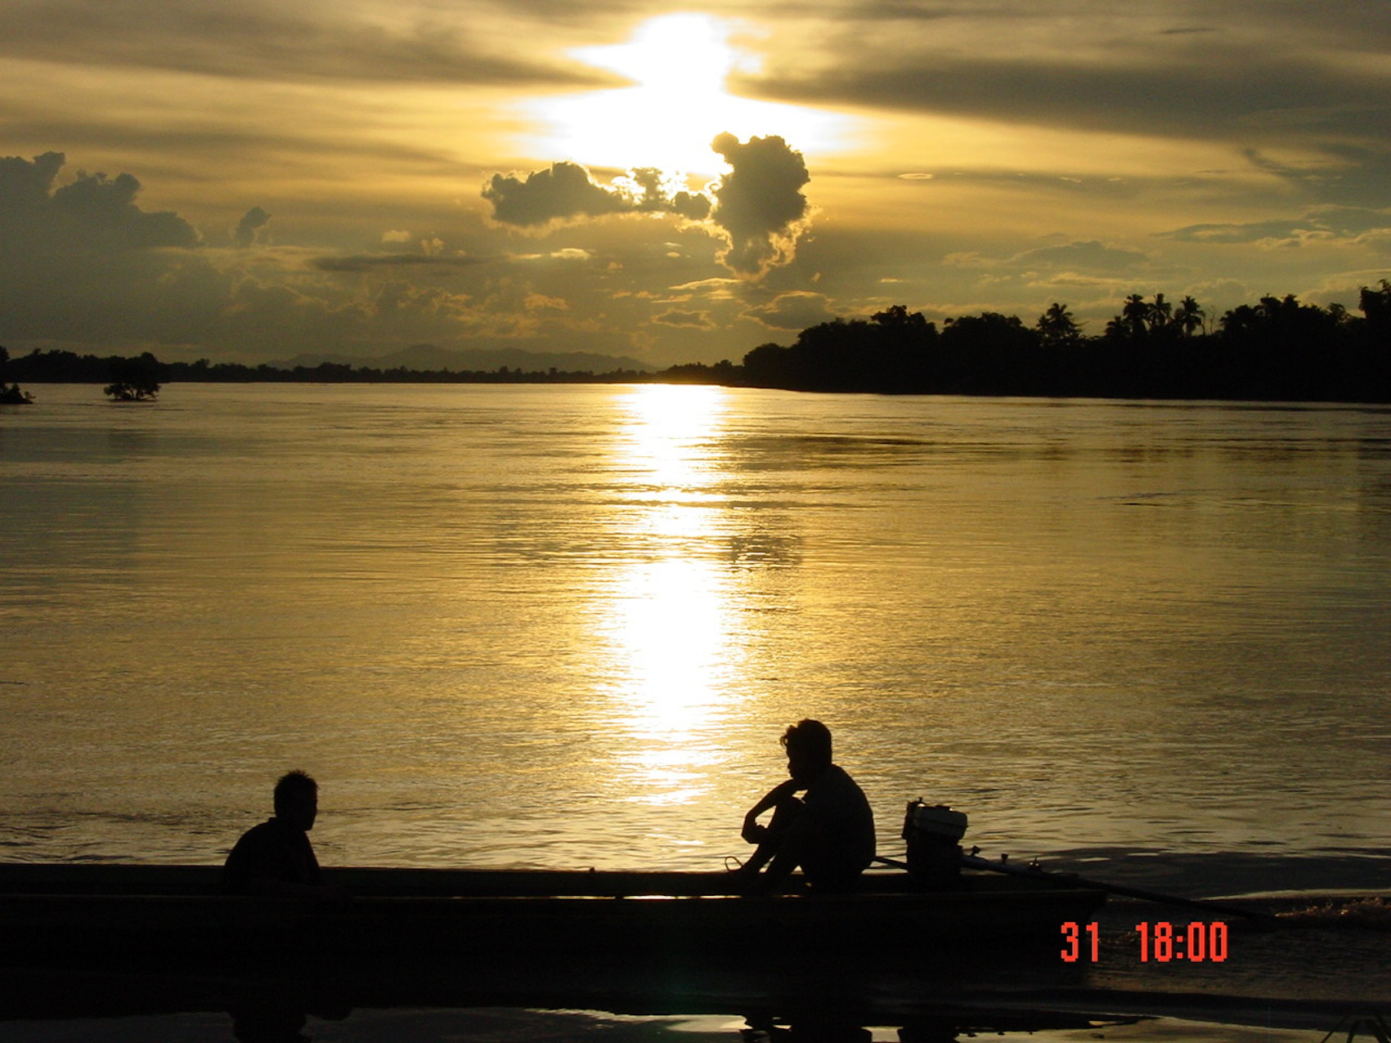
khàwp khun

Slide 22
References
Britton, S. (1989) Tourism, dependency & development: a mode of analysis. In T.V. Singh, H.L. Theuns & F. Go, eds. Towards Appropriate Tourism: the case of developing countries. Frankfurt & Berne, Peter Lang: 93-110.
Payne, A. & Phillips, N. (2010) Development Cambridge: Polity Press.
UNWTO (2014) Tourism Highlights, 2014 edition. Madrid: UNWTO.

