Slide 1


LOOKING EAST BUT LEARNING
FROM THE WEST?
David Harrison
davidharrison53@btinternet.com

Slide 2
THE BASIC ARGUMENT
While there were some differences, the processes through which domestic mass tourism developed in the West in the nineteenth century were repeated with international tourism post-1945 and later in the rise of mass tourism in East Asia in the late twentieth and early twenty-first century

Slide 3
Presentation Outline
The mid-nineteenth century rise of domestic mass tourism in England
Mass international tourism post 1945: Europe
The growth of mass international tourism in Japan
China: a world power in tourism
What is so special about East Asian tourism, especially the Chinese? Do we need a new ‘paradigm’?

Slide 4
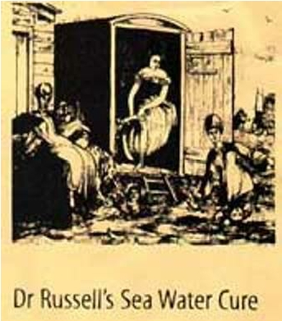
Causes of the expansion of mass tourism
Changes in medical knowledge – bathing in sea water became fashionable in the mid-eighteenth century
Because of this cultural change, seaside resorts started to develop and increasing numbers travelled by road by coach or by steam ship.
Peace after the Napoleonic Wars (1792-1815)

Slide 5
Prosperity as the British population started to benefit from the industrial revolution: fall in death rates and infant mortality rates; improvements in public health. Massive expansion in population and growth of cities.
Major changes in the technology of transport. The railways transformed the British (later, European and American) economy. Resorts closest to cities (and with the fewest natural barriers) developed first.
  Brighton 1837: 50,000 visitors; 1860 (railway completed): 250,000 visitors; 1875: 600,000 to the West pier alone.
  Blackpool: Winter Gardens (1875) held 7.000 people. Its ballroom could accommodate 3,000 dancers. By late 1930s, 7 million visitors a year.
The middle classes rented houses (bringing their own servants) and poorer people stayed in bed and breakfast or came as day trippers.

Slide 6
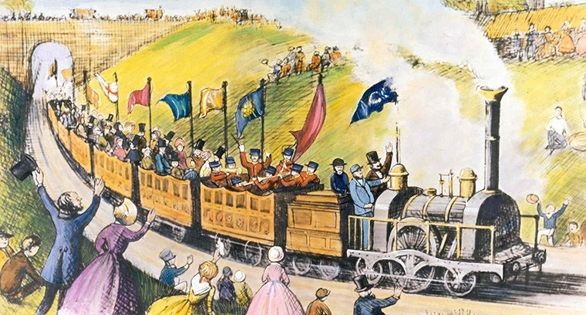
Thomas Cook and the Package Tour
Leicester to Loughborough for temperance meeting
First trip to Scotland
1860s Paris and Switzerland
1908 Cooks open Japan office

Slide 7
Impacts of mass domestic tourism
It is a genuinely, initially temporary mass movement of population from cities to the seaside and countryside.
It transformed small coastal villages into urban centres of population, drawing on their hinterlands for working and prompting mass migration.
These urban centres became ‘growth poles’ or centres of ‘development’
They also became ‘pleasure peripheries’ to the large industrial cities. Tourists went there for fun, for pleasure, to ‘let their hair down.’
These new towns depend on their prosperity for tourism, relying initially on their natural attractions (the sea) and then much more on secondary attractions.
Led by the British, a similar process occurred in Europe and North America
Later, in the 1920s, changed attitudes to the sun and its dangers/benefits were reflected in new patterns of holiday taking.
17

Slide 8

NOT EVERYONE WAS HAPPY
William Wordsworth (unsuccessfully) opposing the construction of the Kendal and Windermere Railway in the (English) Lake District in the 1840s:
There would be ‘cheap trains pouring out their hundreds at a time along the margin of [Lake] Windermere’ and excursionists from the industrial towns of Lancashire and Yorkshire wanting ‘wrestling matches, horses and boat races without number.’ There would also be ‘pothouses and beershops run ‘by the lower class of innkeepers.’

Slide 9

Rev. Francis Kilvert, 1870, on meeting two tourists at Llanthony Abbey in Wales:
Of all noxious animals too the most noxious is a tourist. And of all tourists the most vulgar, illbred, offensive and loathsome is the British tourist.

Slide 10
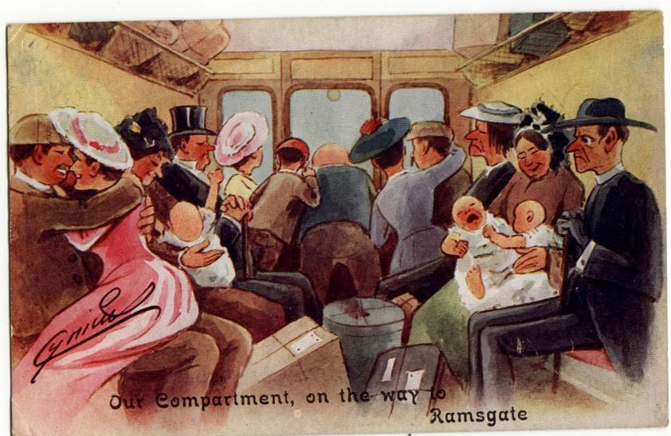
This is a postcard sent by holidaymakers to their friends and relatives c. 1910

Slide 11
The Negative Impacts?
Tourist immorality e.g. drunkenness and public displays of affection
Excursionists came on Sunday and disrupted the Lord’s Day.
Tourists did not spend money in the resorts but brought their own food and (often) their own servants.
Tourism attracted criminals, pickpockets, prostitutes and so on.
Environmental degradation, litter, waste etc.
Lowered ‘the tone’ of nature and their environment. i.e. they were working class!

Slide 12
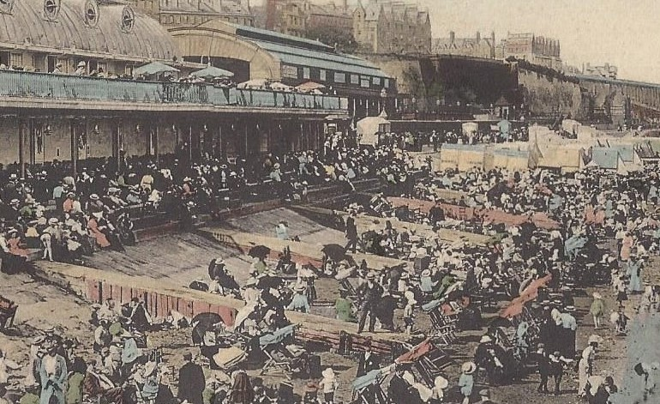
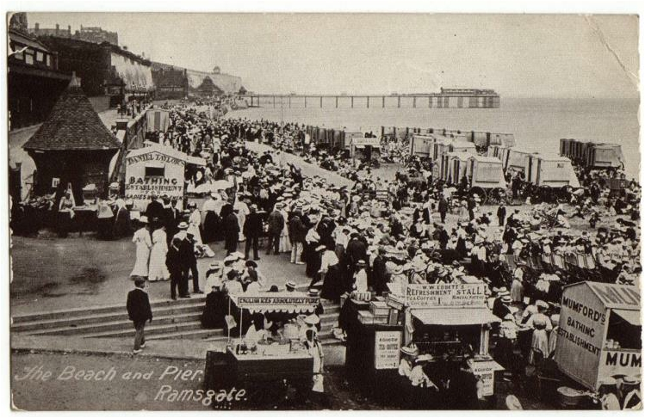
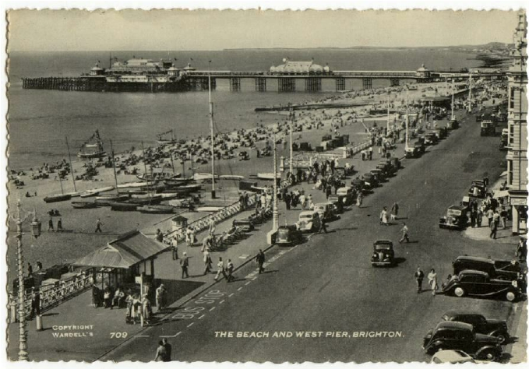
Mass tourism in the late 19th/early 20th century
Ramsgate UK c 1907: note the pier & bathing machines
Brighton, UK c.1010: promenade & pier

Slide 13
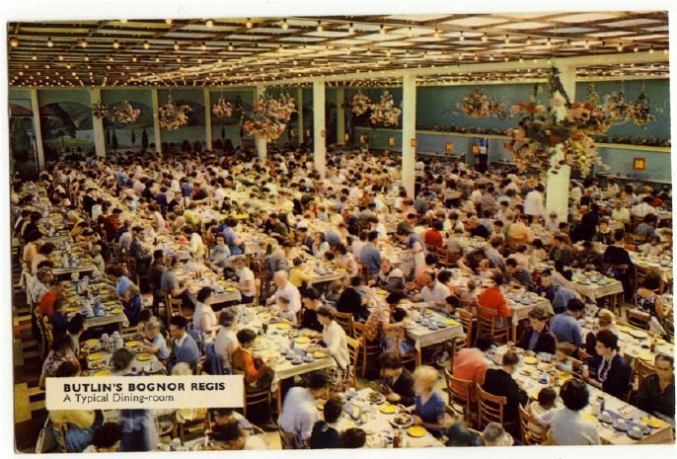
Later Developments
The motor car
The liner (1920s)
The caravan (Caravan Club founded in 1907)
The holiday camp (1930s on)

Slide 14

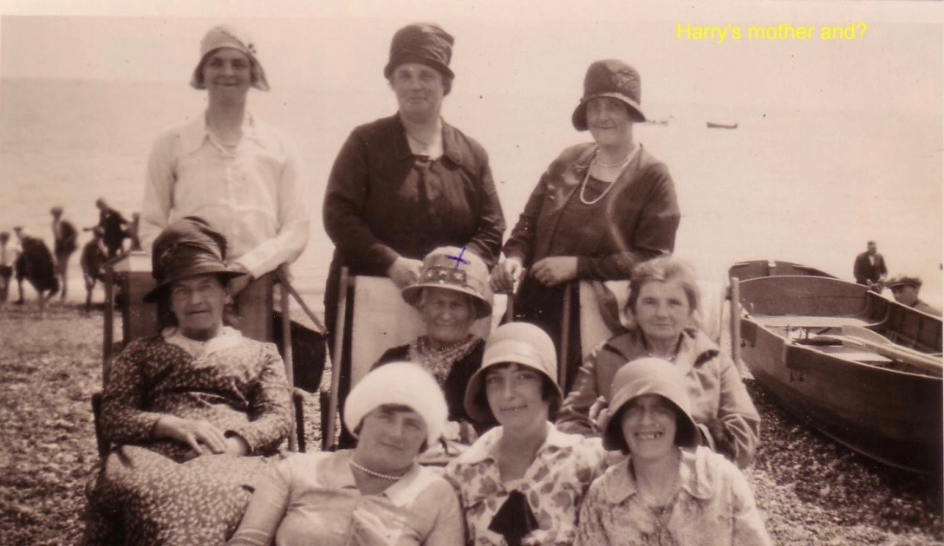

And fashions changed….

Slide 15
Who were the domestic tourists?
Increasingly middle and working class:
Wide variety of interests and motivations: not a homogenous category
  The beach and sea were universal attractions
  ‘Respectable’ visitors wanting classical music, museums and plays
  Important role of seaside orchestras
  Seaside entertainment: blacked-up minstrels, slot machines, freak shows
  With considerable zoning of class interests within and across resorts.

Slide 16
2. Mass International tourism Post-1945
Since 1945, massive growth in international tourism
1950 | 25 million
1960 | 69 million
1970 | 160 million
1980 | 285 million
1998 | 600 million
2006 | 846 million
2014 | 1.1 billion

Slide 17
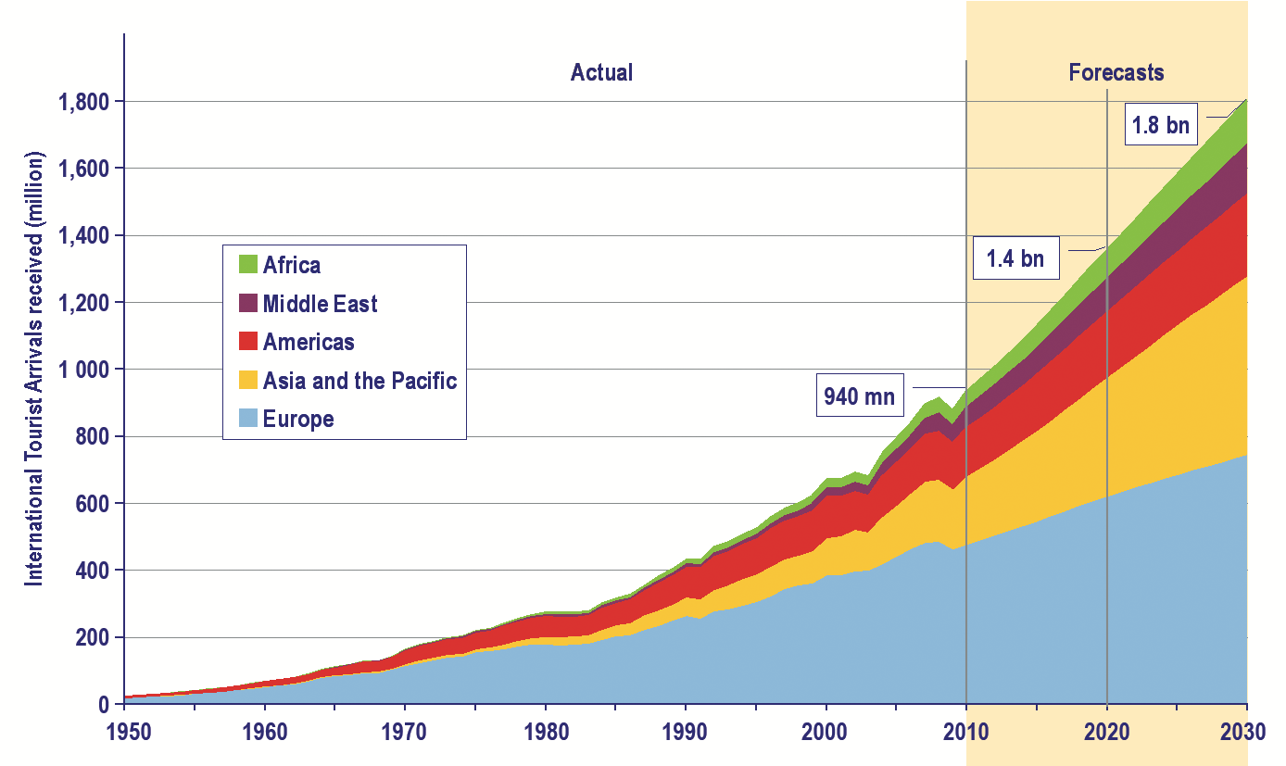
Growth in tourist arrivals since 1950
Note the growth in Asia/Pacific tourism

Slide 18
Western outbound tourism 1950s – 1980s
Causes of Growth
Peace dividend in Europe and North America
Growth of motorised transport and road infrastructure continued, benefiting both domestic tourism and (in mainland Europe) cross-border tourists..
Growth of short-haul charter (package) tourism, especially from UK, Germany and Scandinavia:
  Entrepreneurs used war surplus aircraft and landing strips
  Increasingly prosperous holidaymakers going abroad for first time
  Legislation for increased competition removing protection from national airlines
  Benefited Spain, Italy, Greece, Turkey, Israel, Tunisia, Morocco, Egypt, Israel, Tunisia and Morocco:
  From 1960, charter tourism ‘remapped the Mediterranean’,…turning old, barren and depopulated peripheries into centres of economic growth
Process repeated across Central and East Europe post-1989

Slide 19
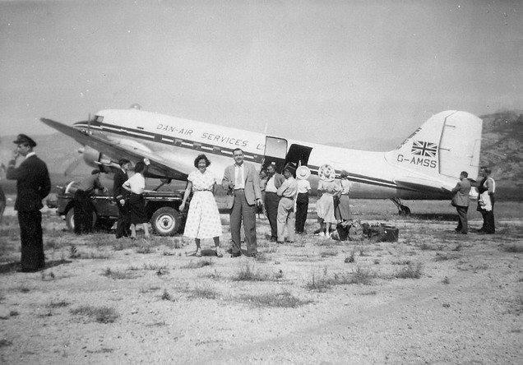
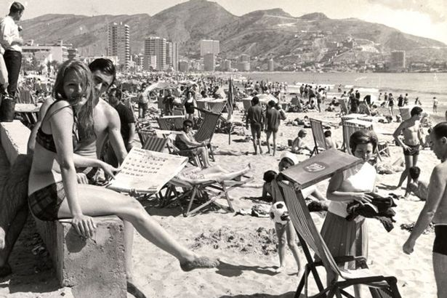
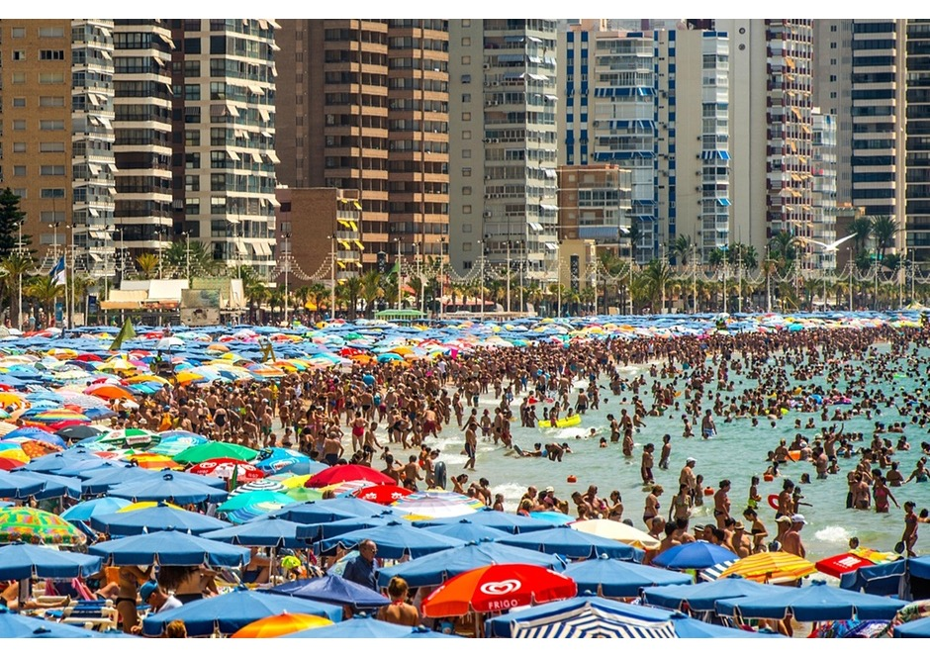
Mid-twentieth century package tourism
1950s charter flight
Benidorm, Spain 1960s and now

Slide 20
The mass tourists of the 1960s and 1970s and beyond
Reasons to travel?
Escape (e.g. from industrialised society to find ‘authenticity’)
Relaxation
To play
To strength family bonds
For prestige/status
Social interaction with like-minded people
Sexual adventures
Education
Self-fulfilment
Wish fulfilment
Types of tourists?
Organised mass
Individual mass
Explorers
Drifters/backpackers
Allocentric/psychocentric
Sightseers and vacationers
Seekers of pleasure or ultimate meaning
(cf Cohen, Ryan, MacCannell and others)
IN SHORT: THERE ARE MANY MOTIVATIONS FOR TRAVEL AND MANY TYPES OF TOURIST

Slide 21
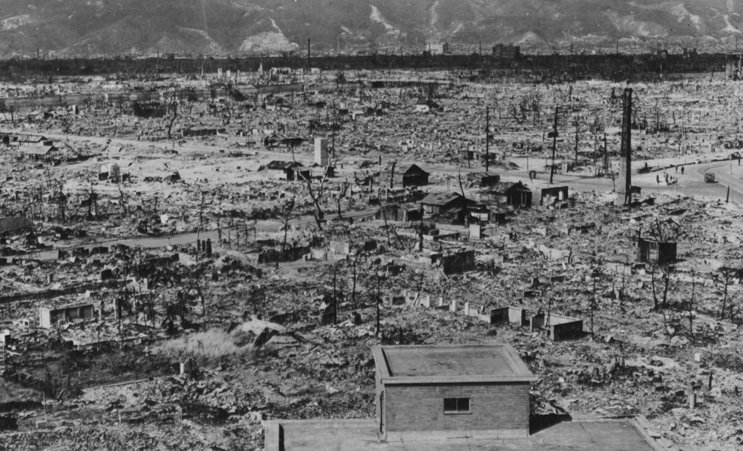
3. Japanese Tourism: from 1970s
As in West, domestic tourism was first, originating in pre-industrial pilgrimage
Outbound tourism developed
slowly after 1945:
a) time to recover from war
b) 1964 reduction in foreign
exchange restrictions
c) Removed in 1978
d) 1970s arrival of wide-bodied jets
e) mid-1980s: the state encouraged outbound tourism as economy boomed
f) Growth from mid-1980s to 2000, then stagnation
g) It took until 2015 for inbound tourism to exceed outbound tourism
Hiroshima 1945

Slide 22
date | Japanese Outbound tourism | Japanese Inbound tourism
 |  | All arrivals | Holidaymakers | % of arrivals
1973 | 2,288,066 | 84,691 | 447,274 | 57.0
1975 | 2,466,326 | 811,672 | 446,420 | 55.0
1985 | 4,948,366 | 2,327,000 | 1,329,000 | 57.1
1990 | 10,997,431 | 3,235,860 | 1,879,497 | 58.1
1995 | 15,298,125 | 3,345,274 | 1,731,439 | 51.8
1999 | 16,357,572 | 4,437,863 | 2,560,343 | 57.7
2000 | 17,818,590 | 4,757,146 | 2,693,357 | 56.6
2005 | 17,403,565 | 6,727,926 | 4,368,573 | 64.9
2010 | 16,637,224 | 8,611,175 | 6,361,974 | 73.9
2011 | 16,994,200 | 6,218,752 | 4,057,235 | 65.2
2012 | 18,490,657 | 8,358,105 | 6,041,645 | 72.3
2013 | 17,472,748 | 10,363,904 | 7,962,517 | 76.9
2014 | 16,903,388 | 13,413,467 | 10,880,604 | 81.1
2015 | 16,213,763 | 19,737,409 | 16,969,126 | 87.2

Slide 23
International arrivals to Japan 2013-2015

Slide 24
Types of Outbound Japanese tourists?
Initially group tours (1964 = 50%) but by 2007 mainly independent (90%)
Kisaeng (male) sex tourism to Thailand & South Korea, mainly 1970s and 1980s
The ‘silver market’ (older tourists)
Returnee colonists to South Korea
Esute tourism: young, single ‘office ladies:’ cosmetics, health and shopping
Hallyu tourism: older Japanese women seeking old Japan in Korean TV soaps
History tourism
Dark tourism: visits to Second World War sites
Tropical island tourists, e.g. honeymooners and divers
Seekers of iconic modernity, e.g. e.g. Hollywood and Disneyland
Literary tourists, e.g. sites associated with Beatrix Potter, the Brontes, or such films as Harry Potter.

Slide 25
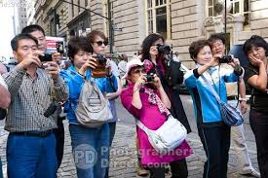
A common complaint about Japanese tourists………

Slide 26
Japanese tourism 2015
Outbound tourism: preference for long-haul travel but slowdown because of economic stagnation.
Japanese led the growth in East Asian tourism since the 1980s
2015: 8% of GDP and 7% of employment
4th largest travel and tourism economy in the world (WTTC) with Japanese among highest spenders
International and domestic tourists attracted to historic villages, theme parks, national parks, heritage sites and ‘fantasy’ sites. ‘Nostalgia rules?’
Inbound tourism is mainly regional, with China increasingly dominant because of young and aspiring middle class. In 2015, China overtook South Korea as primary source of tourists = 25% of all arrivals and 40% of all tourist expenditure.

Slide 27
4. The growth and growth of Chinese Tourism
Historical background
From late 1900s
  Conflict with Japan (Sino-Japanese War 1937-1945)
  1921f - intermittent civil war between communists and nationalists
  External wars – Korean (1952-1953); India (1962) and tensions with USSR
Internal discord
  1950s: land reform and redistribution of land; Hundred Flowers Campaign and Anti-Rightist Movement (1957); Great Leap forward for self-reliance (1958-1961); famine (1958-1962)
  Cultural Revolution and Red Guards (1966-1967 to 1976)
Tight control of internal and outbound travel
1970s: Death of Mao ZeDong 1976; Deng Xiaoping becomes leader 1978 and announces ‘Four Modernisations’ of agriculture, defence, science and technology.

Slide 28
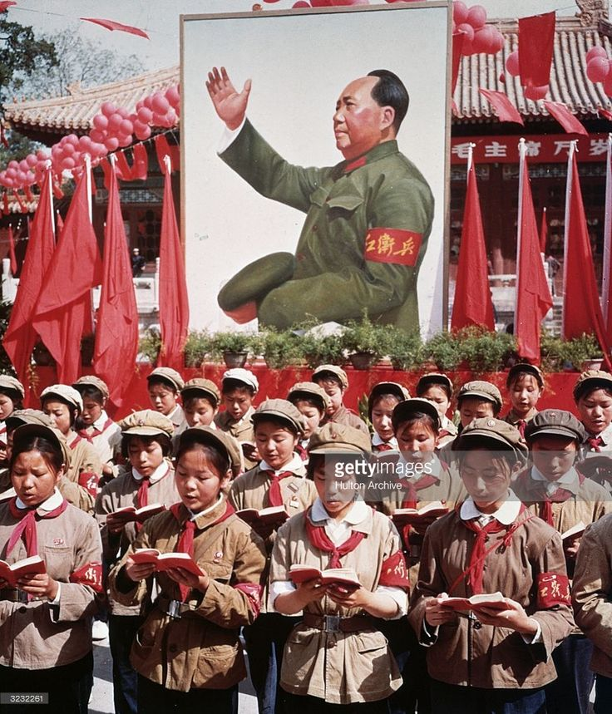
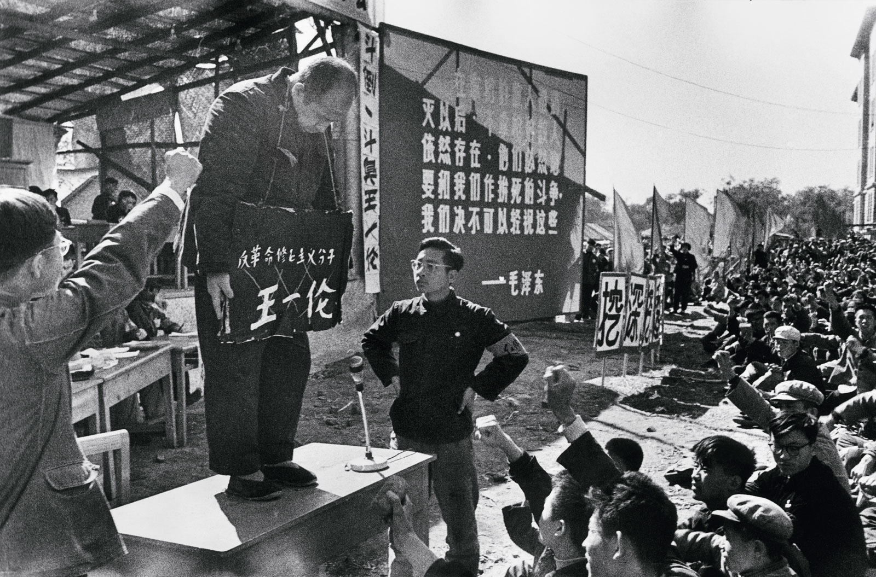
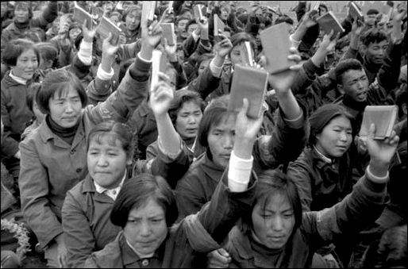
The Cultural Revolution 1966/7 - 1976

Slide 29
Domestic tourism in China
1978f
Annual growth rate 10% plus
Emerging middle class, by 2002 bigger than that of the USA
Increase in disposable incomes
1990s Domestic tourism encouraged by government for economic and social reasons – ‘a catalyst for the development of inland regions’
1999 Instigation of Golden Weeks holiday periods
        1994 – 524 million domestic tourists
        2014 – 3.6 billion
        2015 4 billion (estimated)
75% domestic tourists are urbanites, favouring coastal cites, e.g. Shanghai, Beijing and Chongqing

Slide 30
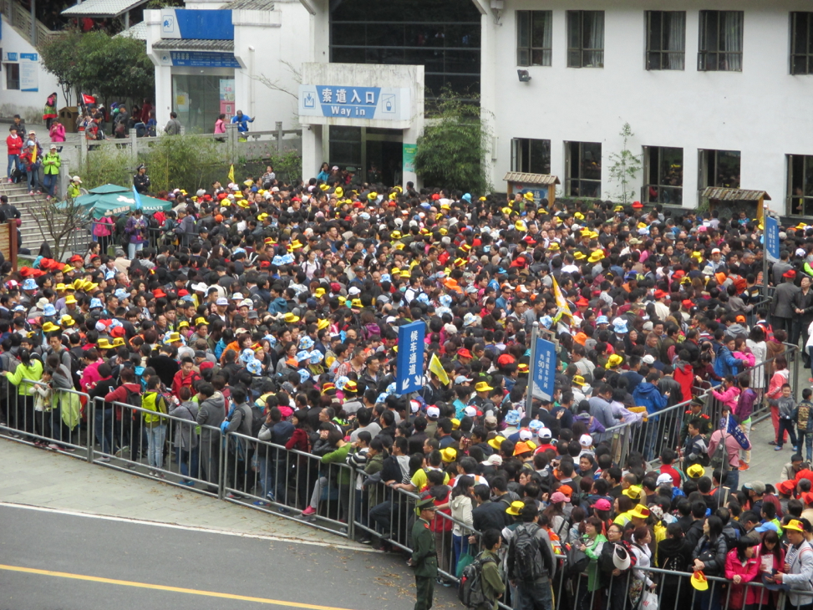
Queue for Gondola Lift, Huangshan, 2015.

Slide 31
Outbound tourism from China
Occurred for same economic reasons as domestic tourism
Increased as restrictions on travel decreased and more countries obtained Approved Destination Status (ADS)
1983 – mid-1990s: VFR permitted to Hong Kong, then Macau, Singapore, and other border countries
2001 China joins world Trade Organisation and outbound tourism increases further.
By 2013, 150 countries had ADS – result of ‘soft diplomacy.’
2000 – 10.5 million outbound trips: 2013 – 95 million
Chinese tourists wanted all over the world….but not always popular

Slide 32
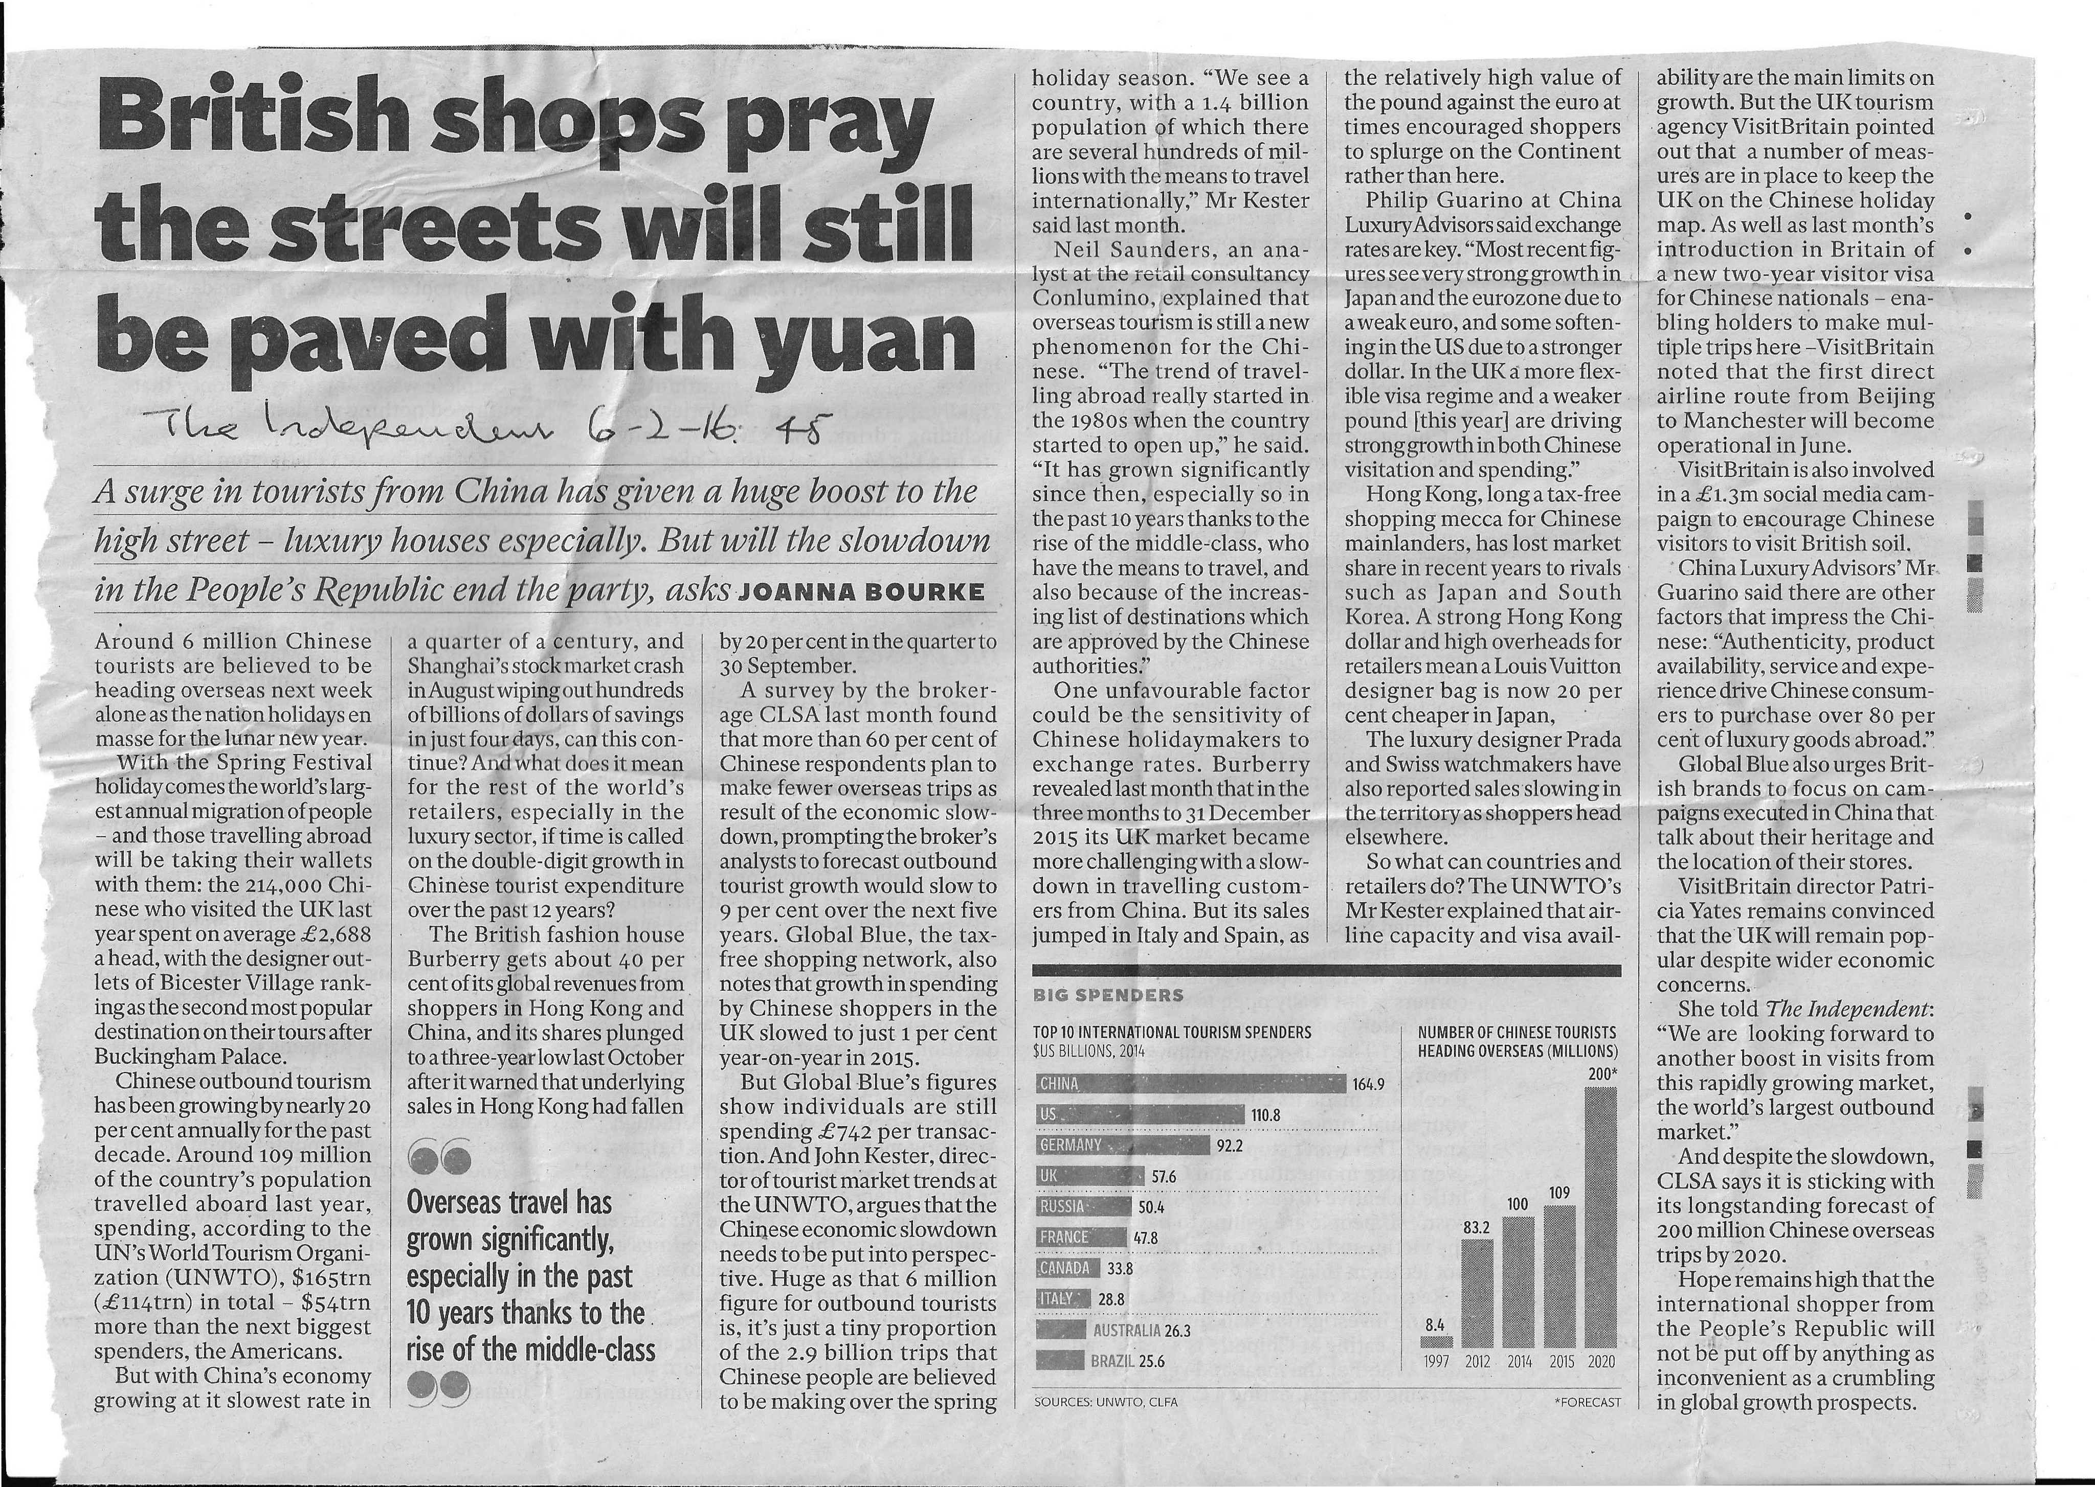

Slide 33
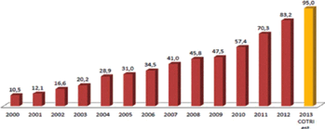
Chinese outbound trips 2000-2013
Arlt 2013: 128

Slide 34
In 2010, THE FOLLOWING PERCENTAGE OF RESIDENTS HELD PASSPORTS
UK - 75%
USA - 46%
CHINA (population 1.3 billion) – apx. 4%

Slide 35
Who are the Chinese outbound tourists?
First generation – new middle class
Second generation - mainly from urban centres – young and middle class
Most go within region – Hong Kong and Macau, Japan, South Korea and Thailand
Long-haul travel (USA, Europe) small but increasing
What do they want?
  Shopping – and ………
  Young travellers – entertainment and adventure
  Long-haul tourists – history, natural and cultural heritage.

Slide 36

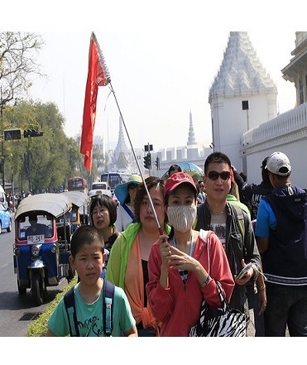
Like all tourists, Chinese tourists attract criticism…
(especially the first generation)
(http://www.eturbonews.com)
Chinese tourists receiving mixed welcome in Thailand
By eTN Global Editor
Created 5 Jul 2015 - 9:46pm
BANGKOK, Thailand - Accused of urinating in public, spitting on the street, or kicking a sacred temple bell – free-spending Chinese tourists are receiving a mixed welcome as their soaring numbers help the kingdom’s creaking economy.

Slide 37
Inbound tourism to China
Less spectacular growth than outbound tourism
1978 – 229, 600 ‘foreign’ (non-Chinese) tourists
  Prioritised in 1986
China inbound tourism 2006-2015 (millions)
year | Total arrivals (overnights) | Foreign | Hong Kong | Macau | Taiwan
2006 | 49.9134 | 18.1061 | 27.9668
2007 | 54.7198 | 21.3989 | 25.3814 | 3.9183 | 4.0212
2008 | 53.0492 | 19.7041 | 25.6686 | 3.8790 | 3.7975
2009 | 50.8752 | 17.6969 | 25.4979 | 3.8480 | 3.8324
2010 | 55.6645 | 21.2764 | 26.0945 | 3.9289 | 4.3647
2011 | 57.5807 | 21.9410 | 26.9159 | 4.2794 | 4.4444
2012 | 57.7249 | 21.9487 | 26.7100 | 4.3157 | 4.7504
2013 | 55.6859 | 20.8071 | 26.0759 | 4.2297 | 4.5732
2014 | 55.6220 | 20.8127 | 25.8745 | 4.2075 | 4.7274
2015 | 56.8857 | 20.2858 | 27.0899 | 4.6660 | 4.8441
Source: https://www.travelchinaguide.com/tourism Accessed 4th August 2016.

Slide 38
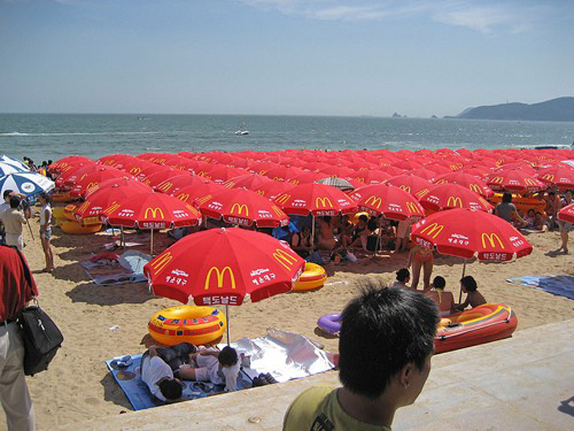
China: a new centre of international tourism…
China 2014
4th most popular destination
(56 million arrivals)
109 million outbound trips
3rd in international receipts
1st in tourist international tourist expenditure

Slide 39
Mass tourism: the overall pattern
Peace and stablility
Prosperity with increased disposable income
Accessible destinations and good transport links
Technological increases facilitating travel
Domestic mass tourism comes first, then intra-regional and long haul travel
A wide variety of tourist motivations and ‘types’
From package/group tours to independent travel
Possible resentment towards tourists because of numbers, class or cultural differences, especially in first wave of inexperienced tourists.

Slide 40
What is so special about East Asian tourism?
There have been differences in the process:
  In Japan and China the state has been more proactive, in both encouraging and restricting travel and tourism
  In China, transport infrastructure is less able to facilitate mass travel, especially because of the concentration of the ‘Golden Weeks’
BUT in other respects East Asian tourism developed in much the same way as in the West.

Slide 41
Do we need a new ‘paradigm’ to understand East Asian tourism?
YES
Western tourism scholarship has been ethnocentric and culture-bound and dominated by ‘a discourse of authenticity. ’
Western tourism scholars have neglected Asian tourism
Motivation of Asian tourists, especially Chinese, are different from Western tourists
Tourism in ‘emergent’ nations – especially Asia – is different to Western tourism and requires a new approach or ‘paradigm.’
Tourism studies should be Asianised and free from Western ethnocentricism.
A ‘mobilities’ paradigm is the answer….

Slide 42
NO
‘Authenticty’ has been an important theme in western tourism studies but has not dominated, even in the work of established scholars (e.g. Erik Cohen), and is virtually absent in several disciplines (e.g. psychology, economics, history), while sociology and anthropology have also focused on many other themes.
Tourism scholars have not neglected Asian tourism – though there has been a (as normal) a time lag. Work on China, for example, is massive and increasing.
‘Paradigms’ are exclusive discourses with specific languages, validated by scholars within the paradigm and inommensurable with other paradigms or position. Cross-over is not possible except through conversion or socialisation.
This is not the case for the study of tourism, which is characterised by multidisciplinarity and the transferability of concepts. We continue to talk to and understand one another – including those who study mobilities…..
Tourists from all over the world – including Asians - have different motivations and fall into many different types, often cross-cutting national status..

Slide 43
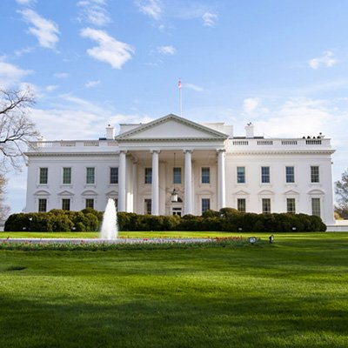
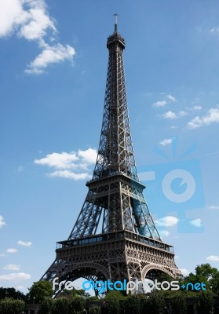
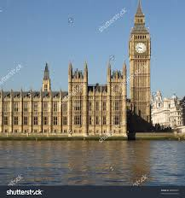
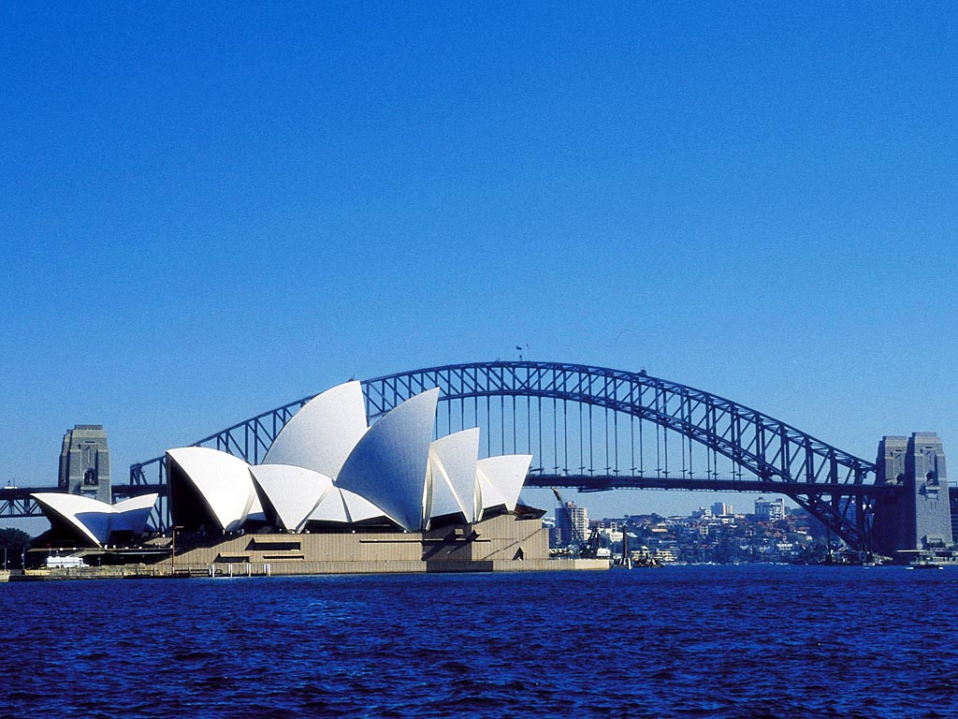

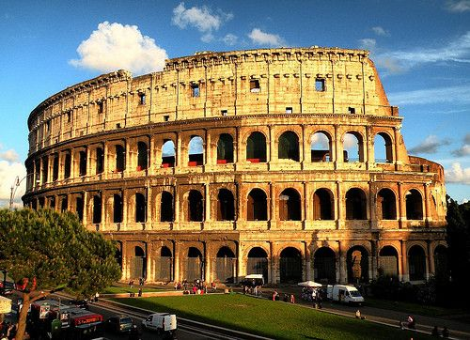
What do these have in common?

Slide 44
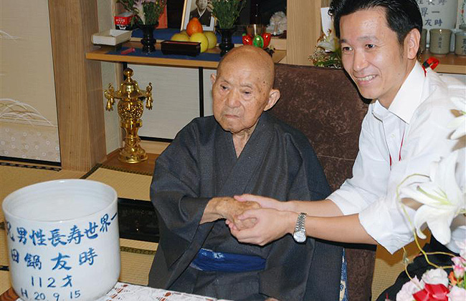

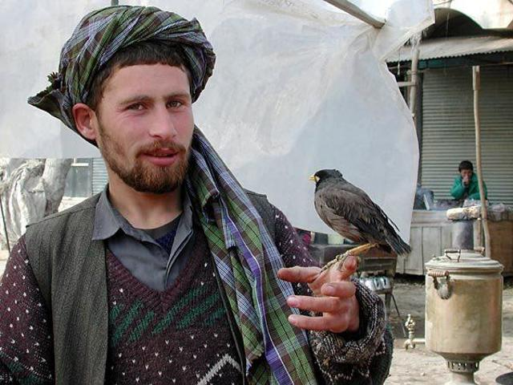
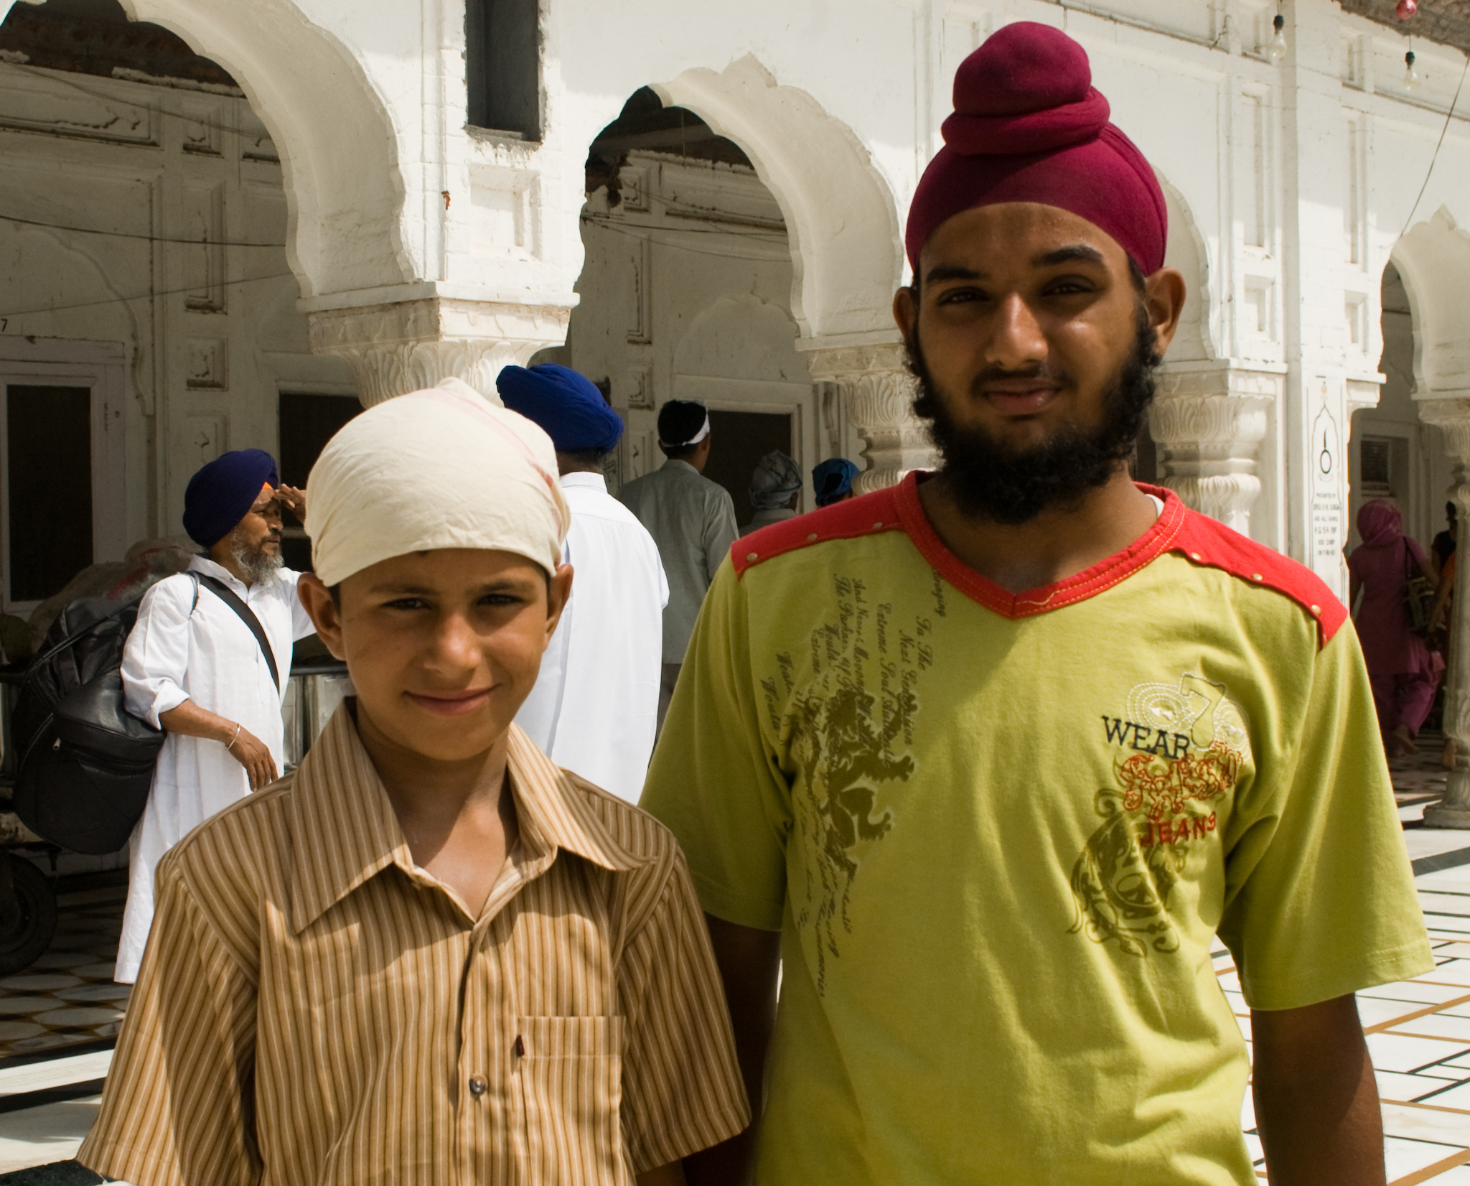


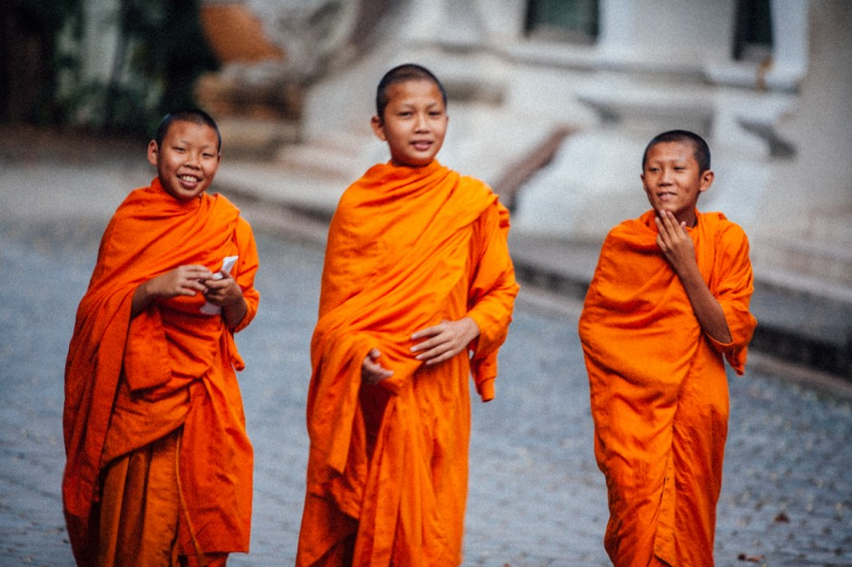
And these?

Slide 45
Finally…….
Could we have a European paradigm?
Or an Asian paradigm?
Is there an alternative social science for Asian tourism?
? ? ? ? ?

Slide 46
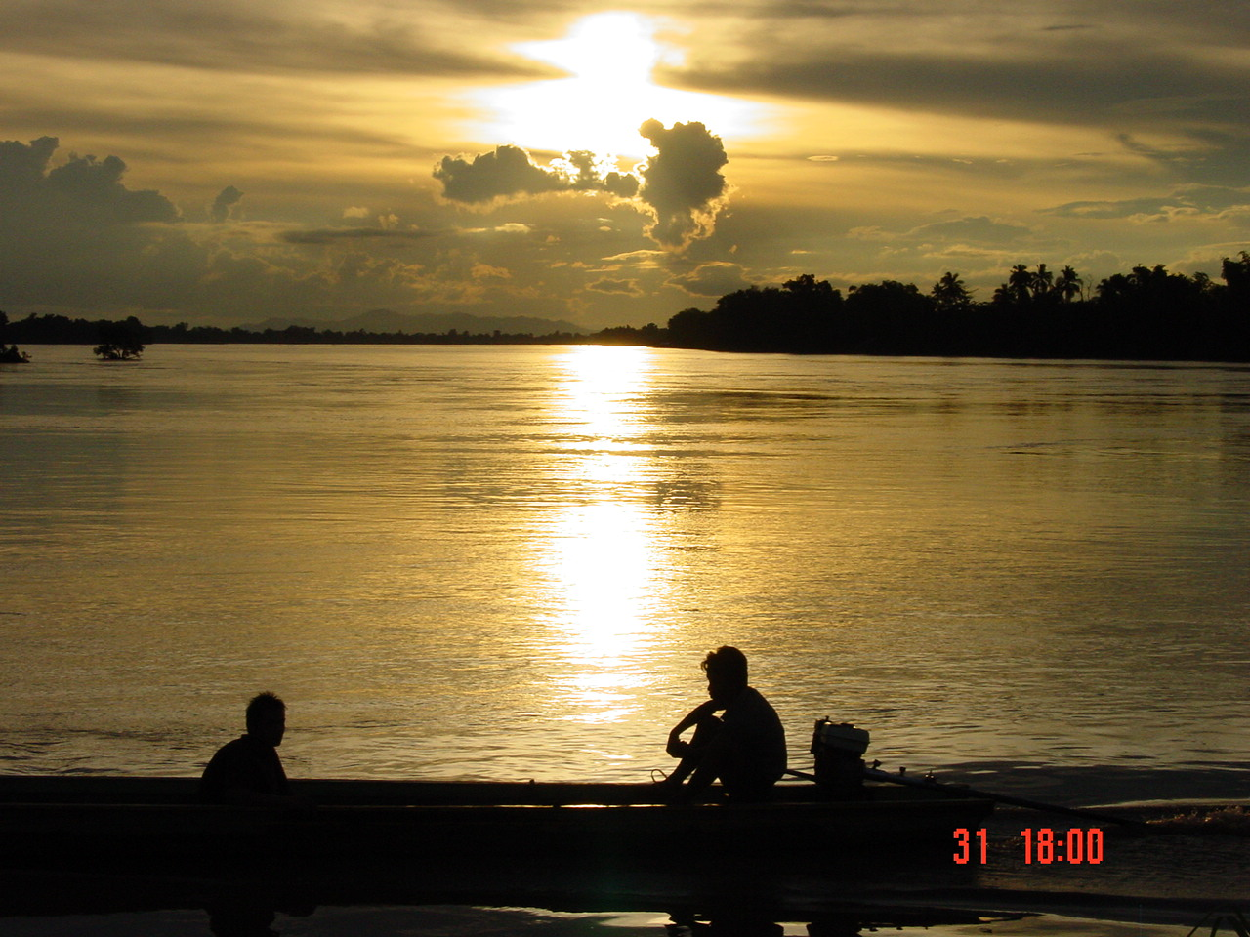
THANK YOU FOR YOUR ATTENTION
WOULD YOU LIKE A DRINK?
ANY QUESTIONS?

