Slide 1

Cultural governance and urban Tourism in China: A cultural political economy approach
Dr. Rui Su
Middlesex University, UK
r.su@mdx.ac.uk

Slide 2

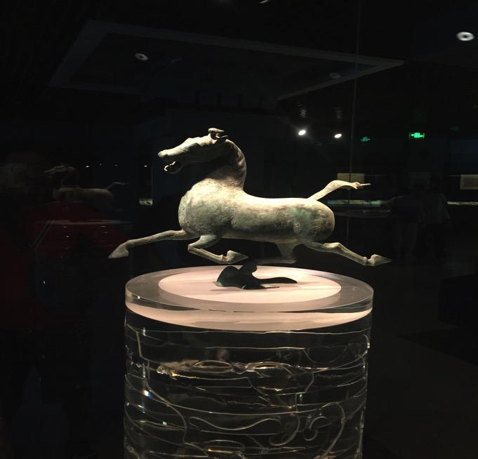
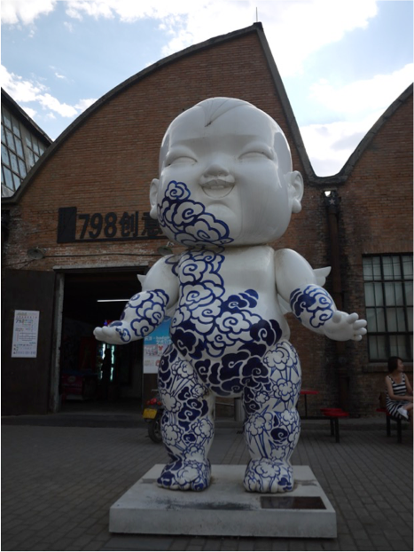

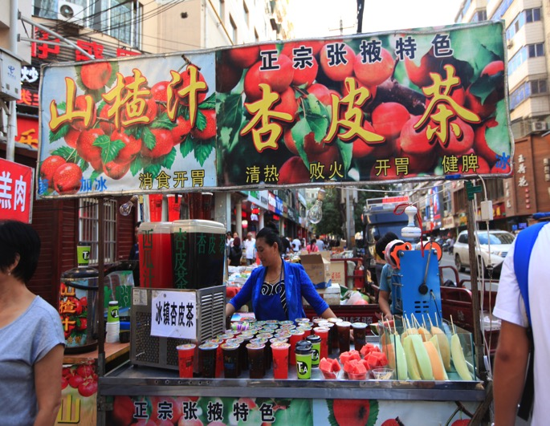
culture
distinctiveness
Cultural heritage
Contemporary arts
diversity
Popular culture
Local everyday lives

Slide 3

Cultural governance
Symbolized as the language of political discourse and power (Isar, Hoelscher & Anheier, 2012)
Responded and acted with social shared values, strategic planning objectives, responsibilities and controls (Banister, 2011).
Prioritized on owning, controlling, consuming and managing cultural assets (Russo & Dominguez, 2013; Smith & Richards, 2013)
Balanced the interactions with actors, including government, business enterprises and civil organizations (Hoffman, Fainstein & Judd, 2003)
Affected the production, distribution, and consumption of wealth, income, and resources (Babe, 2009; Macleod & Carrier, 2010).
Policy planning - Industrial operations

Slide 4

tourism and culture
attractiveness
Cultural/heritage tourism
Creative tourism
competitiveness
Festival/events tourism
Urban tourism

Slide 5
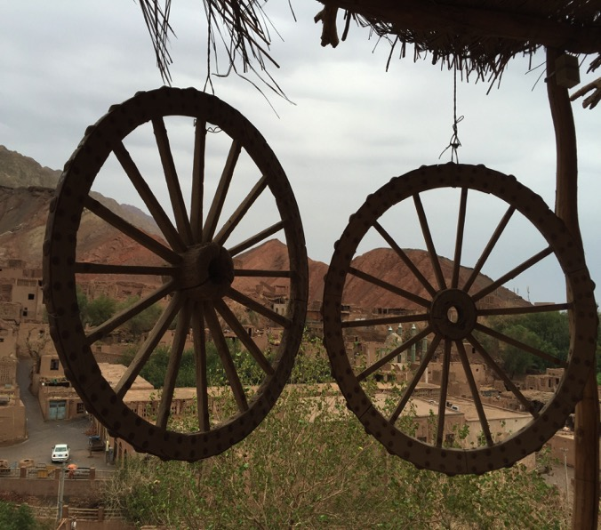

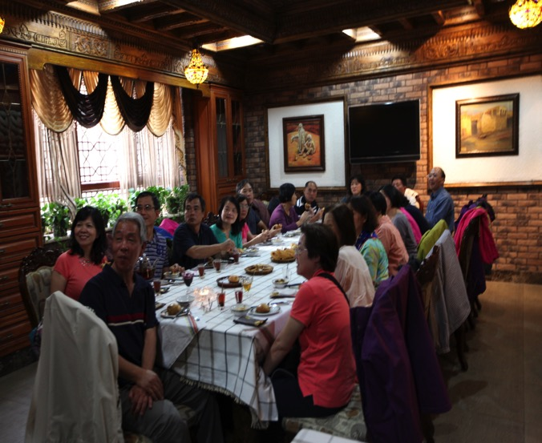
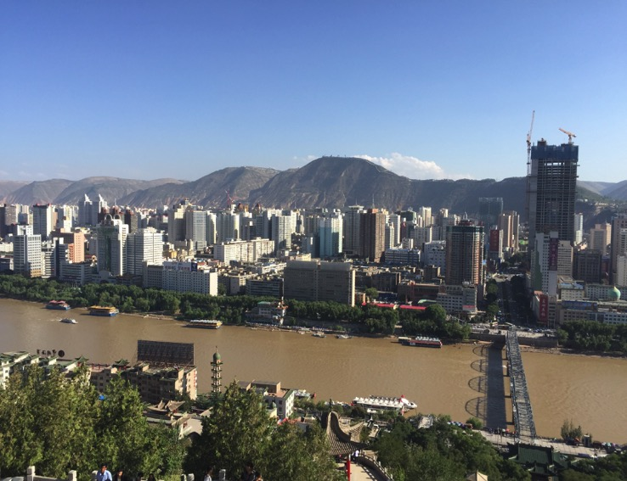
Cultural preservation/continuity
Cultural innovation/R&D,IP
Globalisation
Industrialisation
Tensions
Cultural authenticity/experience economy
Host-guest relationships
Postmodernism
Urbanisation

Slide 6

Cultural political economy (CPE) approach

Slide 7
Cultural political economy (CPE)
Highlighted the contribution of the cultural turn to the analysis of the articulation between the economic and the political and their embedding in broader sets of social relations (Jessop, 2009; Sum & Jessop, 2013).
Analyzed the sense- and meaning-making features theoretically
“Contextualized” the cultural objects, such as discourse, knowledge, materials transformations and associated meaning, with political, social and cultural surroundings (Mosedale, 2011)
Evaluated the connected and circulating relations among actors, micro-processes, and the macro-structures (Chaperon & Bramwell, 2013; Pearce, 2014)
Simplified the complexity of culture
Semiosis
Structuration
Complexity reduction

Slide 8
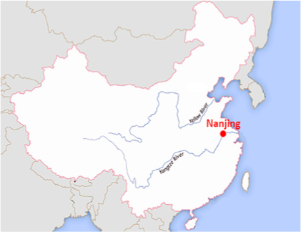
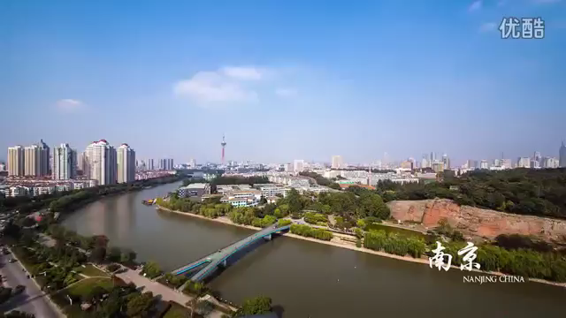
Application in Nanjing, China
As one of the four Chinese ancient capital cities, Nanjing is the capital of Jiangsu Province
Attracted 79 million domestic tourists, 1.07 million international tourists in 2012 (Nanjing Tourism Bureau, 2013)
Contributed to 110.5 billion RMB as tourism industry revenue in 2011, representing 18% of the city’s economy (Nanjing Statistics Department, 2012)
Two phases of data collection: February-April 2011; May-June 2012

Slide 9


Cultural policies and planning
Policies | Priorities
12th Five-Year National Guideline (2011-2015) | - Macro-level objectives of industries - Social cohesion and inclusive
Law of intangible cultural heritage (2011) | Intangible cultural heritage
National excellent cultural tourism directory (2010) | Arts/cultural performances
National guideline for cultural tourism development (2009) | Chinese cultural branding
Measures for cultural independent funding (2006) | Cultural diversification
Law of cultural relics protection (2005) | Cultural heritage and relics
Classification for the cultural industries (2004) | Industrial specificiation

Slide 10
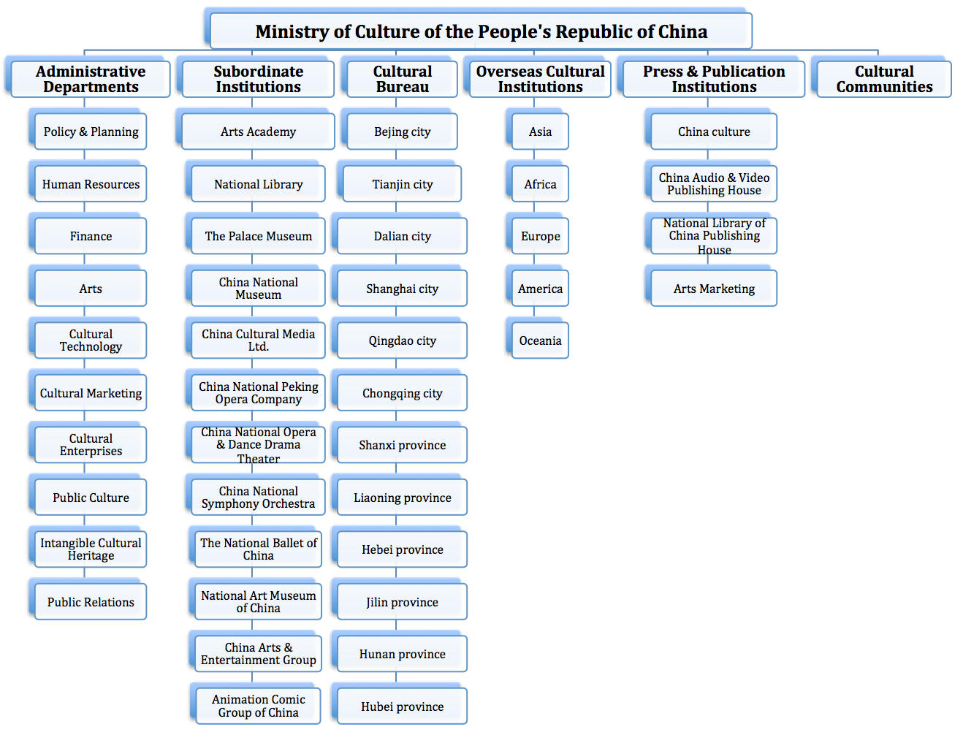


National cultural governance

Slide 11
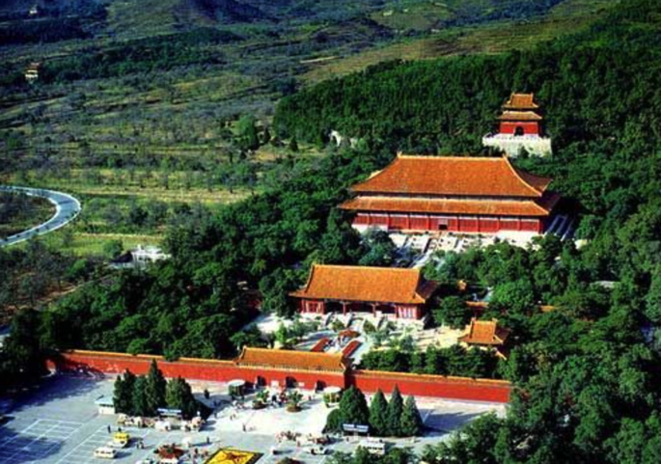
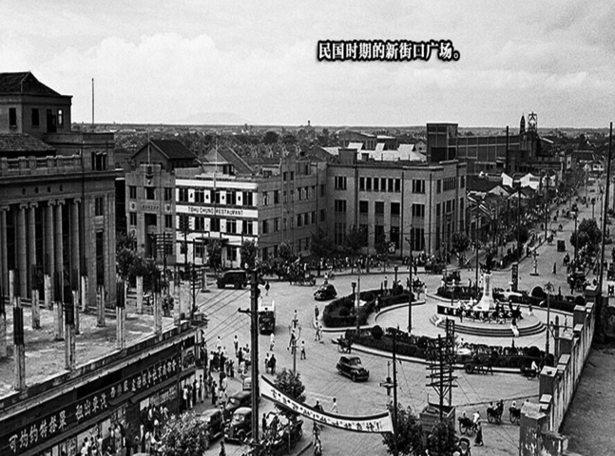
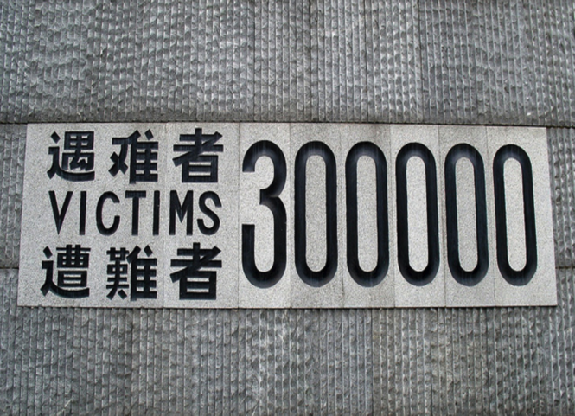
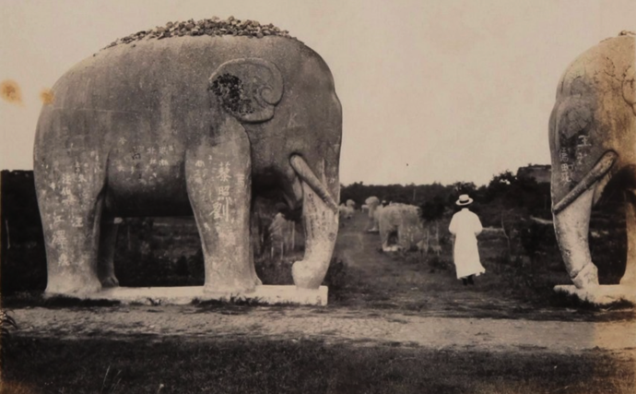
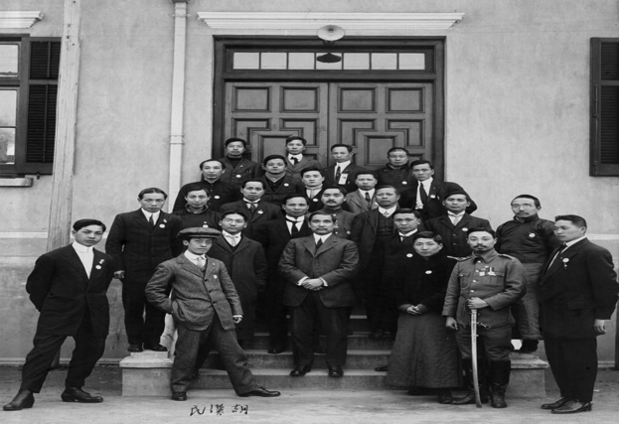
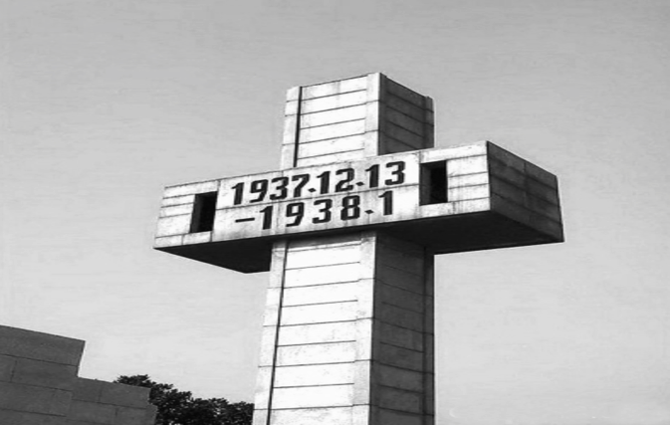
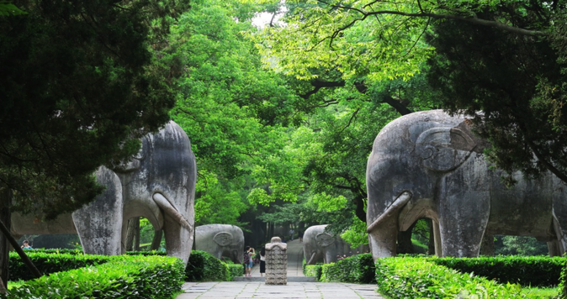
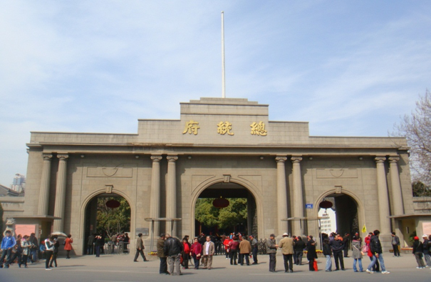
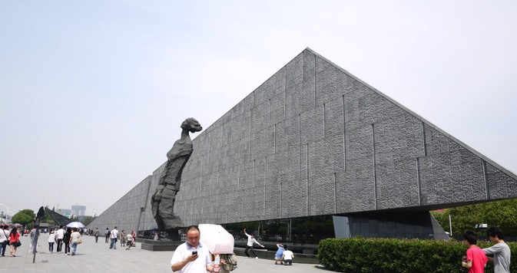
Ming Dynasty (1368-1644)
Republican (1919-1949)
Nanjing Massacre, 1937
Nanjing Massacre Memorial Hall
Tomb of Ming Dynasty
The Presidential Palace

Slide 12
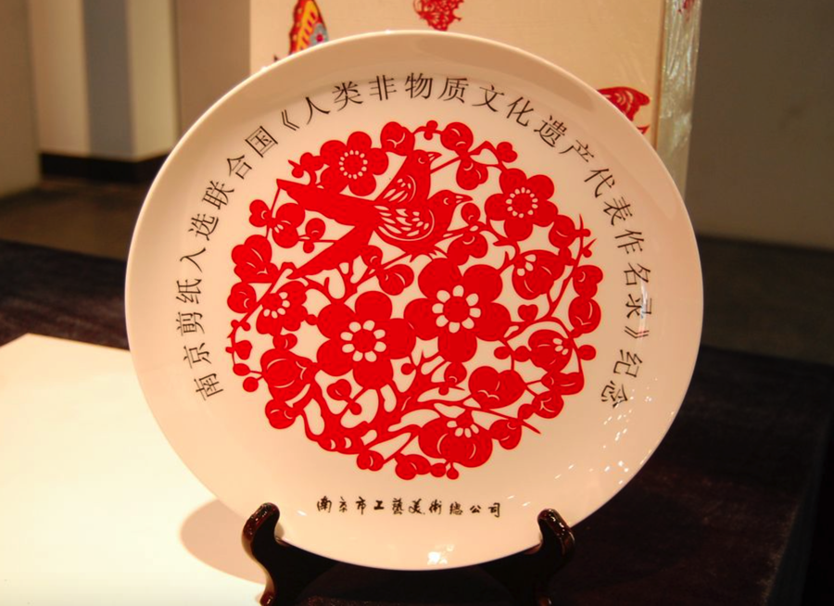




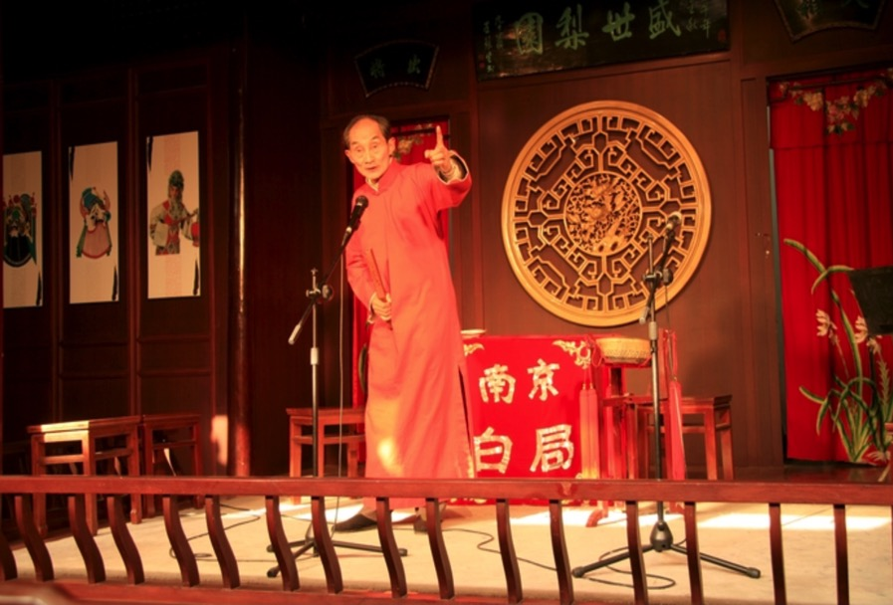
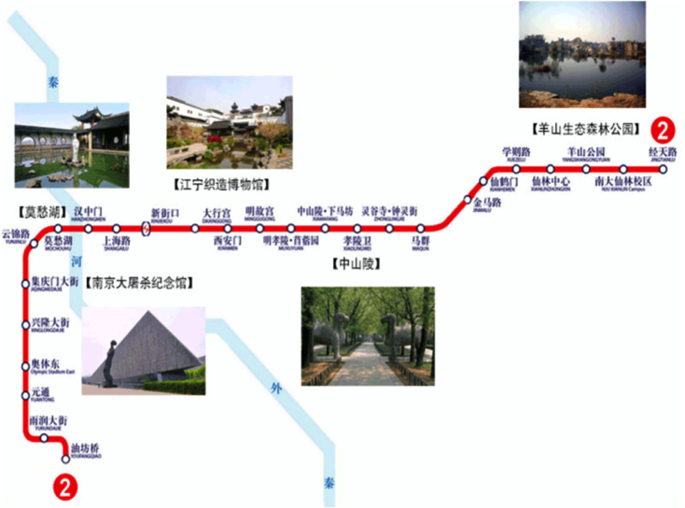
Paper cutting
Research institutions
Baiju, storytelling approach
Transportation and infrastructure

Slide 13
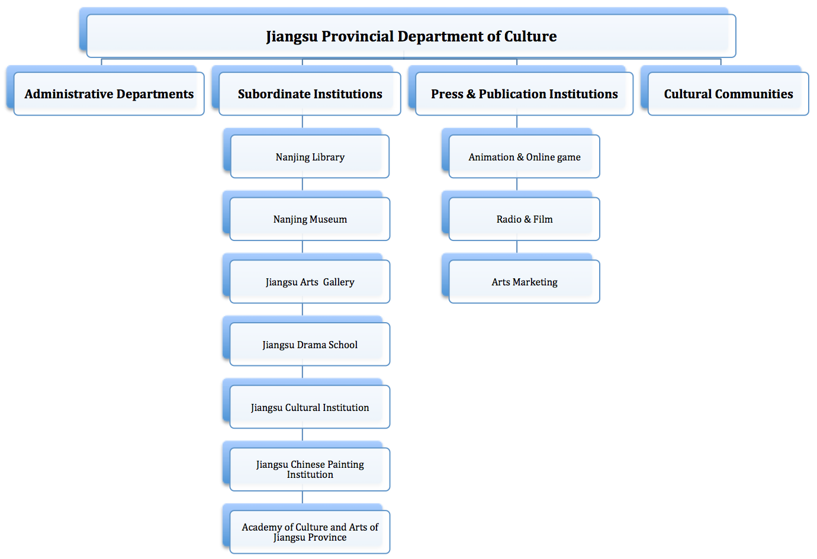
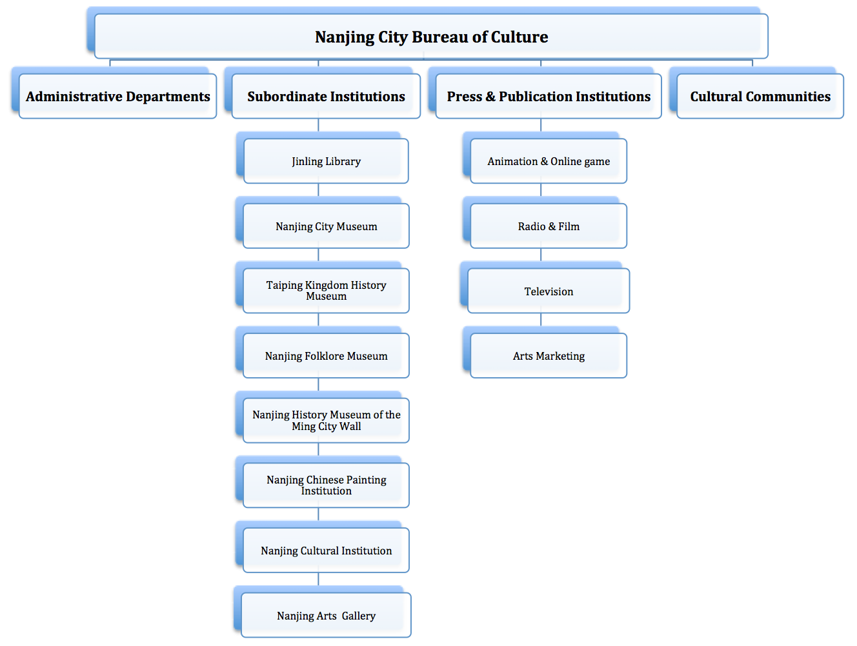


Tensions from Policy planning to Industrial operations
Provincial cultural governance
Local cultural governance

Slide 14
Tensions from Policy planning to Industrial operations
“Being harmonious and avoiding direct conflict is a key principle of China's governance. Direct conflicts are particularly rare in the Chinese political system, because people only take responsibility for their own positions (ge si qi zhi, ge zai qi wei 各司其职, 各在其位)”.
- One Nanjing cultural official
Imbalanced power relations
Multi-governance
Administrative reforms
Industrial reforms
“Between 1980 and 2011, Nanjing has had 10 mayors who have served an average term of merely 3 years. Every mayor has had his own strategies for the growth of Nanjing, which then become the primary guidelines for the master plans. These goals not only bring uncertainties and difficulties when developing the master plan, but they also lead to the city in confusing directions as it works toward urban development”.
-Qian (2013, p.82)
“Lower level government officials sometimes cannot make final independent decisions based on the top-down approach, as well as take a long time to proceed the agreement from other government officials”.
- One Nanjing tourism official

Slide 15
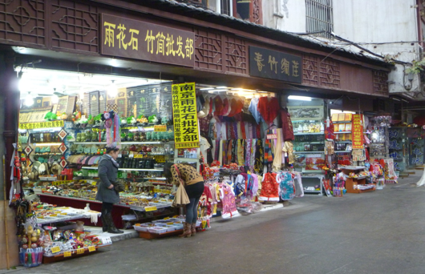
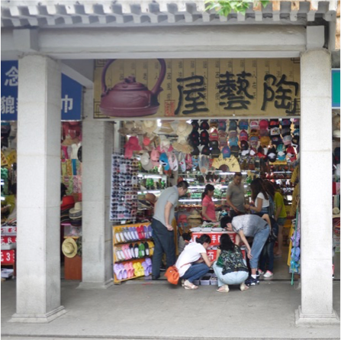
“The public awareness of intellectual property is still weak in China, as there are many copycats in the creative industries. This problematic issue seriously harms the artists’ innovation and empathy, as well as destroying consumers’ confidence of cultural products. I hope the provincial Culture Department and Nanjing city government can communicate with the cultural enterprises, know what they really need and design useful policies for the creative industries”.
- One independent artist

Slide 16
Conclusions
Culture’s importance of political economy
Governance, policy and planning
The involvement of different stakeholders
Production and consumption of cultural products
Interpretation in cultural experiences
Applicable in different urban contexts

Slide 17

Culture is the petrol of countries that are rich in history and talent. In a global economy of knowledge, investing in culture represents a forward looking decision.
– Irina Bokova
Director-General of UNESCO

Slide 18
References
Babe, R.E. (2009). Cultural studies and political economy: Toward a new integration. Lanham, UK: Lexington Books.
Banister, D. (2011). Cities, mobility and climate change. Journal of Transport Geography, 19, 1538-1546.
Chaperon, S. & Bramwell, B. (2013). Dependency and agency in peripheral tourism development. Annals of Tourism Research. 40: 132-154.
Hoffman, L.M., Fainstein, S.S. & Judd, D.R. (2003). Cities and visitors: Regulating people, markets, and city space. Oxford: Blackwell Publishing Ltd.
Isar, Y.R., Hoelscher, M. & Anheier, H. (2012). Introduction. In: M.K. Anheier & Y.R. Isar. (Eds.) The culture and globalization series 5: Cities, cultural policy and governance. Pp.1-12. London: Sage.
Jessop, B. (2009). Cultural political economy and critical policy studies. Critical Policy Studies, 3(3-4), 336-356.
Mosedale, J. (2011). Political economy of tourism: A critical perspective. London: Routledge.
Nanjing Statistics Department (2012). Nanjing statistics report in 2011. Retrieved November 16, 2015, from Web site: http://www.njtj.gov.cn/47448/47488/
Nanjing Tourism Bureau (2013). Statistical bulletin for 2012 Nanjing tourism economy development. Retrieved December 28, 2013, from Web site:
http://www.nju.gov.cn/web_zw/public_detail/detail/105/30147.shtml
Pearce, D. G. (2014). Toward an integrative conceptual framework of destinations. Journal of Travel Research, 53(2): 141-153.
Qian, Z. (2013). Master plan, plan adjustment and urban development reality under China's market transition: A case study of Nanjing. Cities, 30 (2013): 77-88.
Russo, A.P., & Dominguez, A.Q. (2013). From the dual tourist city to the creative melting pot: The liquid geographies of global cultural consumerism. In M. Smith & G. Richards. The Routledge handbook of cultural tourism. Pp.324-331. Oxon: Routledge.
Smith, M. & Richards, G. (2013). Landscapes and destinations. In M. Smith & G. Richards. The Routledge handbook of cultural tourism. Pp.243-246. Oxon: Routledge.
Sum, N.L. & Jessop, B. (2013). Towards a cultural political economy: Putting culture in its place in political economy. Cheltenham, UK: Edward Elgar.

