Slide 1
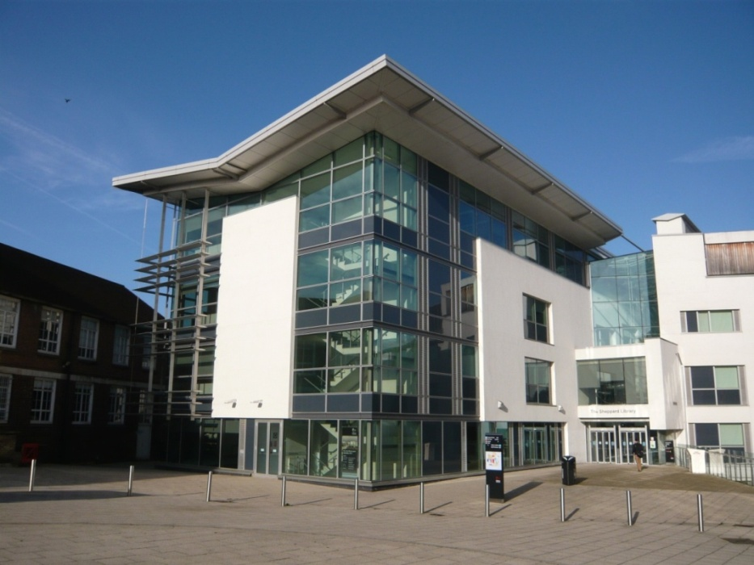

LILAC April 2017
Practitioner research for librarians: a case study
Notes:
VH
Welcome
Introductions:
I’m Vanessa Hill, one of the Service Development Liaison Librarians in Library and Student Support (LSS) at Middlesex University and I support staff and students in the School of S&T specifically computing, product design and engineering, maths and stats.
This is Adam Edwards my line manager who is the Liaison manager for the Schools of S&T and Law.
This is where we work…..The Sheppard Library at Middlesex University in north London.

Slide 2
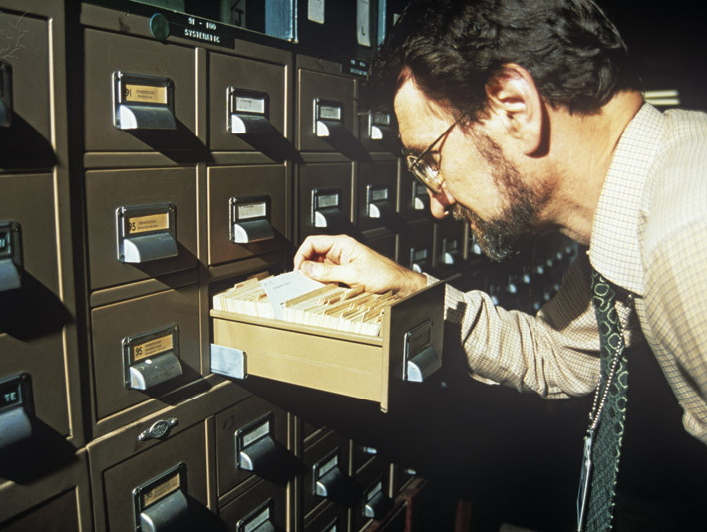
Notes:
VH
Librarians are practice based professionals.
We have professional qualifications, know lots of stuff and help people change their lives.
We’ve both worked in academic libraries for years…..three decades in fact, and have seen many changes during our careers, most significantly:
Polytechnics becoming Universities
Widening participation and
The emergence and proliferation of the Internet
These have had a massive impact on:
Our working environment
How information is accessed and used
And our traditional role as the Guardians of information
Our profession has totally changed.
Yet despite all this change practitioner research within our profession is not very common.
Librarians just tend to get on with their job ………. But sometimes things happen which start a chain of events and everything changes.
And in the next 20 mins we would like to share our story with you…..

Slide 3
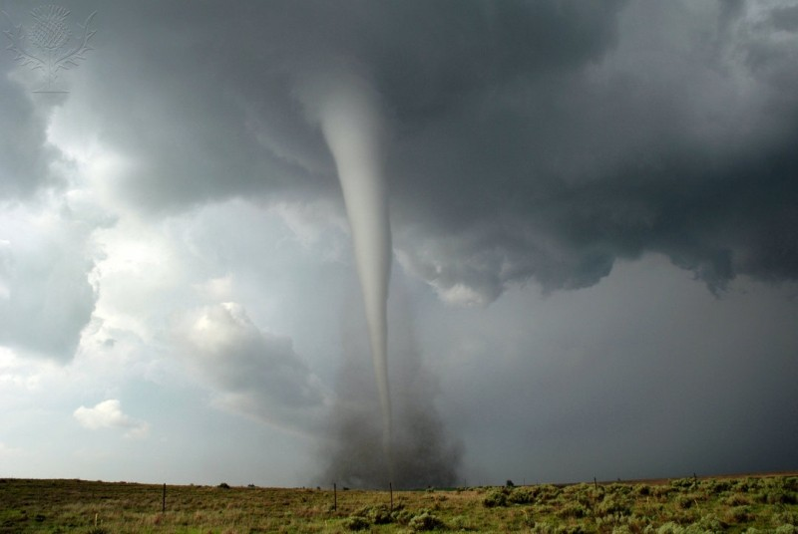
Notes:
VH
Our story is a bit of a whirl wind ……..its about how a change in our pedagogical practice back in 2011 ended up with us being awarded a joint Doctorate in Professional Studies by Public Works in March 2016.
Its true to say that back in 2011 when we first started working together, we didn’t see this coming!!
Our context is in Higher Education, but our experience could apply across the profession and to any one of you sat here today.
But first of all let us explain what a Doctorate in Professional Studies by Public Work is……..

Slide 4
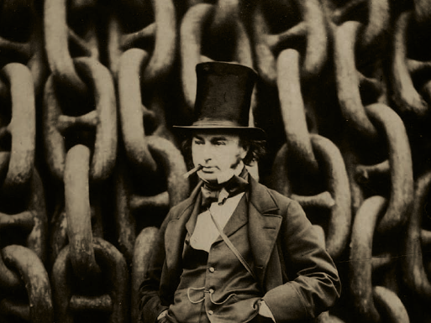
What is a DProf by Public Works?
Notes:
AE
The DProf by Public Works as it is usually shortened to, is one of a number of work-based learning qualifications and awards offered by the Institute for Work Based Learning at Middlesex University.
What is it?
The DProf by Public Works acknowledges at Doctoral level the contribution made to knowledge and practice by innovators who have brought influential thinking and practice into their community of practice.
It is aimed at professionals who have a substantial amount of outputs in the public domain which influence practice and contribute to knowledge…….these are the actual public works.
It is the professional equivalent to the PhD by published works and has the same rigorous assessment methods and criteria.
You can also do a DProf by 3-5 years of reflective practice just as you can do an ordinary Phd.
The focus of it is defined by the candidate’s particular work context and area of activity and their own unique area of interest. In our case this was information literacy…..as you will see later.
The Public works can be in various forms from published works in the traditional sense, but they could also be other things which have made a significant difference such as computer software, art works or business processes. For example Melbourne Transit System.
The value to the individual is an opportunity to develop their thinking and future practice. To others it is a valuable insight into the processes and skills required to transform research into useful outputs that influence thinking, action and practice
We carried out a joint DProf which is fairly unusual, but a joint DProf by Public Works was a University first.
However, as a DProf is grounded in professional practice where people work together, then a joint DProf is perfectly logical.

Slide 5
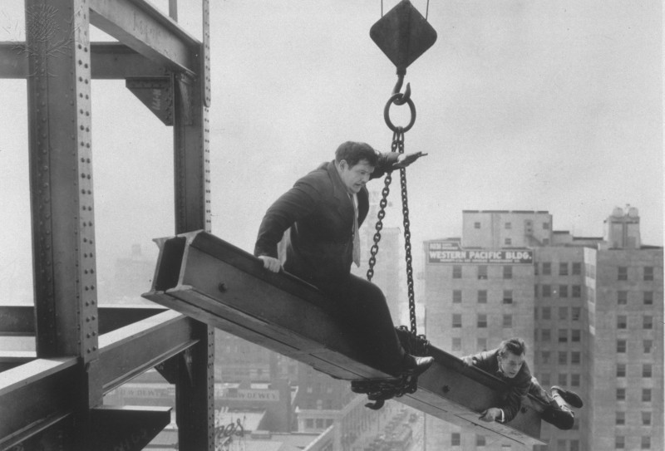
Notes:
AE
So how did we end up doing a DProf by Public Works?
Well its all my fault apparently.
We have both previously taken responsibility for providing library support to the Institute for Work Based Learning at Middlesex University…….therefore we were known to the academics there.
This resulted in the Head of DProfs – Kate Maguire - asking me as a professional librarian to have a look at a DProf application from an overseas librarian in late 2013.
Impressed with my critique, and in a wider discussion about professional practice, I explained how over the previous two and a half years we had made significant changes to our pedagogical practice, had introduced the use of games and were sharing this with other library professionals who were listening to what we were saying.
Kate suggested that this sounded the perfect basis for a DProf by Public Works. Had I considered doing one?
As we had worked collaboratively to develop our practice and the use of games, I declined on the basis that it would be disingenuous to Vanessa if I undertook a DProf on my own.
What I didn’t realise was that DProfs could be undertaken jointly. Great!!
Fast forward 2 months (Jan ‘14) and Vanessa is having a coffee with Kate and I, and we are talking her through the process. All very innocent.
2 hours later we are signed up and Vanessa remembers walking back to her car that night thinking ‘how on earth did that happen……how am I going to get out of this?’

Slide 6
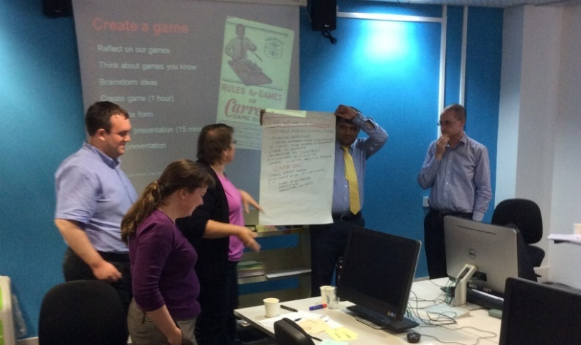
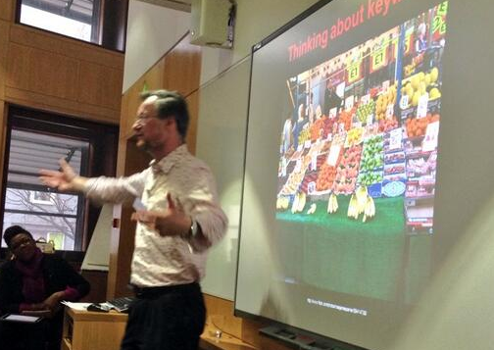
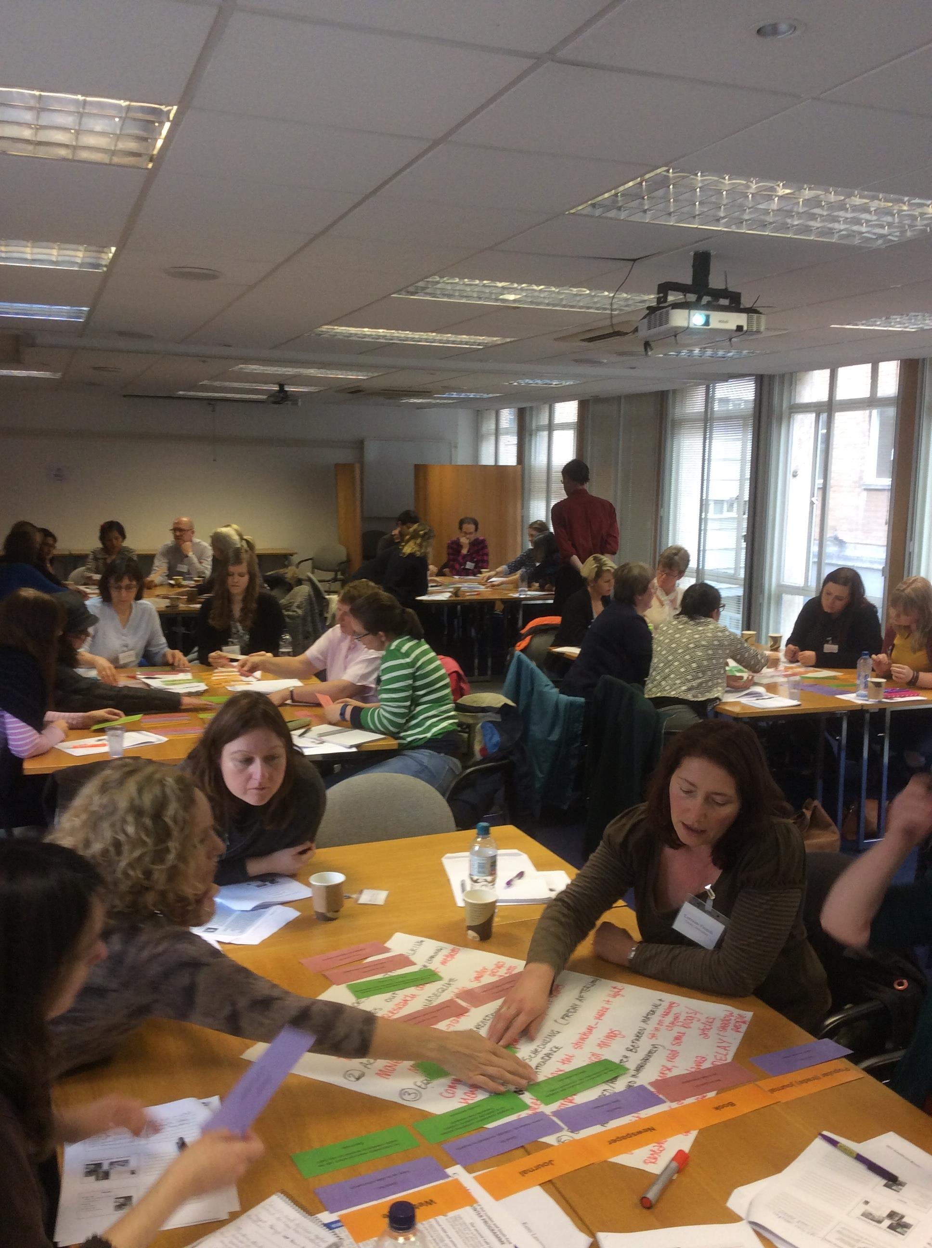
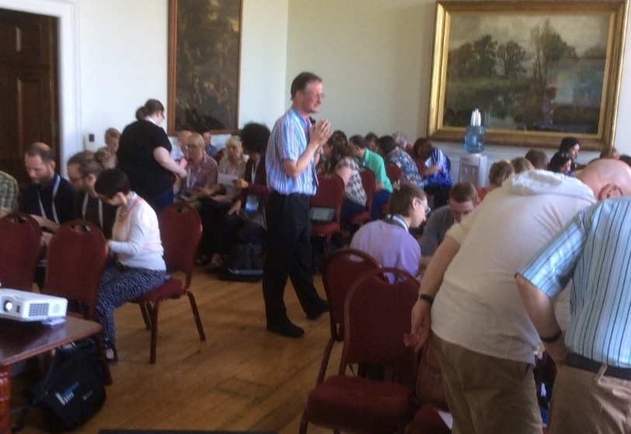
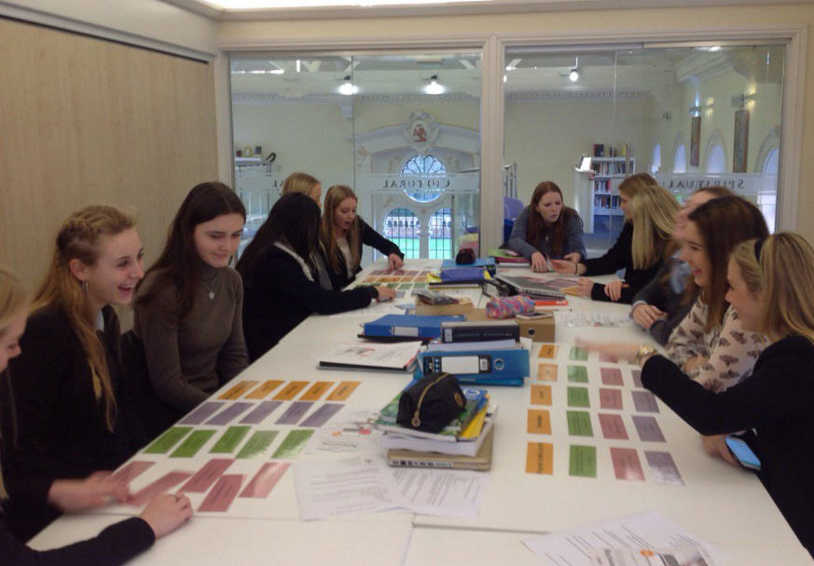
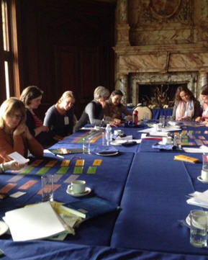
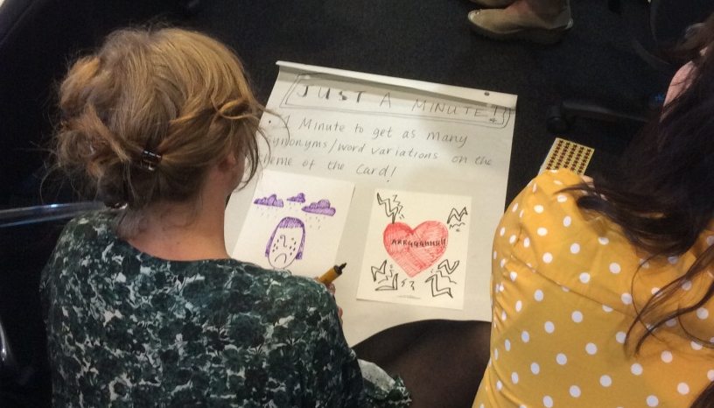
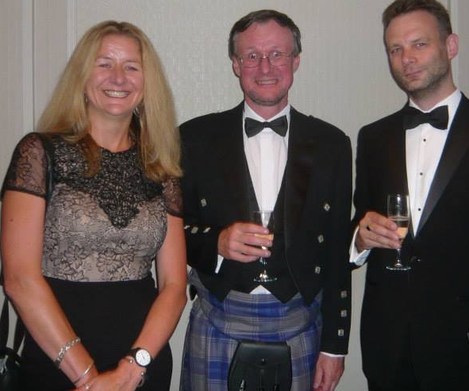
NHS workshop Sept 2014
British Library Jan 2014
CILIP SLG Nov 2015
Wellington School 2016
CILIP conference 2015
NHS workshop Sept 2014
THELMAs June 2014
LISSEE Mar 2016
Notes:
VH
So what was our Public work and how did it develop ?
Our core public work became Enhanced pedagogy for improved information literacy and was the culmination of changes made over a number of years to our pedagogical practice.
To cut a long story short:
As already mentioned, we started working together in 2011.
For various reasons we were both unhappy with our traditional didactic ways of teaching library skills.
So we went back to basics and decided what we really needed to teach in Info Lit workshops.
Therefore we shifted our practice from the teaching of library processes to developing students’ information literacy.
The vehicle to do this was the use of games and activities.
The inspiration for the changes made came from workshops we had attended at CILIP in 2010 and LILAC 2011.
The changes we made appeared to work, so we decided to go public and share with others.
The first time we shared our changed pedagogical practice to a live audience was at a Middlesex University Learning and Teaching conference in 2012.
The next time was at LILAC 2013 and we’ve subsequently shared our practice widely through journals articles, conference papers and workshops both within and outside of our sector including IFLA, CILIP, ILG, CPD25, University Science and Technology Librarians Group, ARLIS, QMUL as well as increasingly outside of our sector for school librarians and the NHS, who are now offering their own workshop based on what they learnt from us.
We were also shortlisted for a THELMA in 2014.
Following requests for more information about our games we made the templates for our games, instructions for their use and lesson plans available on JORUM and following JORUM’s demise, MERLOT and have had a number of visits and teaching observations from librarians from the University of Bath, Bucks New University and Regents University London.
We are not trying to show-off, but the point is that people were listening to us:
What we were doing was making a significant contribution to our profession
Changing the professional practice of other librarians……lots of other librarians had started to use our games
We were challenging established practice by looking at things from a different perspective
And making an impact within our community of practice.
Unbeknown to us at the time, we had met the criteria for doing a Dprof by Public Works.

Slide 7
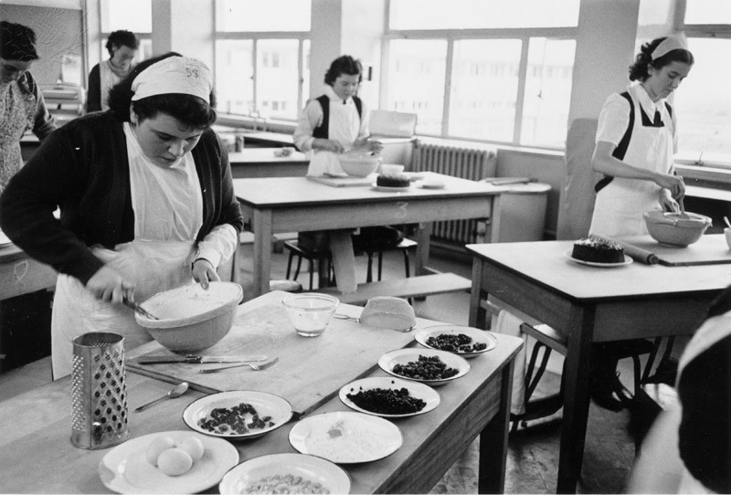
Process
Notes:
AE
So how do you make a DProf?
The application process starts by writing a detailed personal reflective statement….about 2,000 words each.
This part of the process was a valuable opportunity to critique our professional careers and reflect on why and how things had happened. How had we got to where we were, working together, questioning the norms of our profession and so on.
Having successfully applied we were assigned an academic advisor – Kate as it turned out, she clearly wasn’t going to let us out of her grip.
Kate met with us over the following months to advise on structure, direction, focus and generally to completely fry our minds with ideas around transdisciplinarity, hermeneutics and metisage.
As part of the process, applicants can also nominate an academic consultant who is specialist in their area and will engage with them on the specialist nature of their public works. In our case as joint DProffers, we had 2 consultants, chosen by ourselves – the great Dr Sharon Markless who had so influenced the developed of our public work and the equally great Dr Jayne Secker, an expert in the field on information literacy and co-author of ‘A new curriculum for information literacy’ (ANCIL).
Individual candidates normally write a 20-25,000 word statement rather than a PhD thesis. Again as joint candidates we had to double this and ended up considerably exceeding our limit.
The statement is an intense critique of the public works and positions them in a wider context, enabling us to validate our practice through the application of theory.
One thing to note about a DProf is that it doesn’t end. You ‘round things up’ with recommendations for further action, rather than coming to any definitive conclusion - for any oldies out there like us it’s a bit like Limahl’s 1980s classic - it’s a never ending story.

Slide 8

Discovery
Notes:
AE
The risk with looking at your own work, is that you might miss the significance of what you have done because you are focused on what you are doing and thus unaware of the significance to others in your profession…..or as Kate our advisor put it:
Rocket scientists forget that Rocket science isn’t rocket science to rocket scientists.
This became apparent to us as our public work developed.
The process is very fluid. We were constantly pursuing new ideas and lines of enquiry. In short it is a very iterative process, not linear like a PhD. Our starting point was very different to the end point for example we had not anticipated exploring ANCIL or the skills and attributes of the librarian of the future.
We looked at the literature to see how our experience compared with others and as part of the process we engaged in some research to check that the assumptions we were making about academics’ perception of information literacy at Middlesex Uni were correct. They were.
Our work was finally presented to a viva panel on the 20th November 2015….a date forever etched into our memory!!
It all went well and following a few “minor amendments” we finally submitted in January 2016, with it all becoming official in March 2016. Happy Days!

Slide 9
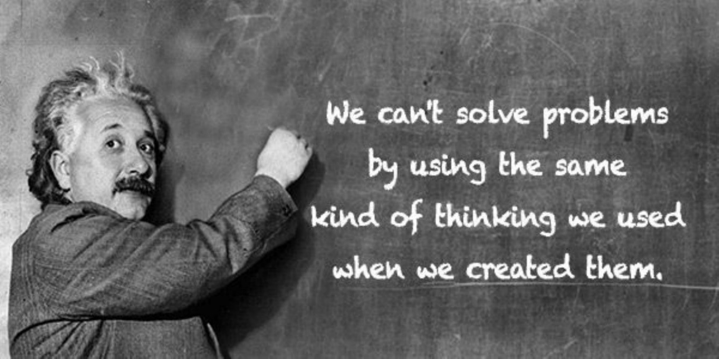
Food for thought
Notes:
VH
We realise as a result of our research that there are bigger issues that the library profession needs to think about:
As long serving librarians in Higher Education academic perceptions of our role appear not to have significantly changed…indeed Adam wrote about this during his MSc Lib course in 1986 and is evidenced by the research interviews that we carried out as part of the DProf.
Skills of the librarian especially our role in the curriculum are still overlooked.
Information Literacy skills are not generally integrated in to the curriculum.
There are often conflicting views around the notion of information and research.
Librarians can tend to see information as ‘functional’ and research as a process whereas…..
Academics tend see information as the ingredients to make new knowledge, whilst research is the means of ‘tapping into a scholarly network’.
Students themselves need to appreciate the difference between gathering information and creating knowledge and if library workshops remain separate to the main business of academia, then nothing will change.
Librarians are generally well thought of by academic colleagues, however the risk is that although we are seen as being competent, our role is not perceived as being crucial to the academic process.
This can lead to “Passive harm by neglect” as Pagowsky and DeFrain put it and raises interesting questions about our positioning as professionals and our professionalism which we also explored in the DProf.

Slide 10
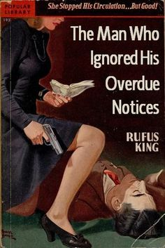
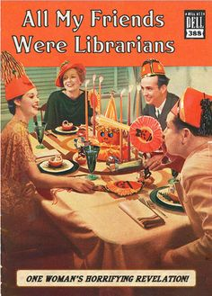
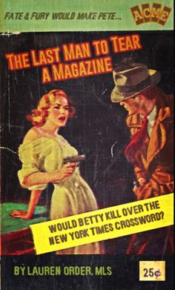
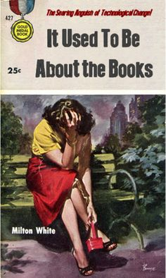
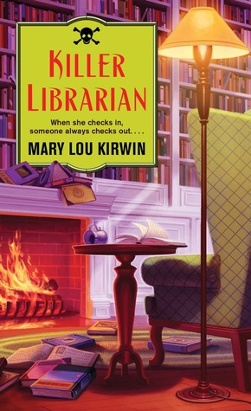
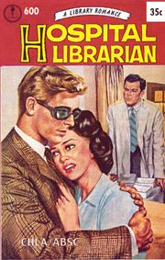
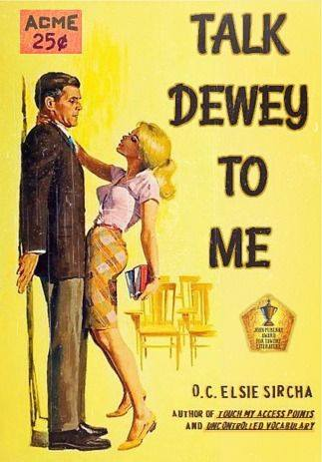
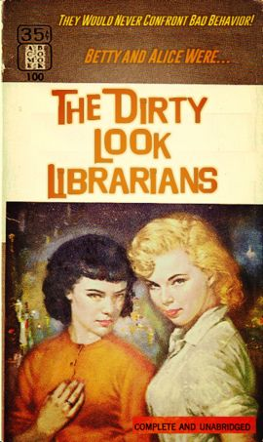
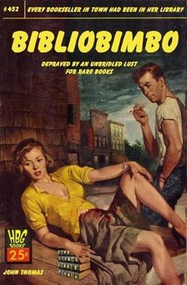

Professionalism
Notes:
AE
Traditionally being professional has been about acquiring a set of qualifications to show that we understand the profession’s common body of knowledge, following a code of conduct and ethics overseen by a professional organisation…..in our case CILIP.
Professionals then deliver solutions to clients based on that expertise.
Changes to the common body of knowledge happen slowly as academic research filters down and the primary focus is on solving problems.
Lester, the WBL guru of professionalism, argues that professionals need to be:
Reflexive about our competencies, i.e. aware our own views influence what we learn from our work, learn from our mistakes and admit when we are wrong.
Creative, to energise what we do and engage with our audiences in new ways as we have with information literacy.
To respect and empathise with our clients, and not adopt a doctor knows best model.
Behave with integrity and responsibly using evidence based practice which is why we are at LILAC!.
High performing professionals should also be open to ideas from other professions and their practices. Vieira uses the term “metissage” which is a French term for cross fertilization. Think of the application of gamification to information literacy, for example as we have done.
This learning by reflective practice and from others, leads to the ultimate professionalism, the artistry exhibited by reflection in action. This enables the professional to instantly apply their expertise in roles and situations which cannot be predicted in advance.
For our profession to move forward and flourish, we need librarians capable of “embracing uncertainty and of turning an unfearing gaze on their own identity and entitlement” (Coonan).

Slide 11
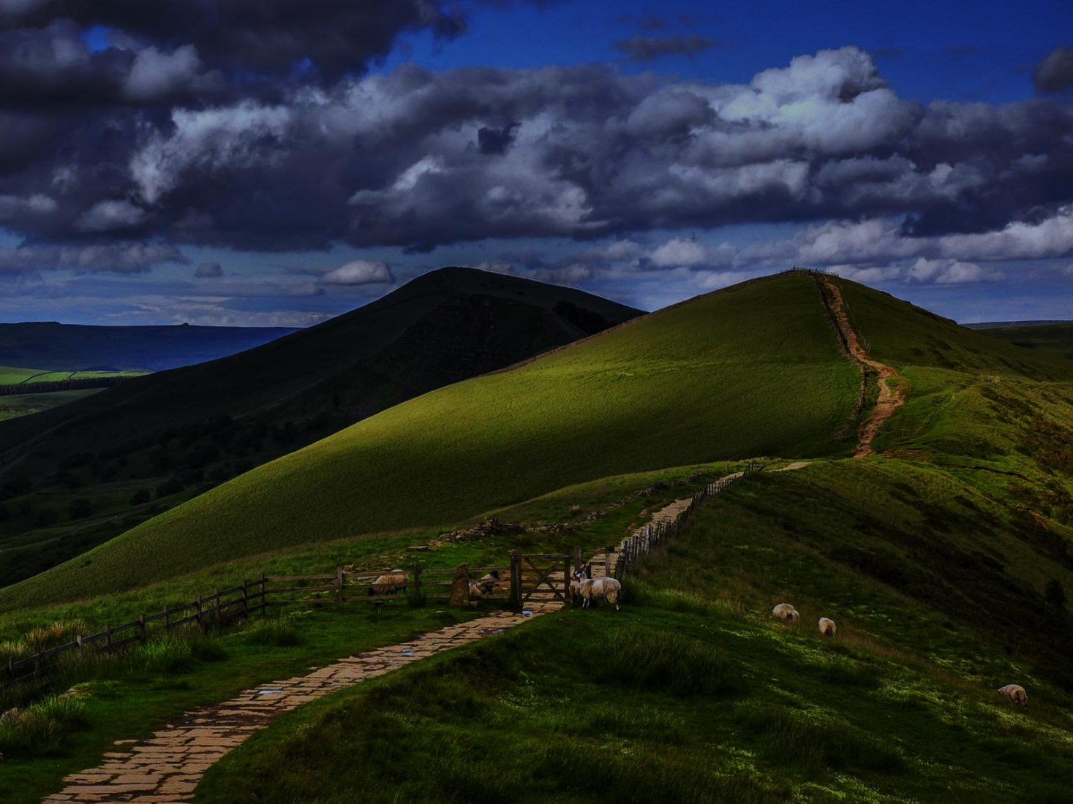
Onwards and upwards
Notes:
VH
So the Librarian of the future needs to think bigger about their role.
We need to move beyond teaching which merely concentrates on how to use our resources to find information.
To quote Emma Coonan once more, librarians need to be able to
“articulate how the use of those resources might support the academic journey as an on-going process of making sense, constructing meaning, creating conceptual relationships and even negotiating one’s own identity within a community of practice”
We also need to break away from information literacy being something librarians talk to each other about at conferences and get this into the wider world of Higher Education practice.
Nobody else talks very much about information literacy outside of librarianship. For example, Adam recently searched three key Higher Education journals including Studies in Higher Education for articles on Information Literacy. There were only three!
But of course we can’t do this on our own:
We need to convince our universities to take IL seriously as a fundamental part of employability and academic literacy.
This is a mammoth task, but Maynooth and Chester are already making some progress and are using ANCIL as their foundation.
We also need to find ways to describe what we do in a way that academic staff will find meaningful. Perhaps we should actually talk in terms of Academic literacy rather than information literacy?

Slide 12
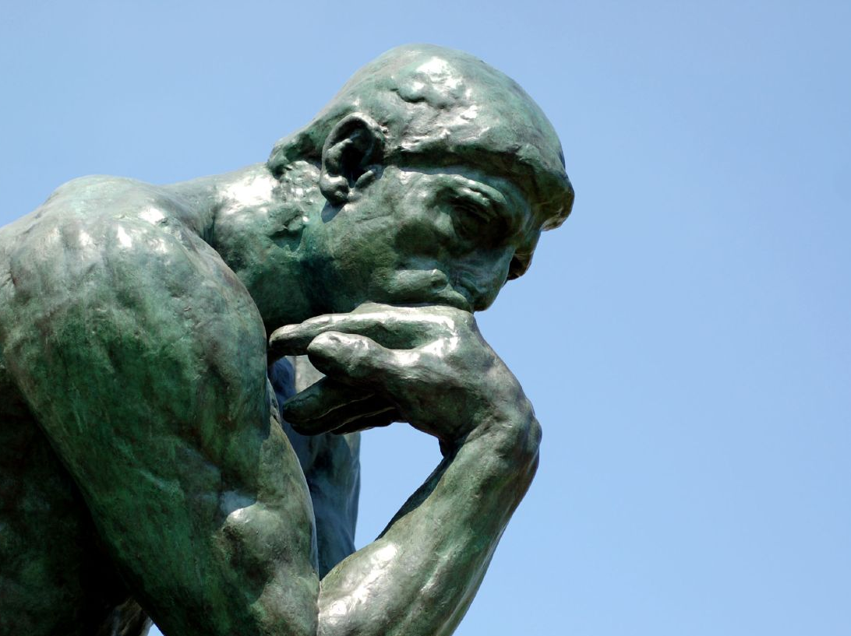
Final thoughts
Image: https://www.flickr.com/photos/seatbelt67/502255276
Notes:
AE
What have we gained from doing a DProf?
We now understand more clearly how and why academic librarianship has changed from what we were trained for.
Rather than feeling de-professionalised, we can see how we can unchain ourselves from the past and move forward.
While we may have not said anything new about information literacy we have:
We have devised practical ways of making a difference in the classroom which has already been widely embraced by colleagues.
And thought about information literacy above and beyond our previous understanding.
Through our research we are equipped with new insight, ideas, language, and knowledge – all of which can help and feed innovation.
All of this has lead to a greater ability to work with academics and bring insight, perspective and knowledge into information and academic literacy discussions.
We realise that many of the assumptions that we make as a profession and which are made by others about us are unfounded. And this leave the gates open for new innovation, collaboration and further public work.

Slide 13
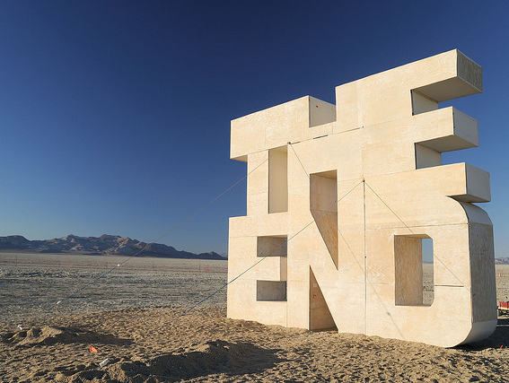
Dr Adam Edwards a.edwards@mdx.ac.uk
Dr Vanessa Hill v.hill@mdx.ac.uk
https://contentbuilder.merlot.org/toolkit/users/Adam17/edwardshill

Slide 14
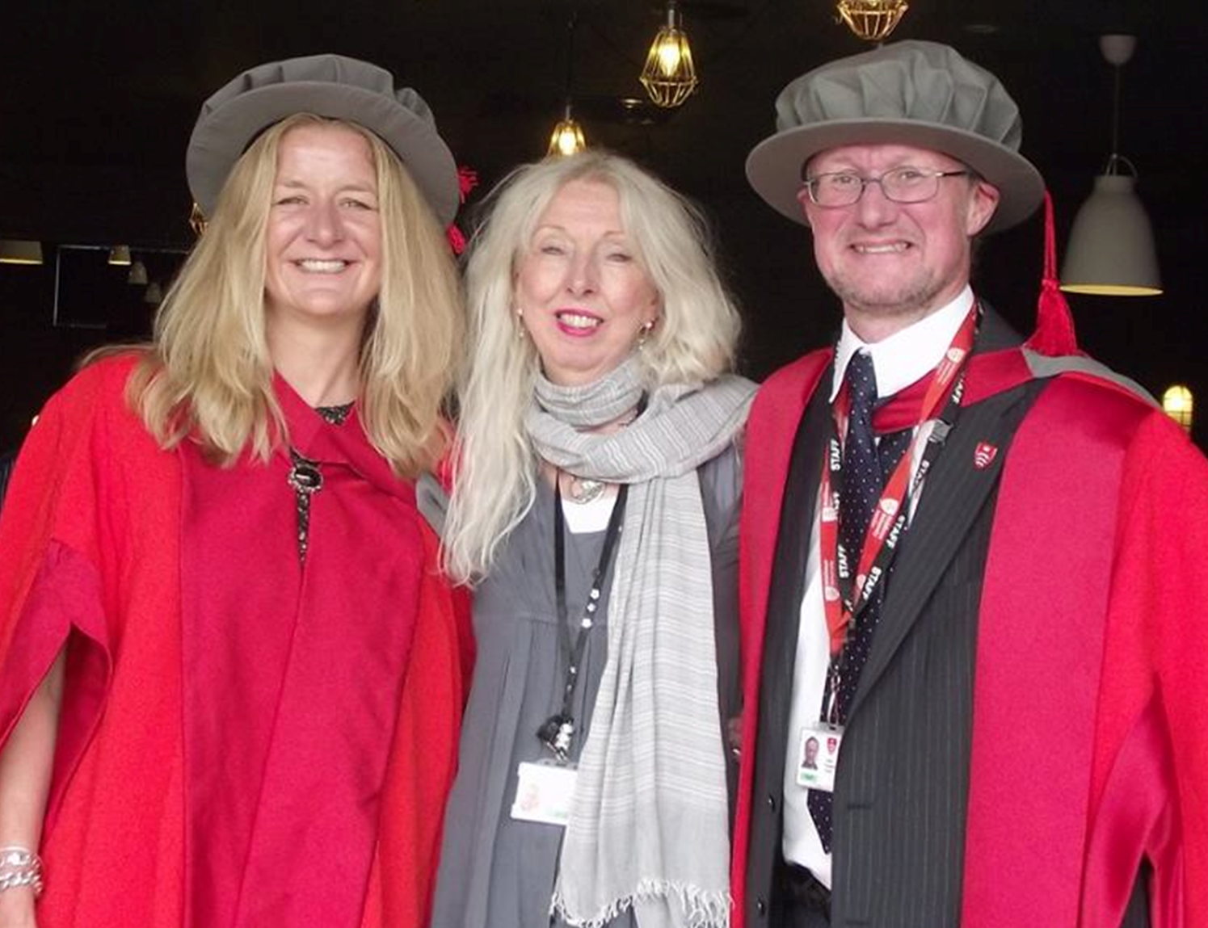
http://www.mdx.ac.uk/courses/postgraduate-research-degrees/iwbl-dprof-public-works
Notes:
And just to prove we actually did it….

Slide 15


Slide 16
References
Coonan, E. (2014). The 'F' word: information literacy, 'find', and other verbs. Academia.edu. Available at https://www.academia.edu/9261623/The_F_word_information_literacy_find_and_other_verbs
Coonan, E. (2017) Towards a constructive unbalancing: the reflexive turn in information literacy. In Global Perspectives on Information Literacy: Fostering a dialogue for international understanding. ARCL White Paper. Not yet published. Available at https://drive.google.com/file/d/0BzT2sL8tu8HDNFRpbzZJNWNGUGc/view
Edwards, J. A. and Hill, V. (2016). Demythologising librarianship: future librarians in a changing literacy landscape. DProf. Middlesex University. Available at http://eprints.mdx.ac.uk/18944/
Lester, S. (2010). On professions and being professional. Available at http://www.sld.demon.co.uk/profnal.pdf
Pagowsky, N. and DeFrain, E. (2014). Ice, ice baby: Are librarian stereotypes freezing us out of instruction? In the Library with the Lead Pipe, 3/6/14. Available at http://www.inthelibrarywiththeleadpipe.org/2014/ice-ice-baby-2/
Schön, D. A. (1990). Educating the reflective practitioner. Jossey-Bass, San Francisco.
Vieira, R. (2014) Life stories, cultural metissage, and personal identities, SAGE Open, 4 (1). pp.5-6.
Wilson, P. (1983). Second-hand knowledge: An inquiry into Cognitive authority. Westport, CT: Greenwood Press.

