Slide 1
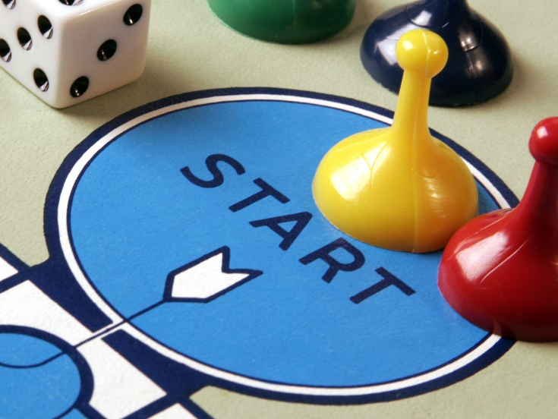
Cambridge Libraries Conference Jan 2018
Game On!
Enhancing engagement, interaction and reflection in
library workshops
Notes:
AE
Intros.
Adam Edwards: Library Liaison Manager for Law, Science and Technology and Collaborative Partners.
Vanessa Hill: Service Development Liaison Librarian: Computing, Product Design and Engineering, Maths and Stats.

Slide 2
Game plan
https://img.clipartfest.com/b17088237d66739da4f3e3e3067e38fb_work-on-the-game-plan-not-the-game-plan-clipart_640-480.png
Notes:
AE
At Middlesex University we are increasingly using games and other play related activities as a way of enhancing our information literacy teaching
In doing so we have moved away from a traditional didactic behaviourist style of teaching much loved by many librarians.
When we talk about the use of games, we are not talking Monopoly or Scrabble, but rather we use the language of games e.g. decision making, interaction, teamwork, competition, problem solving etc.
This is commonly referred to as Gamification.
During the next 30 mins we will:
Explain how our pedagogy changed and the principles that now underpin all our teaching in library workshops
Consider how gamification works in our context and how it enhances information literacy
Explore the value of using games as a tool to encourage engagement, interaction and reflection in library workshops
Delegates will also have an opportunity to try out one of our games.

Slide 3
Notes:
VH
As Adam has mentioned our library workshops used to be very traditional. They were:
Teacher led
Didactic
Lots of demos
Too much information
Little student engagement or interaction
Tedious for us and the students
Very little learning or development of skills.
All this changed in late 2010 when I attended a workshop on ‘Teaching information literacy in HE workshop’ at CILIP facilitated by Sharon Markless.
What I took away from this workshop are 5 learning principles which now form the basis of how we now teach and are always at the back of our mind when designing library workshops.
These are:
Don’t try and cover too much: We teach 3-5 times more than students will take in, so concentrate on what will make the biggest difference. Everything else can be consigned to the online learning environment.
Don’t try and clone your own expertise: It’s not possible to distil your own expertise in to a one hour workshop. Students are unlikely to approach information retrieval in the way that we do.
Discussion is powerful: We can learn a lot about their understanding from the questions they ask and the feedback they give. What we hear, what they say, what they don’t say can help guide the content of a workshop.
Learning by doing is empowering: Let students discover for themselves…..together, encourage active participation through a variety of activities, learn from their mistakes and find solutions when things don’t work.
Students should be learners, not the taught, working together to learn: Our role is to support and facilitate, not to dictate.

Slide 4
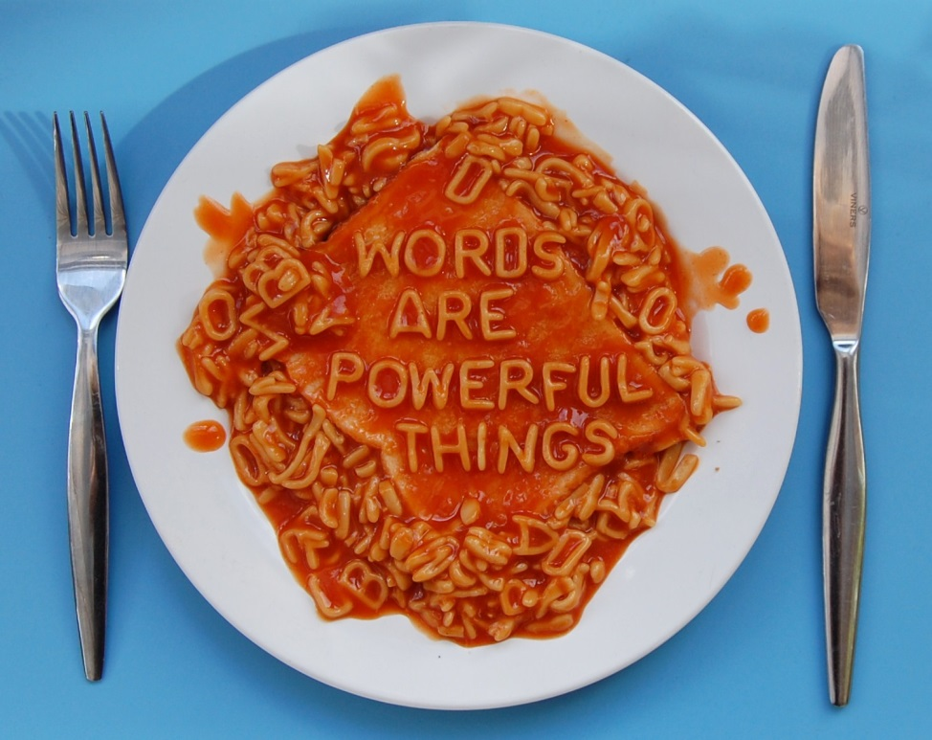
https://jmrlblog.files.wordpress.com/2014/06/booksonshelves_95584771.jpg
Notes:
VH
With these principles in mind we started to consider what we really needed to teach students.
This is what we came up with – 4 key areas to cover in library workshops:
Thinking about the value of different sources of information especially in their academic writing
Constructing keywords i.e. using the right search terms to find what is needed, refining search results etc
Hands-on self exploration of relevant resources i.e. no demonstrations.
Evaluating information found for relevance and quality.
What we then needed was a vehicle to enable learning to happen……..(next slide).

Slide 5
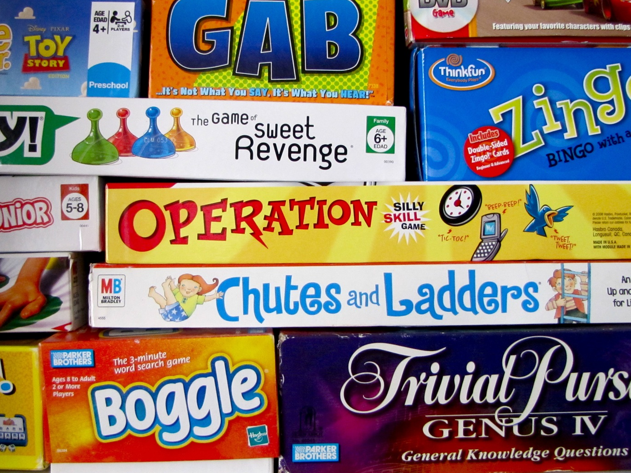
Notes:
AE
The inspiration came from a workshop I attended at LILAC 2011 on using games in library workshops.
So we started to develop games and activities for 1st year workshops around the four key areas.
This has subsequently been rolled out across all levels with different games and activities used throughout.
As a basic rule the games should be:
Fun and enjoyable – the Merriam-Webster Dictionary defines games as an “activity engaged in for diversion and amusement”
Quick – no more than about 10 mins
Simple – easy and cheap to prepare
Easy to grasp and play- no complicated rules
Meet a specific need or objective- not playing games for the sake of it
In addition Burgun believes that games should also include an element of competition and decision-making and other experts consider that collaboration is a significant factor.
The important thing about them is that they enable discussion, collaboration, peer learning, reflection and feedback.
So lets try some of them out……

Slide 6
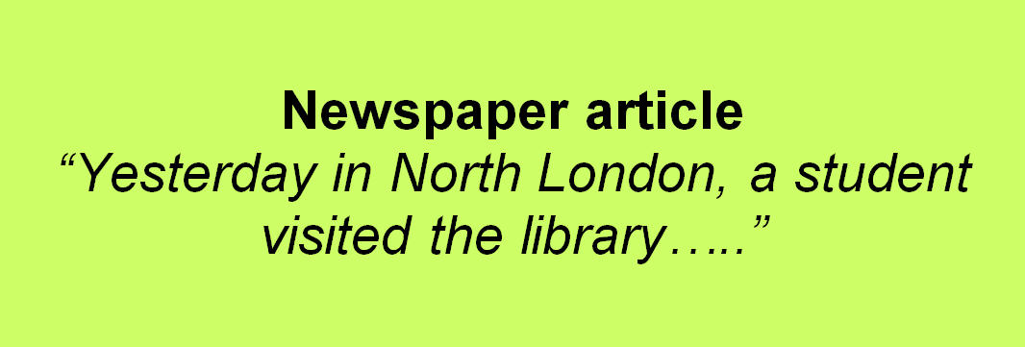
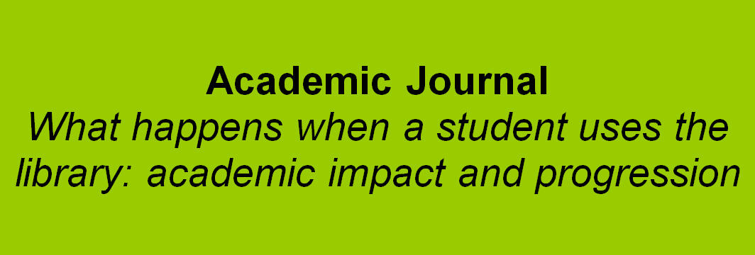
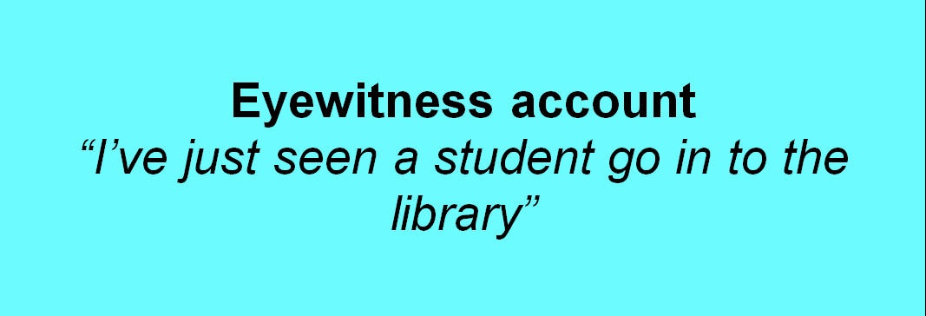
Notes:
AE
This is a game that we use 2nd year students to get them thinking about:
The provenance of information
How it is created
What value it has
It is usually preceded with a discussion about what ‘Currency’ and ‘Authority’ means in the context of libraries and followed by feedback and further discussion about issues arising from the activity.
Have a go.
Currency
How old: How old is the information? Does it need to be up-to-date?
Last updated: When was the information last updated?
What: Do you know what was updated. Think Wikipedia. There is often an explanation of what has been updated in new edition of a book.
Authority
Author: Do you know who the author is?
Qualifications: What is the author’s knowledge base?
Verifiable: Can the information be supported? Another witness or further info from a different source. Is there any peer review?

Slide 7
http://www.flickr.com/photos/rossjamesparker/89414788/
Notes:
VH
This is an activity that we use to get students thinking about keywords and is just one of several activities that we use to develop these skills.
Its less about games, but does encourage interaction.
Run the exercise.
This exercise can be run as a whole class activity or in small groups to add an element of competition.
Its usually followed by a similar activity based around the project the students are currently working on so that new skills can be immediately applied.

Slide 8
https://jmrlblog.files.wordpress.com/2014/06/booksonshelves_95584771.jpg
Notes:
VH
Dewey game if time.
This game was developed for our Foundation students who respond well to activities and physically moving about.
Understanding Dewey and how books are arranged may not be appropriate to all students, but the principles of the game could be applied to other things such as constructing references.

Slide 9
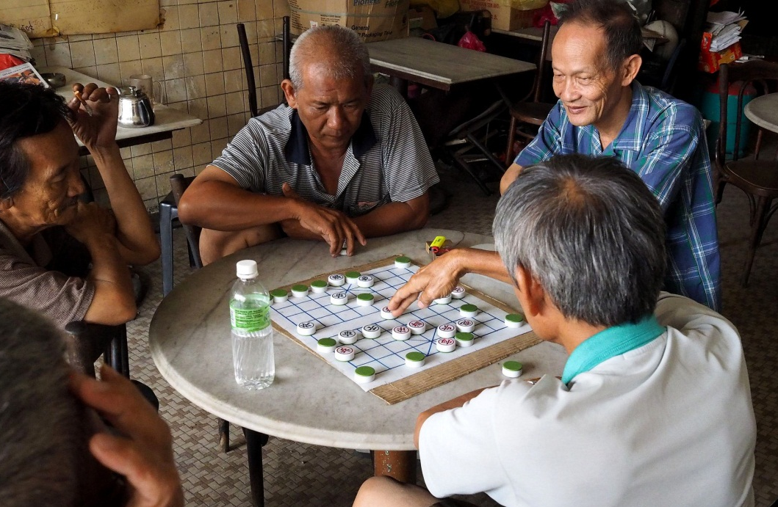
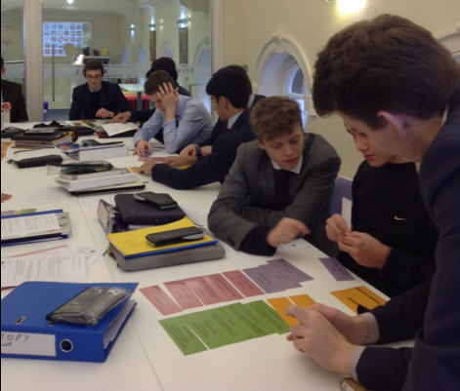
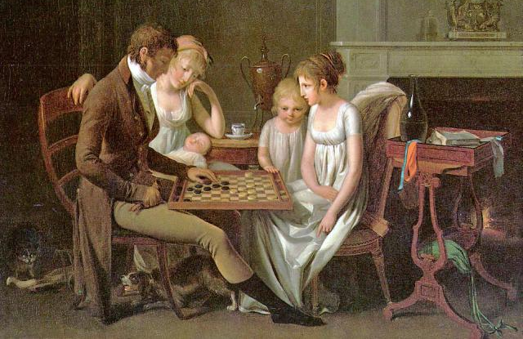
Notes:
VH
So what happens during one of these activities?
As students take part…..
They are engaged and there is increased interest and motivation
After all playing games can be a social and communal activity
There is lots of discussion……collective and peer learning. What we hear the students discuss is indicative of what they know and what they don’t know.
Students appear to be learning……Burgun believes that games teach us how to learn, activating prior knowledge and building on existing skills. This is the constructivist approach to learning which is the foundation of our changed pedagogical practice.
Students seem willing to ask questions and voice opinions. Games indeed can alleviate some of the fear that students experience when using a library, what Walsh describes as ‘library anxiety’. Students are able to experiment in a safe environment.
We can respond as necessary….challenging misconceptions and filling gaps in their knowledge
And teaching is more fun.
Thus the use of games in our workshops empowers students to make decisions based on prior knowledge, plan a course of action, consider the outcomes, solve problems, absorb and consolidate new information, and learn from that.

Slide 10
Final thoughts
Notes:
AE
Developments in technology, the advent of the Internet, the proliferation of information and ease of access to this information has changed everything for librarians.
Information is ubiquitous and students can now go it alone.
Online databases and Resource Discovery tools make searching for academic information easier…
Therefore we don’t really need to teach traditional library skills i.e. process….how to use databases, e-resources and so on.
But we do need to teach students to be information literate with the ability to critically evaluate the information they find.
We now have time to do this in library workshops.
Teaching is more fun for the students and for us.
And the changes we have made seem to have an impact on grades.

Slide 11
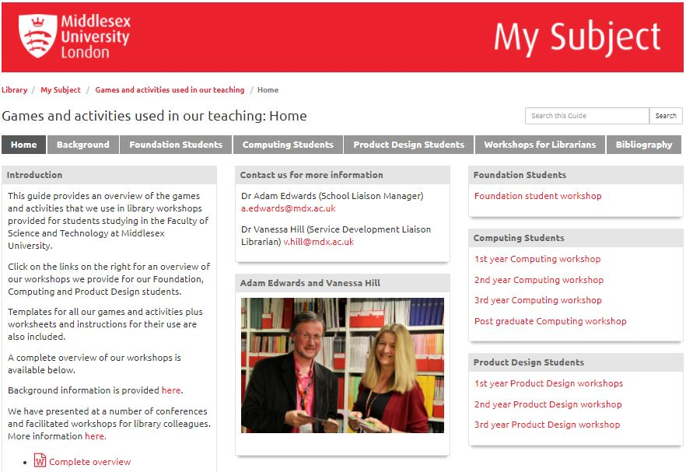
http://libguides.mdx.ac.uk/MDXGames
Notes:
VH
Finally….
You can find out more about our games and activities including templates and instructions for use, plus lesson plans on this website.
The ‘Bibliography’ tab provides details of a number of papers that we have written on the subject plus our joint doctorate which stems from our use of games and activities in library workshops.
Over the last few years we have run several one day workshops for CILIP, school and NHS librarians and details of these plus our contact information is available if anyone is interested in a longer workshop..

Slide 12
https://upload.wikimedia.org/wikipedia/commons/9/93/Question_mark_road_sign,_Australia.jpg

Slide 13
Dr. Adam Edwards a.edwards@mdx.ac.uk
Dr. Vanessa Hill
v.hill@mdx.ac.uk
http://libguides.mdx.ac.uk/MDXGames
Copyright Fotolia under Microsoft licence http://office.microsoft.com/en-gb/images/results.aspx?qu=blank+sign&ex=1#ai:MP900442493|

Slide 14
References
Barzilai, S. and Blau, I. (2014). Scaffolding game-based learning: impact on learning achievements, perceived learning, and game experiences. Computers and Eduaction, 70, pp.65-79.
Boyle, S. (2011). Using games creatively to enhance information literacy sessions. LILAC 2011. London School of Economics, UK. 18-20th April 2011. Available at http://www.slideshare.net/infolit_group/boyle-using-games-to-enchance-information-literacy [Accessed 26th June 2014]
Burgun, K. (2013). Game design theory: a new philosophy for understanding games. London, CRC Press.
Danforth, L. (2011). Why game learning works. Library Journal, 136 (7), p.67.
Dempsey, J., Haynes, L., Lucassen, B. and Casey, M. (2002). Forty simple computer games and what they could mean to educators. Simulation & Gaming, 33 (2). pp.157-168.
Edwards, J. A. and Hill, V. (2016). Demythologising librarianship: future librarians in a changing literacy landscape. DProf. Middlesex University. Available at http://eprints.mdx.ac.uk/18944/
Edwards, J. Adam (2017) Evolving pedagogical practice at Middlesex University: the state of our art.SCONUL Focus (68). pp. 47-57. ISSN 1745-5790
Egenfeldt-Nielsen, S. (2011). What makes a good learning game? E-learn Magazine. Available at http://elearnmag.acm.org/archive.cfm?aid=1943210 [Accessed 12th March 2015]
Febey, K. and Coyne, M. (2007). Program evaluation: The Board Game- an interactive learning tool for evaluators. American Journal of Evaluation, 28 (1), pp. 91-101.
Notes:
Need to check refs.

Slide 15
Filippou, J., Cheong, C., and Cheong, F. (2014). Improving study habits using a behaviour change framework incorporating social motivation and gamification. PACIS 2014 Proceedings. Paper 264. Available at http://aisel.aisnet.org/pacis2014/264 [Accessed 13th March 2015]
Frazer, A., Recio-Saucedo, A., Gilbert, L. and Wills, G. (2013). Profiling the educational value of computer games. Interaction Design and Architecture(s) Journal, 19, pp.9-27.
Gardner, H. (2006). Multiple intelligences: new horizons. New York, Basic Books.
Isbister, K., Flanagan, M. and Hash, C. (2010). Designing games for learning: insights from conversations with designers. CHI2010: remember and reflect, Atlanta, GA, USA. pp.2041-2044.
Kim, B. (2012). Harnessing the power of game dynamics: why, how to, and how not to gamify the library experience. College & Research Libraries News News, 71 (8), pp.465-469.
Merriam-Webster Dictionary. (2015). Definition of ‘Game’. Available at http://www.merriam-webster.com/dictionary/game [Accessed 4th May 2015]
Sailer, M., Hense, J., Mandl, H. and Klevers, M. (2013). Psychological perspectives on motivation through gamification. Interaction Design and Architecture(s) Journal, 19, pp.28-37.
Walsh, A. (2014). The potential for using gamification in academic libraries in order to increase student engagement and achievement. Nordic Journal of Information Literacy in Higher Education, 6 (1), pp.39-51.
Zagal, J., Rick, J. and His, I. (2006). Collaborative games: Lessons learned from board games. Simulation & Gaming, 37 (1). pp.24-40.

